Slide 1
Consultant Services CUF• February 2020
Notes:
Welcome and intro

Slide 2
CONSULTANT CONTRACT MANAGER OVERVIEW Monitoring Commercially Useful Function
Presented by: ODOT Office of Consultant Services

Slide 3
LEARNING OBJECTIVES
FHWA COMPLIANCE AND ODOT RESPONSIBILITY.
UNDERSTANDING CUF.
UNDERSTANDING CUF PARAMETERS.
IDENTIFY BASIC REQUIREMENTS FOR MONITORING .
IDENTIFY ISSUES AFFECTING CUF COMPLIANCE.
UNDERSTANDING THE IMPORTANCE OF DOCUMENTATION.
DISTINGUISH BETWEEN CONSULTANT COMPLIANCE -VS- CONSULTANT NON-COMPLIANCE.

Slide 4
MONITORING OBJECTIVES
ENSURE DBE’S ARE ENGAGED IN MEANINGFUL CONTRACTING ACTIVITIES.
SERVES AS A DETERRENT TO FRAUD.
PRESERVES THE INTEGRITY OF THE DBE PROGRAM.

Slide 5
What is a Commercially Useful Function (CUF)?

Slide 6
DBE PROGRAM POLICY
The Ohio Department of Transportation, in compliance with federal law (49 CFR 26) are to ensure firms owned and controlled by minorities, women and other socially and economically disadvantage persons have the maximum opportunity to participate in the performance of services requested by a construction project.

Slide 7
DBE PROGRAM POLICY
The ODOT DBE Program identifies how DBE participation is counted toward the DBE goal on a federally-funded project. Credit for DBE participation can only be counted if the DBE performs a commercially useful function (CUF) pursuant to 49 CFR § 26.55, et seq.

Slide 8
AGREEMENT LANGUAGE
CLAUSE V - DISADVANTAGED BUSINESS ENTERPRISE (DBE) REQUIREMENTS
It is the policy of the Ohio Department of Transportation that Disadvantaged Business Enterprises (DBEs) shall have equal opportunity to compete for and perform subcontracts which the Consultant enters into pursuant to this contract. The Consultant must use good faith efforts to include DBE subconsultants. Consequently, the requirements of Title 49 CFR Part 26 apply to this contract. The Consultant must ensure that the DBE subconsultant(s) is performing a "commercially useful function" as defined in 49 CFR 26.55.

Slide 9
PROFESSIONAL OR A/E SERVICES INCLUDE
PLANNING
ENVIRONMENTAL
DESIGN
CONSTRUCTION INSPECTION/ADMIN
BRIDGE INSPECTION
RIGHT OF WAY ACQUISTION SERVICES
OTHER

Slide 10
MONITORING RESPONSIBILITIES
PRIME CONSULTANT.
DBE SUBCONSULTANT.
ODOT CONSULTANT CONTRACT MANAGER.

Slide 11
SPECIFIC DUTIES
ODOT CONSULTANT CONTRACT MANAGER MAINTAINS A DBE TRACKING LOG.
ODOT CONSULTANT CONTRACT MANAGER TO PERFORM DBE OWNER DESK QUESTIONNIARE REVIEW.
ODOT CONSULTANT CONTRACT MANAGER TO PERFORM DBE KEY PERSONNEL QUESTIONNAIRE.
ODOT CONSULTANT CONTRACT MANAGER TO PROVIDE COMPLIANCE DETERMINATION AND DEDUCT ANY PARTICIPATION THAT CANNOT BE COUNTED TOWARD THE GOAL.

Slide 12
odot CONTRACT MANAGER CUF REVIEW PHASES
INITIAL DESK REVIEW
ON-SITE REVIEW/PHONE INTERVIEW
POST ON-SITE REVIEW
CUF DETERMINATION
RECORDKEEPING

Slide 13
ODOT CONTRACT MANAGER CUF PROCESS FLOW CHART

Slide 14
odot CONTRACT MANAGER CUF TRACKING LOG

Slide 15
DBE EMAIL NOTIFICATION INITIAL CUF REVIEW

Slide 16
DBE EMAIL NOTIFICATION OF ONSITE REVIEW

Slide 17
DBE CUF COMPLIANCE DETERMINATION NOTICE

Slide 18
DBE CUF NON-COMPLIANCE NOTICE

Slide 19
PRIME Consultant NOTICE OF DBE NONCOMPLIANCE

Slide 20
EVALUATING CUF

Slide 21
CONSULTANT CONTRACT MANAGER CUF REVIEW PHASE
DBE OWNER QUESTIONNAIRE.
DBE KEY PERSONNEL QUESTIONNAIRE.

Slide 22
CUF EVALUATION KEY FACTORS
IS THE AMOUNT OF WORK CONSISTENT WITH NORMAL INDUSTRY PRACTICE?
IS THE AMOUNT THE FIRM IS PAID, COMMENSURATE WITH THE WORK BEING PERFORMED?
BASED ON THE SPECIFICS IN THEIR CONTRACT, IS THE DBE FIRM RESPONSIBLE FOR NEGOTIATING PRICE, DETERMINING QUALITY AND QUANTITY, ORDERING AND PAYING FOR MATERIALS BEING USED AND/OR INCORPORATED INTO THE PROJECT?

Slide 23
DBE PERFORMANCE EXPECTATIONS
THE DBE FIRM MUST BE RESPONSIBLE FOR
PERFORMANCE
MANAGEMENT
SUPERVISION
Of ALL WORK, AS IDENTIFIED IN THE APPROVED SUBCONTRACT AGREEMENT.

Slide 24
DBE PERFORMANCE RED FLAGS
DBE WORK BEING PERFORMED BY ANOTHER CONSULTANT.
DBE WORK BEING PERFORMED JOINTLY WITH ANOTHER CONSULTANT.
WORK PERFORMED, IS OUTSIDE THE DBE’S KNOWN EXPERIENCE AND/OR CAPABILITY.

Slide 25
POTENTIAL AREAS OF CUF NON COMPLIANCE
MANAGEMENT
EQUIPMENT
WORKFORCE
MATERIALS

Slide 26
MANAGEMENT RED FLAGS
DBE SUPERINTENDENT IS NOT A REGULAR EMPLOYEE OF THE DBE.
DBE PROVIDES LITTLE OR NO SUPERVISION OF WORK.
DBE FIRM OWNER, IS NOT AWARE OF THE STATUS OF WORK BEING PERFORMED.

Slide 27
EQUIPMENT RED FLAGS
PROFESSIONAL EQUIPMENT (EX. COMPUTERS, SOFTWARE PROGRAMS ETC.) USED BY THE DBE FIRM, BELONG TO THE PRIME CONSULTANT OR AFFILIATE.
PROFESSIONAL EQUIPMENT (EX. COMPUTERS, SOFTWARE PROGRAMS ETC.) USED BY THE DBE BELONG TO ANOTHER CONSULTANT WITH NO FORMAL LEASE AGREEMENT

Slide 28
WORKFORCE REQUIREMENTS
THE DBE FIRM(S) MUST KEEP A REGULAR WORKFORCE.
THE DBE CONSULTANT(S) CANNOT “SHARE” EMPLOYEES WITH NON-DBE CONSULTANT(S), ESPECIALLY THE CONSULTANT OF AN AFFILIATE OF THE PRIME.
DBE FIRM MUST BE RESPONSIBLE FOR ALL PAYROLL AND LABOR COMPLIANCE REQUIREMENTS FOR ALL EMPLOYEES WITHIN THE CONTROL OF THE COMPANY.

Slide 29
WORKFORCE RED FLAGS
MOVEMENT OF EMPLOYEES BETWEEN CONSULTANTS.
EMPLOYEE PAID BY BOTH THE DBE AND PRIME CONSULTANT.
EMPLOYEE WORKING FOR PRIME IN THE MORNING AND THE PRIME IN THE AFTERNOON.
EMPLOYEES UNACCOUNTED FOR ON A CERTIFIED PAYROLL.

Slide 30
MATERIAL REQUIREMENTS
If material is part of the DBE subcontract agreement, the DBE must be responsible for:
Ordering the material and negotiating cost.
Arranging for delivery and taking possession of the material.
Paying for all materials and supplies provided.

Slide 31
MATERIAL RED FLAGS
MATERIALS FOR THE DBE, ARE ORDERED AND/OR PAID FOR BY THE PRIME CONSULTANT.
MATERIALS FOR THE DBE ARE DELIVERED TO, BILLED TO, OR PAID FOR BY ANOTHER CONSULTANT.

Slide 32
DBE NON COMPLIANCE
DBE IS NOT PERFORMING A COMMERCIALLY USEFUL FUNCTION.
DBE FAILS TO PROVIDE DOCUMENTS AS REQUESTED.
DBE FAILS TO RESPOND TO EMAILS AND/OR PHONE CALLS.

Slide 33
COMMUNICATION
PRIME CONSULTANT
DBE CONSULTANT
ODOT CONTRACT MANAGER

Slide 34
PROMPT PAYMENT Specifications for Consulting Services
2.14 - Prompt Payment
The Consultant shall pay each Subconsultant within 30 Calendar Days after receipt of payment from the Department for services performed and invoiced by the Subconsultant. The Consultant shall also require that this contractual obligation be placed in all Subconsultant contracts that it enters into and further require that all Subconsultants place the same payment obligation in each of their lower tier contracts.

Slide 35
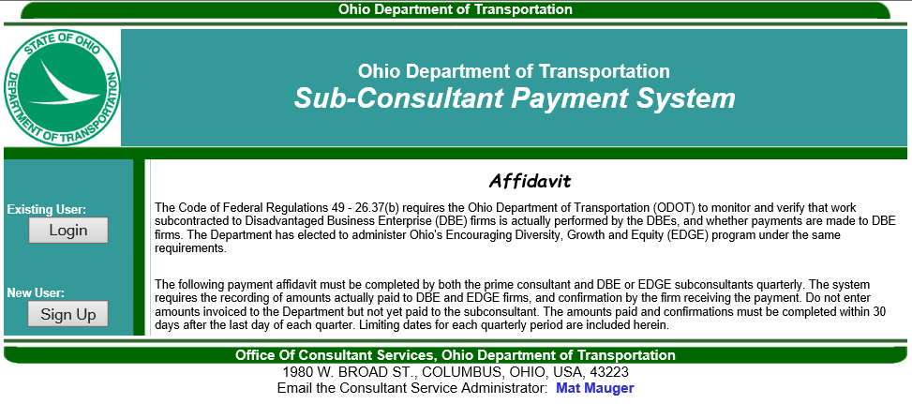
PROMPT PAYMENT
?

Slide 36
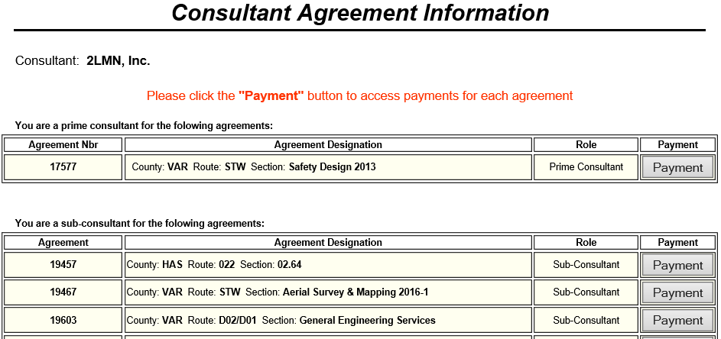
PROMPT PAYMENT
?

Slide 37
KNOWLEDGE REVIEW
What does the acronym “CUF” stand for?
What Federal law ensures DBE firms have a fair opportunity to participate in Federally funded projects?
What does the acronym “DBE” stand for?
What must a DBE firms do for their work to count toward the goal?
Notes:
Commercially Useful Function
CFR 49.26
Disadvantage Business Enterprise
Perform a Commercially Useful Function

Slide 38
KNOWLEDGE REVIEW CONTINUED
What is the purpose for monitoring the DBE consultant?
What forms assist ODOT personnel in monitoring consultants for Federal Compliance?
Where can information be found on which DBE consultants are working on a project site?
What is the DBE consultants responsibility?

Slide 39
AVAILABLE RESOURCES
ODOT SITE MANAGER PORTAL “Contractor Reports” http://www.odotonline.org/cmsportal/default.asp
OHIO REVISED CODE - http://codes.ohio.gov/orc/4115
CFR 49.26 - https://www.transportation.gov/osdbu/disadvantaged-business-enterprise/49-cfr-part-26-sample-disadvantaged-business
DAVIS BACON AND RELATED ACTS FREQUENTLY ASKED QUESTIONS - https://www.dol.gov/agencies/whd/government-contracts/construction/faq
Notes:
Add sites

Slide 40
AVAILABLE RESOURCES CONTINUED
COMMERCIALLY USEFUL FUNCTION VIDEO - https://www.fhwa.dot.gov/federal-aidessentials/catmod.cfm?id=86
EVALUATING A COMMERCIALLY USEFUL FUNCTION VIDEO - https://www.fhwa.dot.gov/federal-aidessentials/catmod.cfm?id=95
DBE PROGRAM REGULATIONS 49 CFR 26 4 25 OFFICIAL QUESTIONS AND ANSWERS – http://www.dot.state.oh.us/Divisions/ODI/SDBE/Pages/default.aspx

Slide 41
ODOT DISTRICT CONSULTANT CONTRACT MANAGER CONTACT INFORMATION
District 1 – Lori Brikman Lori.Brinkman@dot.ohio.gov | District 2 – Jorey Summersett Jorey.Summersett@dot.ohio.gov
District 3 – Shelley Pitcher Shelley.Pitcher@dot.ohio.gov | District 4 – Robert Shenal Robert.Shenal@dot.ohio.gov
District 5 – Nikunj Kadakia Nikunj.Kadakja@dot.ohio.gov | District 6 – Holly Grimes Holly.Grimes@dot.ohio.gov
District 7 – Amy Schmidt Amy.Schmidt@dot.ohio.gov | District 8 – Lee Matthes Lee.Matthes@dot.ohio.gov
District 9 – Tom Barnitz Tom.Barnitz@dot.ohio.gov | District 10 – Alan Craig Alan.Craig@dot.ohio.gov
District 11 – Timothy Stillion Tim.stillion@dot.ohio.gov | District 12 - Kevin Rohde Kevin.Rohde@dot.ohio.gov

