Slide 1
Determining Seismic Hazard
General
Earthquakes and Ground Motion in Ohio
Site Classification
Site Factors
Seismic Performance Zones
Worked Examples
Geotechnical Engineer’s Input

Slide 2
What’s this all about?
AASHTO 3.10.1
“Bridges shall be designed to have a low probability of collapse,. . . . . . . . . . . when subject to earthquake ground motions that have a 7% probability of exceedance in 75 yrs” (about 1 in 1000 yr return period).

Slide 3

How do we do that?
We need to understand how seismically induced ground motion and structure components interact.
Washington Cathedral
Virginia Event 2011

Slide 4
Epicenter Distance
Structure of
Interest
Fault Rupture
(Epicenter)
Energy Propagation
In Soil
Energy Propagation
In Rock as ground motion
Earthquake
Magnitude
M

Slide 5
There are several parts to the puzzle:
A causative event (earthquake) to create ground motion.
A structure to shake (bridge).
A physical connection between the two (earth).
A body of science upon which to base engineering practice (seismology, earthquake engineering)
Codification of appropriate engineering practice (AASHTO LRFD, ODOT BDM etc)
Notes:
In this session we'll be dealing with 1 and 3, a little of 4 and quite a lot of 5

Slide 6
Seismic Hazard
How do we define or describe a seismic hazard?
Earthquake magnitude?
Earthquakes are always classified on a logarithimic scale, usually 1 – 10, so that 7.0 is 100 times stronger than 5.0 and 8.0 is 1000 times stronger than 5.0

Slide 7
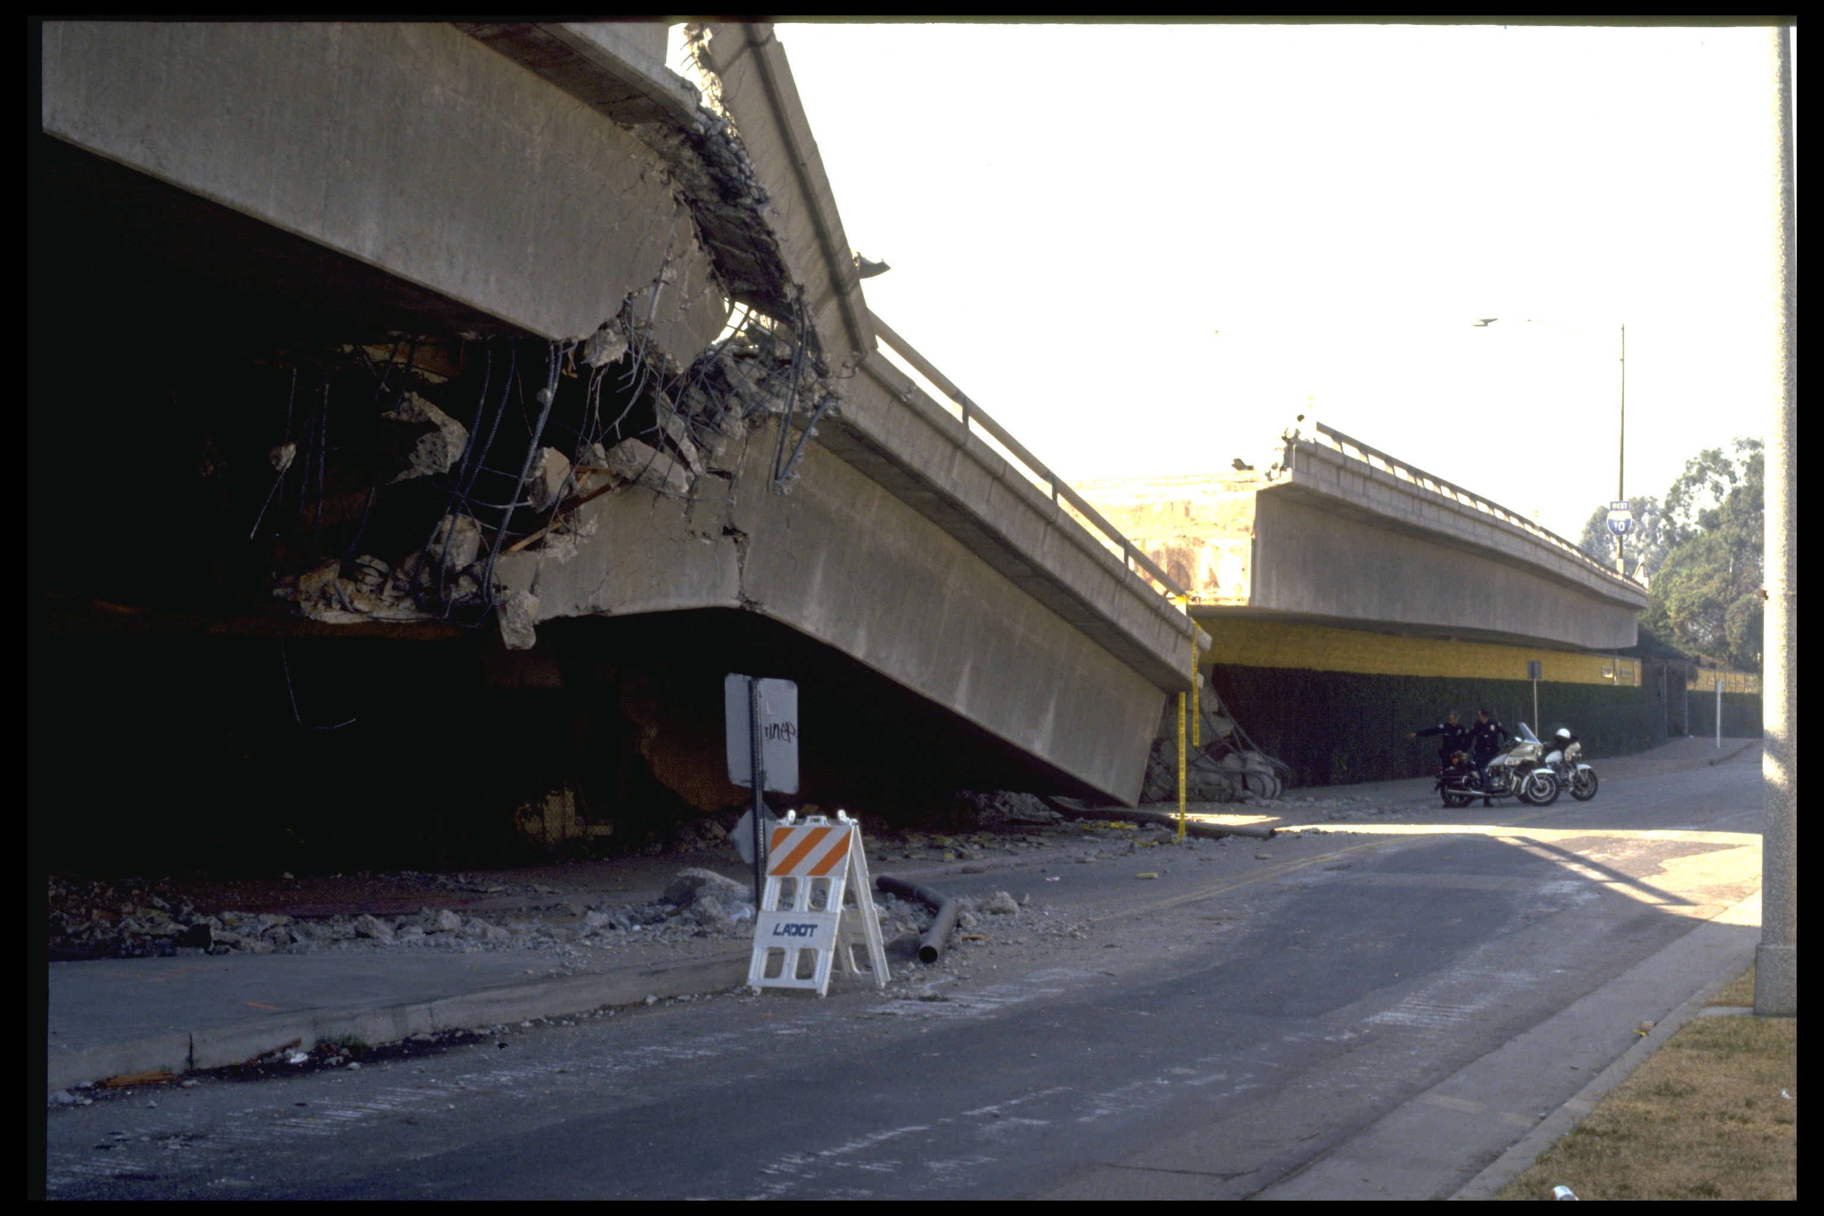
Distance to Epicenter
(500 miles is better for your structure than 5 miles)

Slide 8
Site Conditions
Can have a significant local effect by amplifying ground motion.
Frequency of Occurrence
-Infrequent is best!

Slide 9
To understand the physical connections, we start by relating earthquake magnitude to ground motion.

Slide 10
Earth scientists study this – at places like:
Pacific Earthquake Engineering Research Center UC Berkeley
Multidisciplinary Center for Earthquake Engineering Research The University at Buffalo
Mid-America Earthquake Center University of Illinois At Urbana-Champaign
USGS – Research and monitoring world-wide.

Slide 11
Intermediaries synthesize research findings into usable engineering principles as published in such documents as:
LRFD Bridge Design Specifications AASHTO (2014, and interims)
Recommended LRFD guidelines for the Seismic Design of Highway Bridges (Applied Technology Council and Multidisciplinary Center for Earthquake Engineering Research (ACT/MEER)
ODOT Bridge Design Manual

Slide 12
USGS, together with the various research organizations, developed models that are used to predict what is called the MCE –
Maximum Considered Earthquake
A “maximum considered earthquake” (MCE) for a specific area, is an earthquake that is expected to occur once in approximately 2500 yrs; that is, it has a 2% probability of being exceeded in 50 yrs.
Notes:
Ok – back to the process we have to follow

Slide 13
Code Reference Documents Considered by USGS:
2012 International Building Code
2010 ASCE/SEI 7 Standard
2003 NEHRP Recommended Provisions
2009 AASHTO Guide Specifications for LRFD Seismic Bridge Design (7% in 75 yrs probability of occurrence)

Slide 14
Earthquakes and Ground Motion in Ohio
Ohio is on the fringe of the New Madrid Seismic Zone. We get the left-overs from any event that occurs on that system.
Leftovers can be a problem - Cincinnati experienced some damage in the 1811/12 event.
Notes:
This is a nice seque back to Ohio seismology.

Slide 15
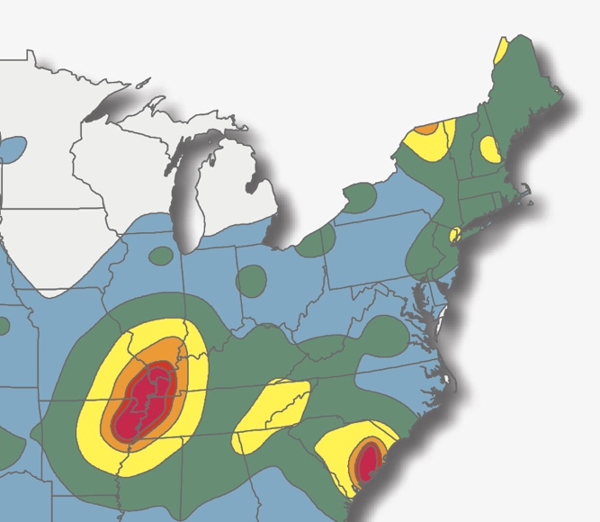
‘Home Grown’ Ohio Earthquakes
New Madrid Seismic Zone

Slide 16
Ohio has experienced ~230 small earthquakes (>2.0) and a few medium events (<5.4) since mid-18th century.

Slide 17
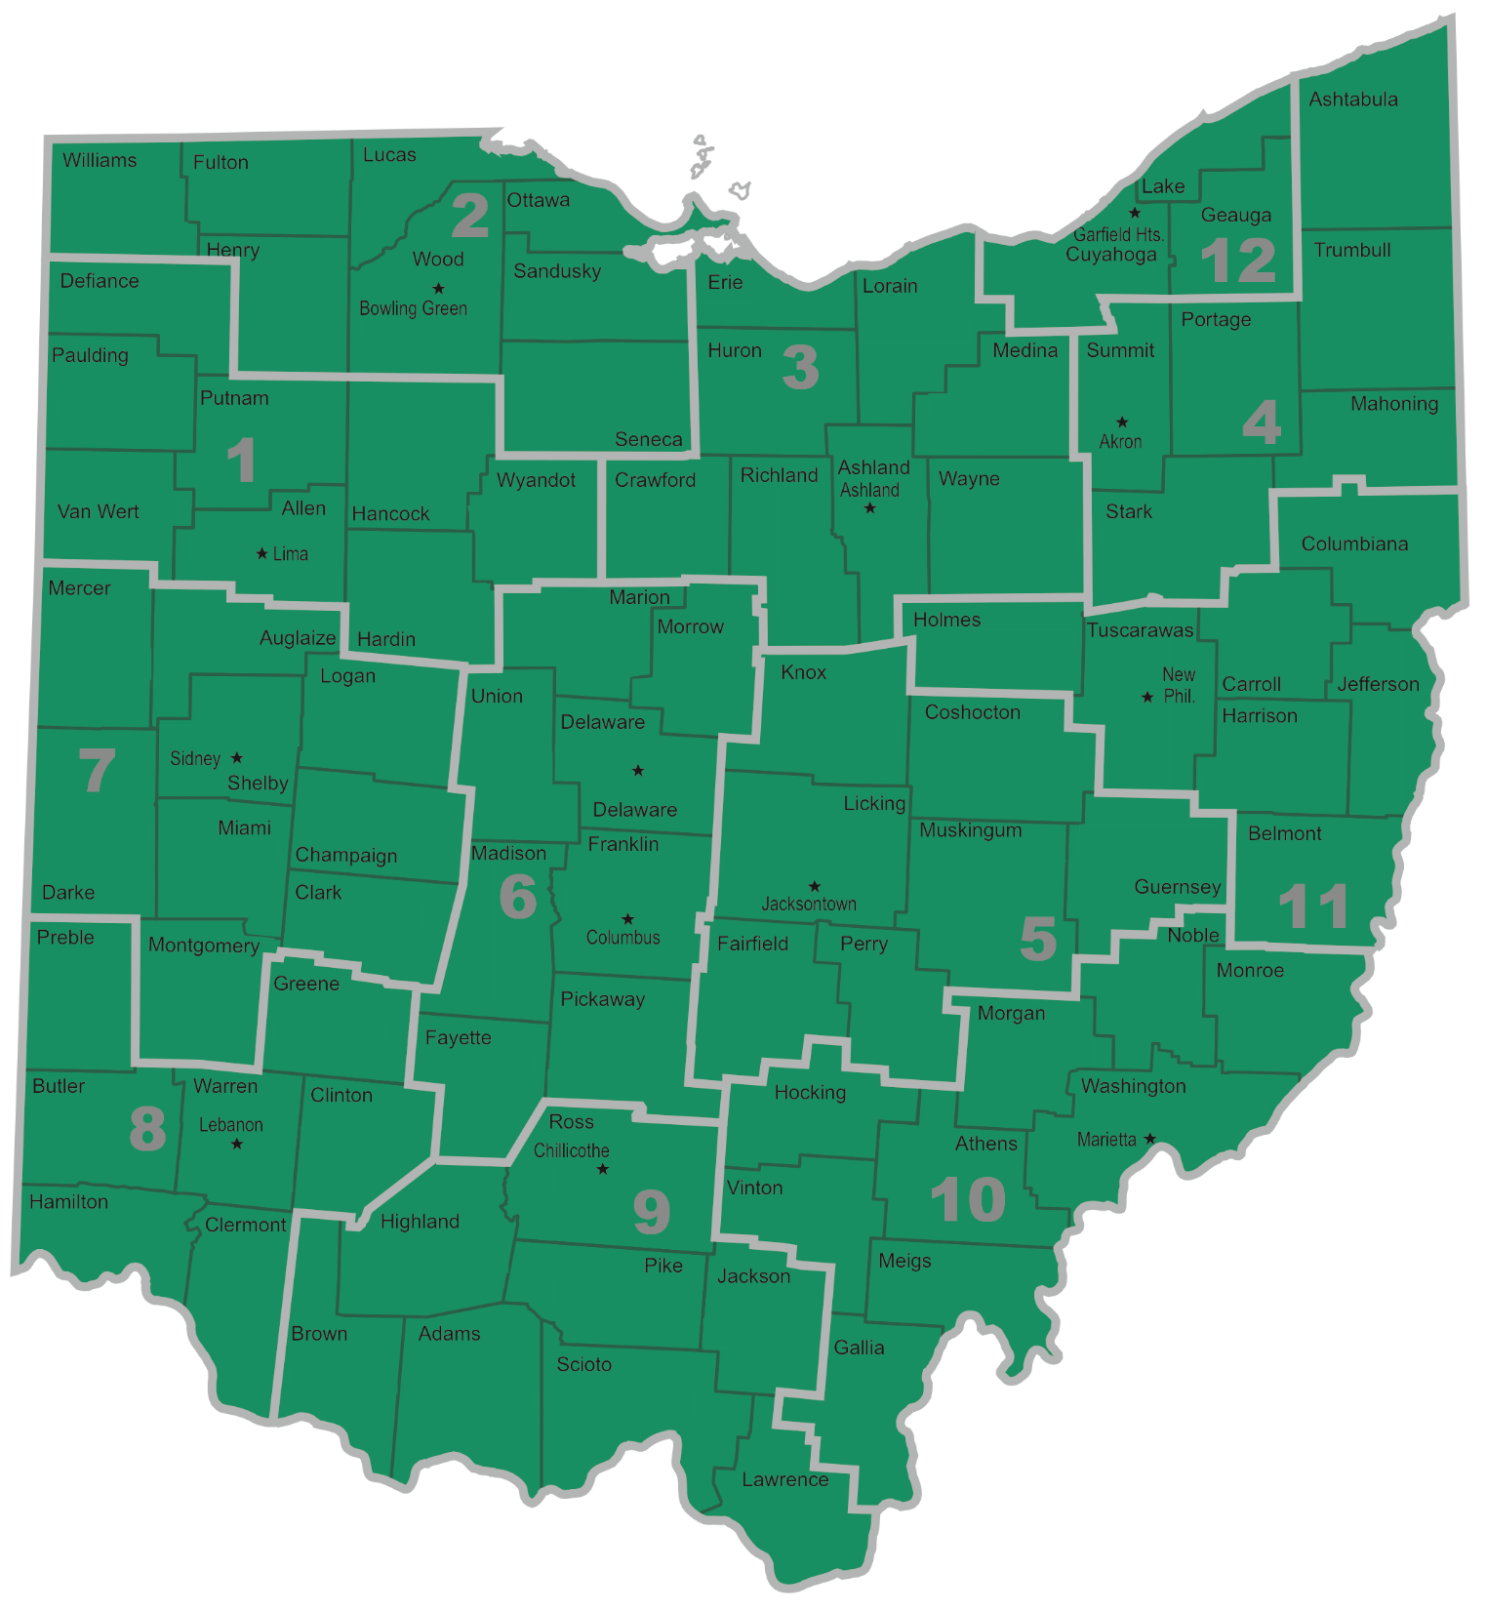

Slide 18
‘Anna’
Area

Slide 19
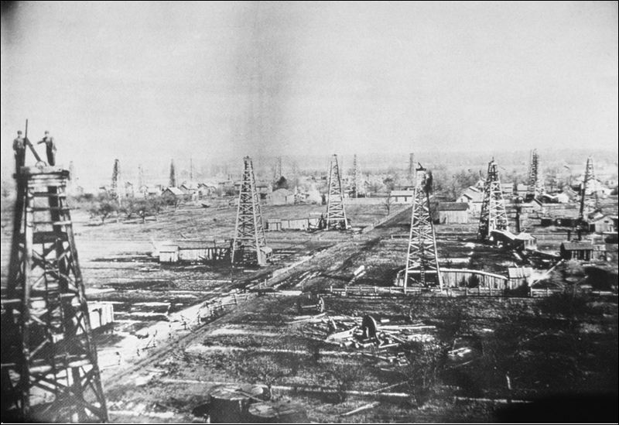
Note a correlation with the 1880-1940 period of peak
hydrocarbon (gas and crude oil) extraction in this area.
Northwest Ohio
1888

Slide 20
Lake and Ashtabula
counties – Note the correlation
with operations
of a deep well
injection system from mid-1980’s to early 2000’s
in this area.

Slide 21
Here’s the Youngstown Area – Note correlation with recent fracking and deep well disposal operations post 2000.

Slide 22
Which is more critical -
A magnitude 7.7 earthquake on the New Madrid Fault 500 miles away or a magnitude 5.4 earthquake on an unknown fault in northeast Ohio 3 miles from your new bridge?

Slide 23
To get a general idea, we can use a Ground Motion Prediction Equation (GMPE)
Cornell's Method (1979)
ln A_{p} = 6.74 + 0.859 * M_{l} – 1.8 * ln (R + 25)
A_{p} = Peak Ground Acceleration (cm/s²)
M_{l} = Magnitude R = distance (km)
Note: 289 GMPE equations published 1964-2010 for PGA.
Notes:
remember that this has largely been replaced by more complex PSHA tools (probabilistic seismic hazard analysis) - but may have some merit for local studies that the national programs can't cover
Equation, explain input variables

Slide 24
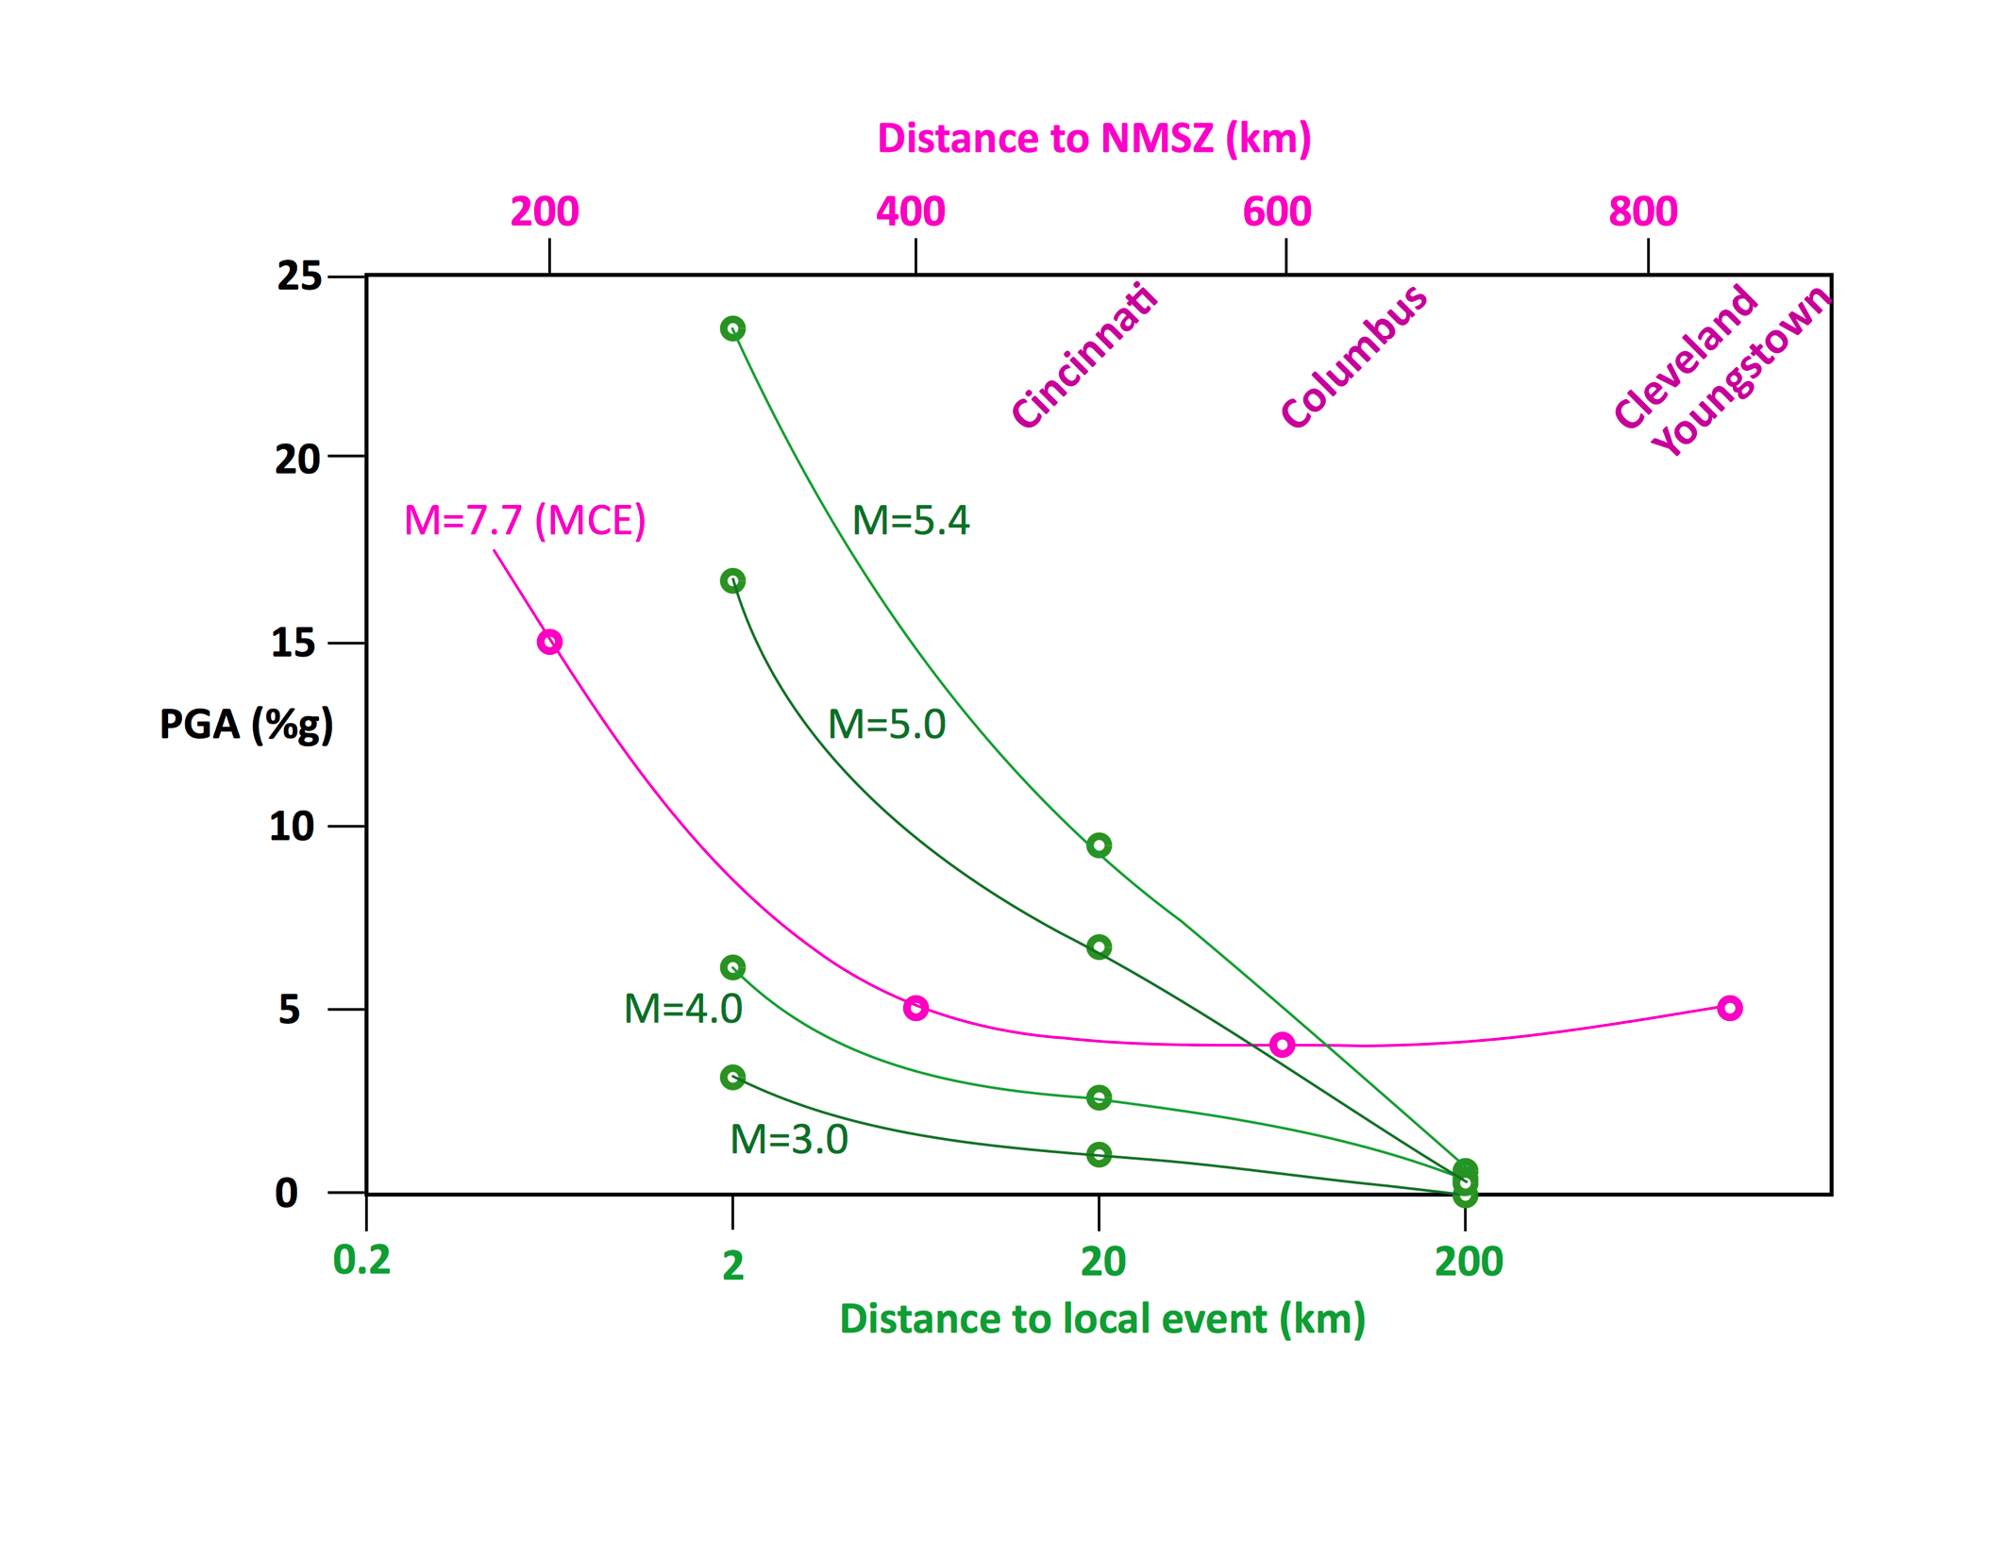
Notes:
remember that this has largely been replaced by more complex PSHA tools (probabilistic seismic hazard analysis) - but may have some merit for local studies that the national programs can't cover
Equation, explain input variables

Slide 25
Spectral Acceleration – What is it?
Raw
Accelerograph
Record
Convert this to something that can be useful for design
Develop a Design Response Spectrum
Displays Maximum Acceleration for a range of ground motion periods

Slide 26
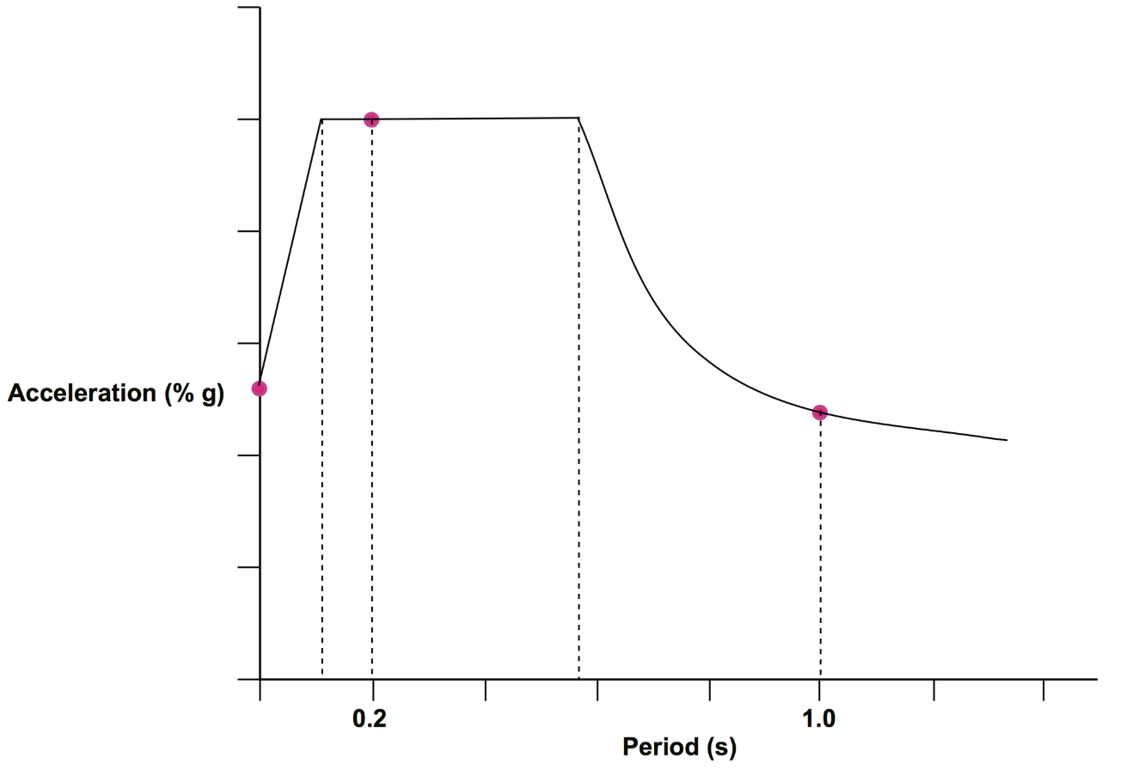
Construction of the Raw Design Spectrum
Input:
PGA – Peak Ground Acceleration
S_{s} – short period Spectral Acceleration
S₁ – long-period Spectral Acceleration
Apply Site Specific Factors
S_{s}
PGA
S₁

Slide 27
Site Classification – Why is it important?
To Develop Site Specific Factors required to construct the Design Spectrum.

Slide 28
Site Class Definitions
Site Class | Soil Profile Name | Average Properties in Top 100 ft
 |  | Soil Shear Wave Velocity | Standard Penetration Resistance | Soil Undrained Shear Strength
A
B
C
D
E
E may, together with F, be a special case – very weak soils.

Slide 29
Site Class Definitions
(consider upper 100 ft)
Site Class | Soil Profile Name | Soil Shear Wave Velocity, v _{s}, (ft/s)
A | Hard rock | v_{s} > 5,000
B | Rock | 2,500 < v_{s} < 5,000
C | Very dense soil and soft rock | 1,200 < v_{s} < 2,500
D | Stiff Soil Profile | 600 < v_{s} < 1,200
E | Soft Soil Profile | v_{s} < 600
Difficult to measure – Can use seismic CPT or published values,
with caution; only basis to classify sites as A or B.

Slide 30
Shear Wave Velocity Estimates
Soil/Rock Type | P Wave ft/s | S Wave ft/s | Site Class
Scree, vegetal soil | 1000-2300 | 330-1000 | D/E
Dry sands | 1300-3900 | 330-1640 | C/D/E
Wet sands | 4900-6600 | 1300-2000 | C
Saturated shales and clays | 3600-8200 | 660-2600 | B/C/D
Marls | 6600-9800 | 2500-5000 | B
Saturated shale and sand sections | 4900-7200 | 1640-2500 | B/C
Porous and saturated sandstones | 6600-11500 | 2600-5900 | A/B
Limestones | 11500-19600 | 6600-10800 | A
Dolomite | 11500-21300 | 6200-11800 | A
Coal | 7200-8900 | 3300-4600 | B
Classification Criteria
and below | 600 | E
600 | 1200 | D
1200 | 2500 | C
2500 | 5000 | B
5000 | and above | A

Slide 31
Site Class Definitions
Site Class | Soil Profile Name | Standard Penetration Resistance, N
A | Hard rock | NA
B | Rock | NA
C | Very dense soil and soft rock | N > 50
D | Stiff Soil Profile | 15 < N < 50
E | Soft Soil Profile | N < 15

Slide 32
Site Class Definitions
Site Class | Soil Profile Name | Soil Undrained Shear Strength, s_{u} , (ksf)
A | Hard rock | NA
B | Rock | NA
C | Very dense soil and soft rock | s_{u} > 2.0
D | Stiff Soil Profile | 1.0 < s_{u} < 2.0
E | Soft Soil Profile | s_{u} < 1.0

Slide 33
Site Class Definitions
Site Class | Soil Profile Name | Soil Shear Wave Velocity | Standard Penetration Resistance | Soil Undrained Shear Strength
E | - | Any profile with more than 10 ft of soil having the following characteristics: Plasticity index PI > 20, Moisture Content w > 40%, and Undrained shear strength s_{u} < 500 psf

Slide 34
Site Class Definitions
Site Class | Soil Profile Name | Soil Shear Wave Velocity | Standard Penetration Resistance | Soil Undrained Shear Strength
F | - | Any profile containing soils having one or more of the following characteristics: Soils vulnerable to potential failure or collapse under seismic loading such as liquefiable soils, quick and highly sensitive clays, collapsible weakly cemented soils. Peats and/or highly organic clays (H > 10 ft of peat and/or highly organic clay where H = thickness of soil) Very high plasticity clays (H > 25 ft with plasticity index PI > 75 Very thick soft/medium stiff clays (H > 120 ft)

Slide 35
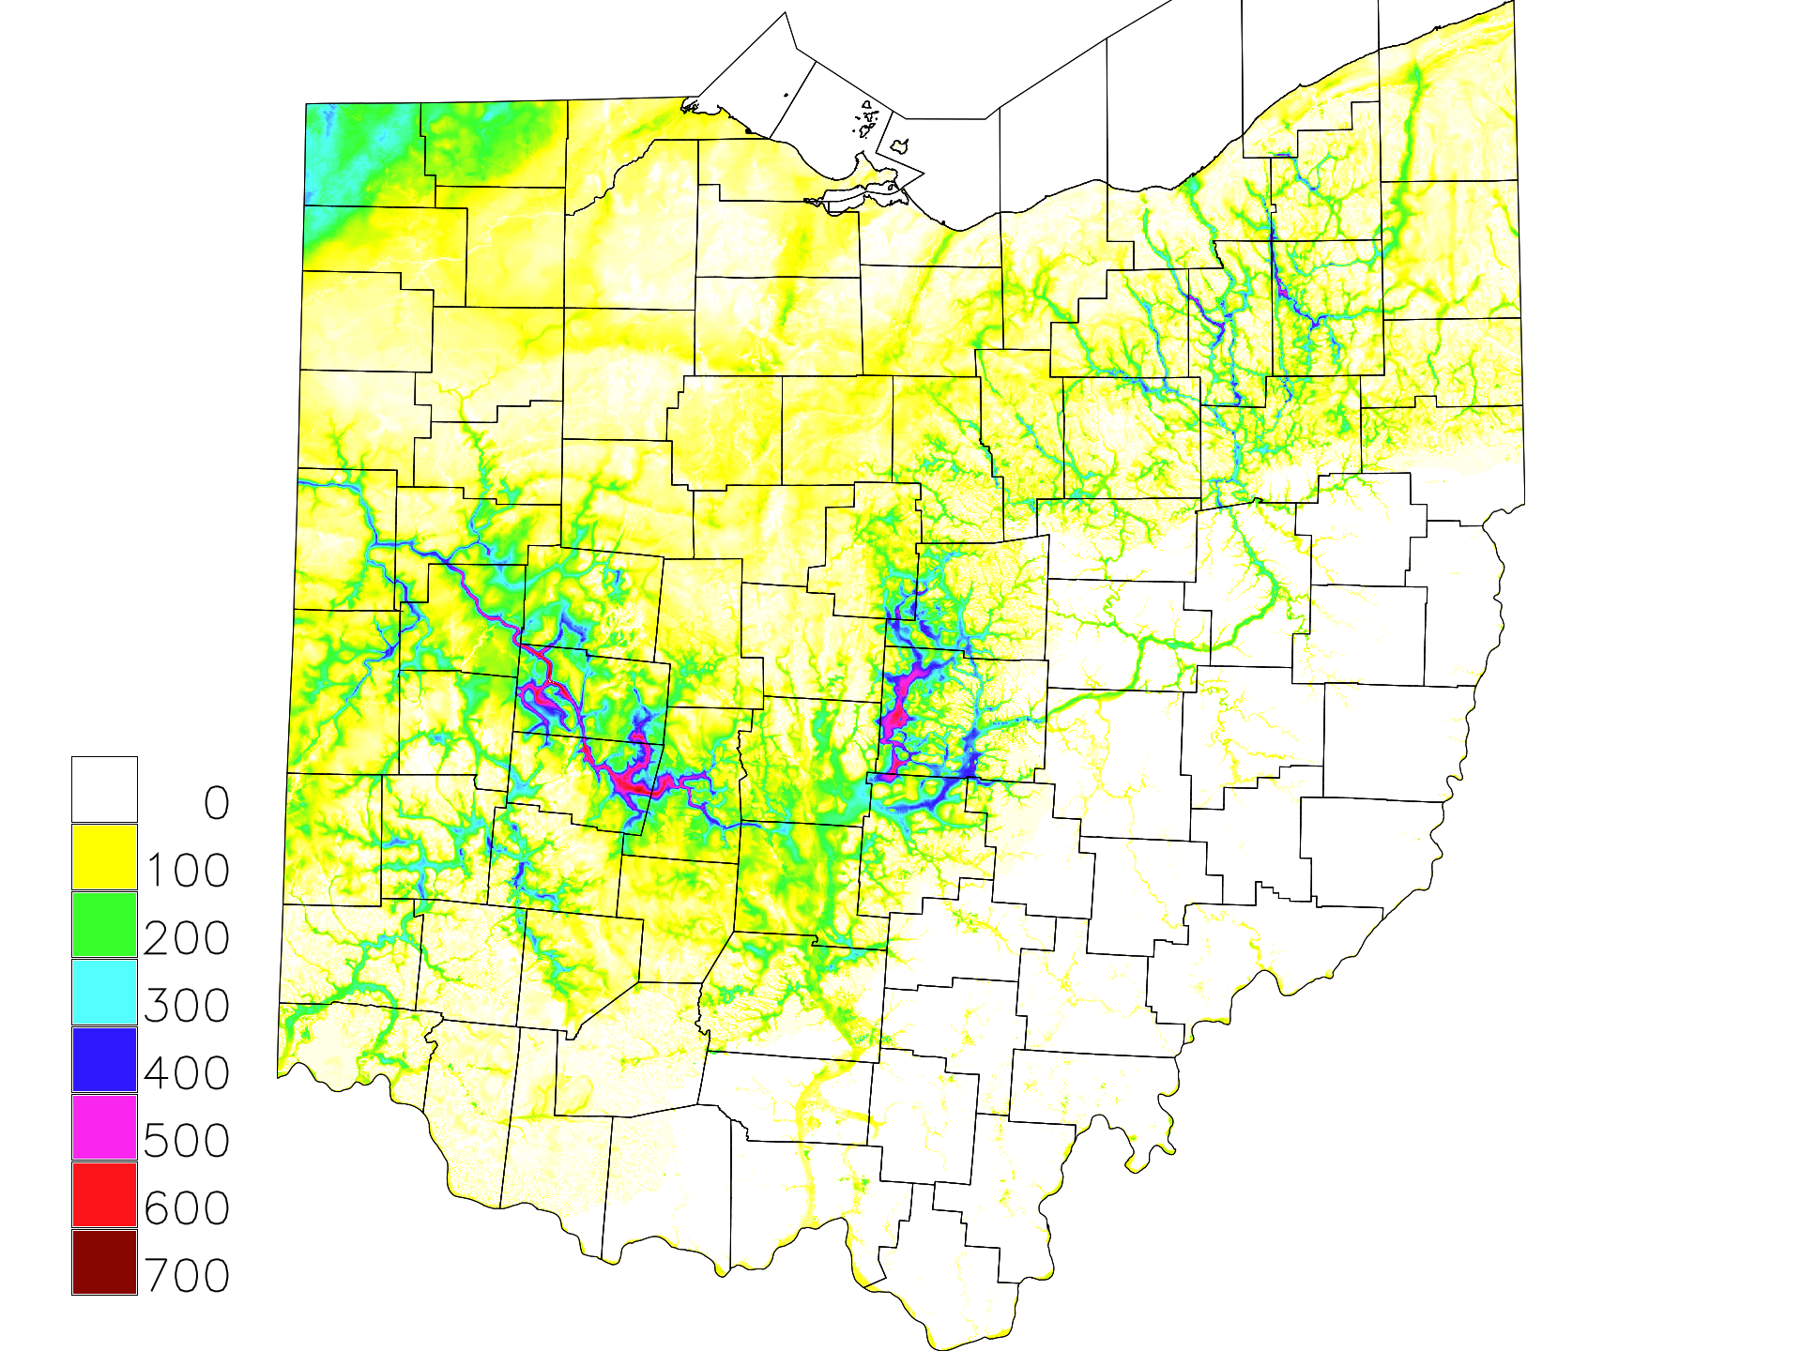
Soil Cover
Thickness

Slide 36
Values of Site Factors F_{pga} and F_{a} (AASHTO)
<0.10
<0.25
0.8
1.0
1.2
1.6
2.5
Site Class | PGA¹ | <0.10 | 0.20 | 0.30 | 0.40 | >0.50
 | S_{s}¹ | <0.25 | 0.50 | 0.75 | 1.00 | >1.25
A |  | 0.8 | 0.8 | 0.8 | 0.8 | 0.8
B |  | 1.0 | 1.0 | 1.0 | 1.0 | 1.0
C |  | 1.2 | 1.2 | 1.1 | 1.0 | 1.0
D |  | 1.6 | 1.4 | 1.2 | 1.1 | 1.0
E |  | 2.5 | 1.7 | 1.2 | 0.9 | 0.9
F ²
¹ | Use straight-line interpolation for intermediate values.
² | Site-specific geotechnical investigation and dynamic site response analysis should be performed for all sites in Site Class F.
Tables 3.10.3.1-1 and -2.

Slide 37
Values of Site Factors F_{v} (AASHTO)
Site Class | Spectral Acceleration Coefficient At Period 1.0 sec (S₁)¹
 | <0.1 | 0.2 | 0.3 | 0.4 | 0.5
A | 0.8 | 0.8 | 0.8 | 0.8 | 0.8
B | 1.0 | 1.0 | 1.0 | 1.0 | 1.0
C | 1.7 | 1.6 | 1.5 | 1.4 | 1.3
D | 2.4 | 2.0 | 1.8 | 1.6 | 1.5
E | 3.5 | 3.2 | 2.8 | 2.4 | 2.4
F ²
¹ | Use straight-line interpolation for intermediate values.
² | Site-specific geotechnical investigation and dynamic site response analysis should be performed for all sites in Site Class F.
<0.1
0.8
1.0
1.7
2.4
3.5

Slide 38
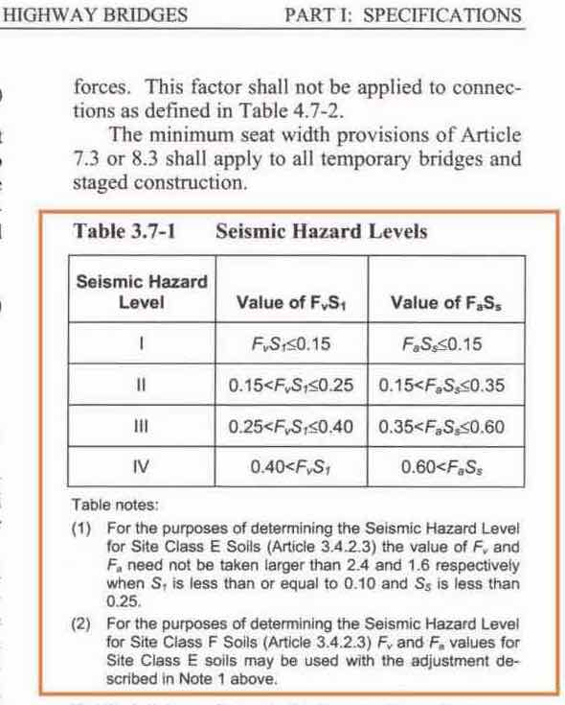
For the purpose of determining the Seismic Hazard Level for Site Class E Soils (Article 3.4.2.3) the value of F_{v} and F_{a} need not be taken larger than 2.4 and 1.6, respectively, when S₁ is less than or equal to 0.10 and S_{s} is less than 0.25.

Slide 39
(2) For the purposes of determining the Seismic Hazard Level for Site Class F Soils (Article 3.4.2.3) F_{v} and F_{a} values for Site Class E soils may be used with the adjustment described in Note 1 above.

Slide 40
Values of Site Factor F_{a} (ODOT)
Site Class | S_{s}¹ | <0.25 | 0.50 | 0.75 | 1.00 | >1.25
A |  | 0.8 | 0.8 | 0.8 | 0.8 | 0.8
B |  | 1.0 | 1.0 | 1.0 | 1.0 | 1.0
C |  | 1.2 | 1.2 | 1.1 | 1.0 | 1.0
D |  | 1.6 | 1.4 | 1.2 | 1.1 | 1.0
E |  | 1.6 | 1.7 | 1.2 | 0.9 | 0.9
F |  | 1.6
¹ | Use straight-line interpolation for intermediate values.
Site Class | S_{s}¹ | <0.25
A |  | 0.8
B |  | 1.0
C |  | 1.2
D |  | 1.6
E |  | 1.6
F |  | 1.6
ODOT BDM – use site factors for Site Class D for Site Class E and F (S.3.10.3.2).
F_{pga} remains unchanged from AASHTO.

Slide 41
Values of Site Factors F_{v} (ODOT)
Site Class | Spectral Acceleration Coefficient At Period 1.0 sec (S₁)¹
 | <0.1 | 0.2 | 0.3 | 0.4 | 0.5
A | 0.8 | 0.8 | 0.8 | 0.8 | 0.8
B | 1.0 | 1.0 | 1.0 | 1.0 | 1.0
C | 1.7 | 1.6 | 1.5 | 1.4 | 1.3
D | 2.4 | 2.0 | 1.8 | 1.6 | 1.5
E | 2.4 | 3.2 | 2.8 | 2.4 | 2.4
F | 2.4
¹ | Use straight-line interpolation for intermediate values.
Site Class | Spectral Acceleration Coefficient At Period 1.0 sec (S₁)¹
 | <0.1 | 0.2 | 0.3 | 0.4 | 0.5
A | 0.8 | 0.8 | 0.8 | 0.8 | 0.8
B | 1.0 | 1.0 | 1.0 | 1.0 | 1.0
C | 1.7 | 1.6 | 1.5 | 1.4 | 1.3
D | 2.4 | 2.0 | 1.8 | 1.6 | 1.5
E | 2.4 | 3.2 | 2.8 | 2.4 | 2.4
F | 2.4
¹ | Use straight-line interpolation for intermediate values.
ODOT BDM – use site factors for Site Class D for Site Class E and F (S.3.10.3.2).

Slide 42
How does it work?
Ground Motion (PGA, S_{s}, S₁)
+
Site Classification (A-F)
+
Site Factors (F_{pga}, F_{s}, F_{v})
Design Response Spectrum
(Design Acceleration = Acceleration * Site Factor)
Seismic Zone Determination (1-4)

Slide 43
Table 3.10.6.1 – Seismic Zones
Acceleration Coefficient S_{D1} | Seismic Zone
S_{D1} < 0.15 | 1
0.15 < S_{D1} < 0.30 | 2
0.30 < S_{D1} < 0.50 | 3
0.50 < _{SD}1 | 4
S_{D1} < 0.15 | 1
S_{D1} is the 1-second period spectral design acceleration – S₁ * F_{v}
ODOT BDM S.3.10.3.2) ‘All bridges in Ohio are located within Seismic Performance Zone 1’.

Slide 44
Construction of Design Response Spectrum
Using LRFD
Figures 3.10.2.1-1 through 21
PGA = 0.3s
S_{s} = 0.5s
S₁ = 0.2s
Site Class = C

Slide 46
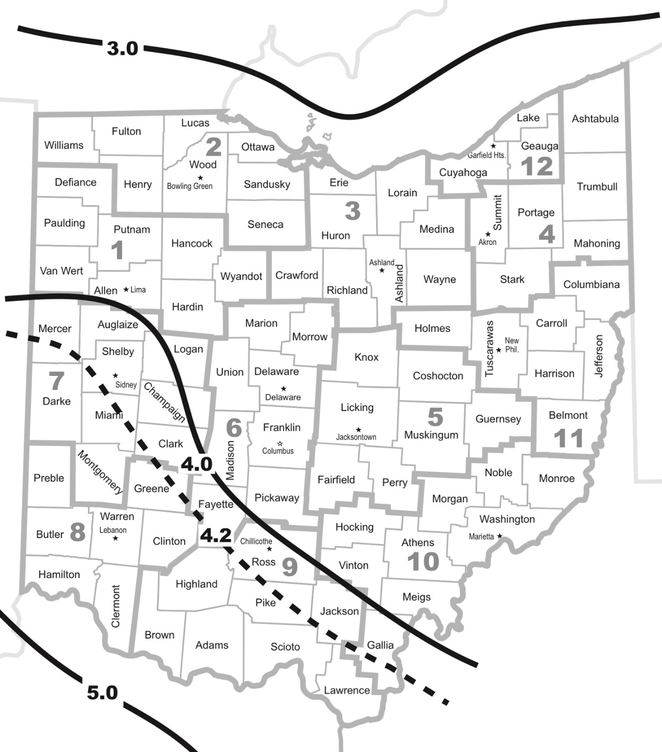
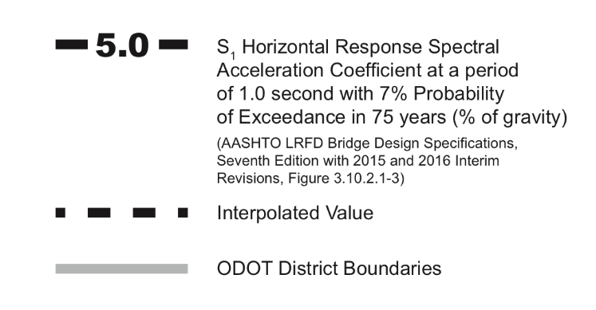
S_{D1} = S₁ * F_{V}
if S_{D1} > 0.15 and F_{v} = 3.5
S₁ > 0.15/3.5 = 0.042
(4.2%g)
BDM Fig 301.4.1.1-1

Slide 47
All bridges in Ohio are in Seismic Performance Zone 1 S_{D1} <= 0.15
Determine Site Class ‘designer shall analyze soil borings………..’ LRFD 3.10.3.1
Is Site Class
A, B or C?
Consider only
BDM 304.4.4.1a
BDM 304.4.1b
YES
NO
Is Site Class F?
YES
NO
Consider BDM
301.4.4.1a, 301.4.4.1b
LRFD 5.10.11.4.1d,
5.10.11.4.1e
Is S₁ >=0.042?
(Fig 301.4.4.1-1)
NO
YES
Is 0.1<S_{D1}<0.15?
(use F_{v}=2.4)
NO
BDM
301.4.4.2a
YES OR UNKNOWN

Slide 48
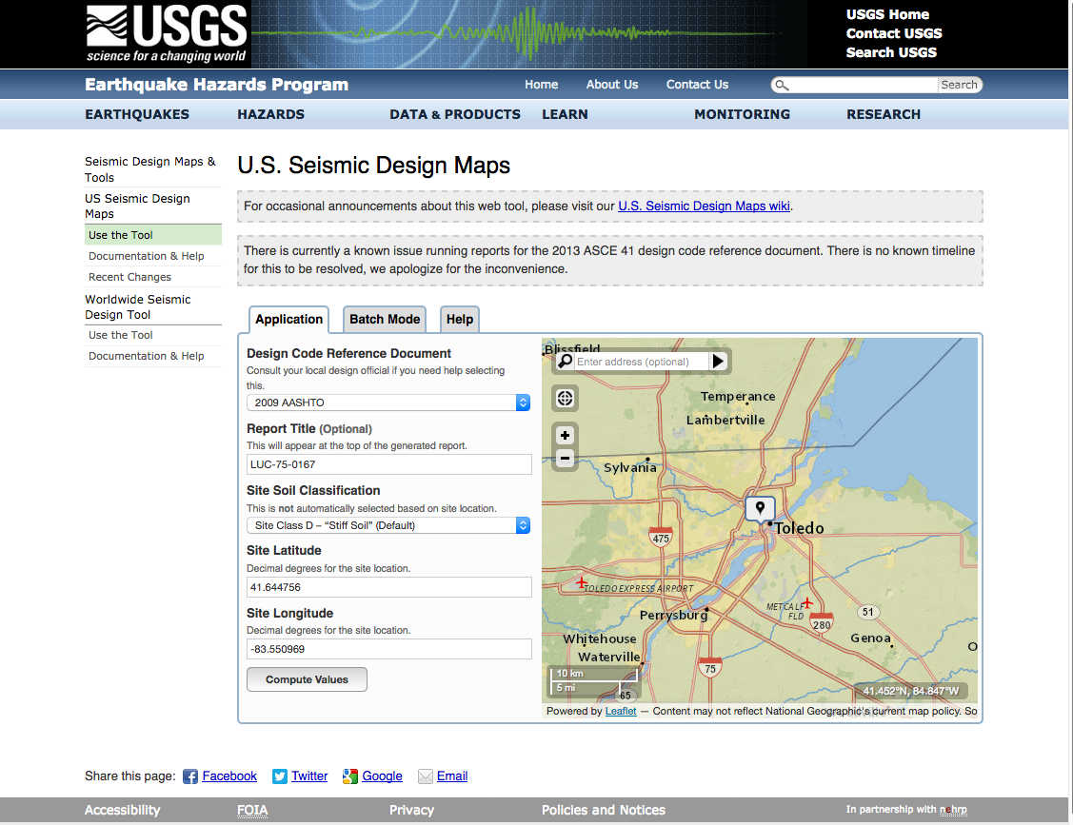

Slide 49
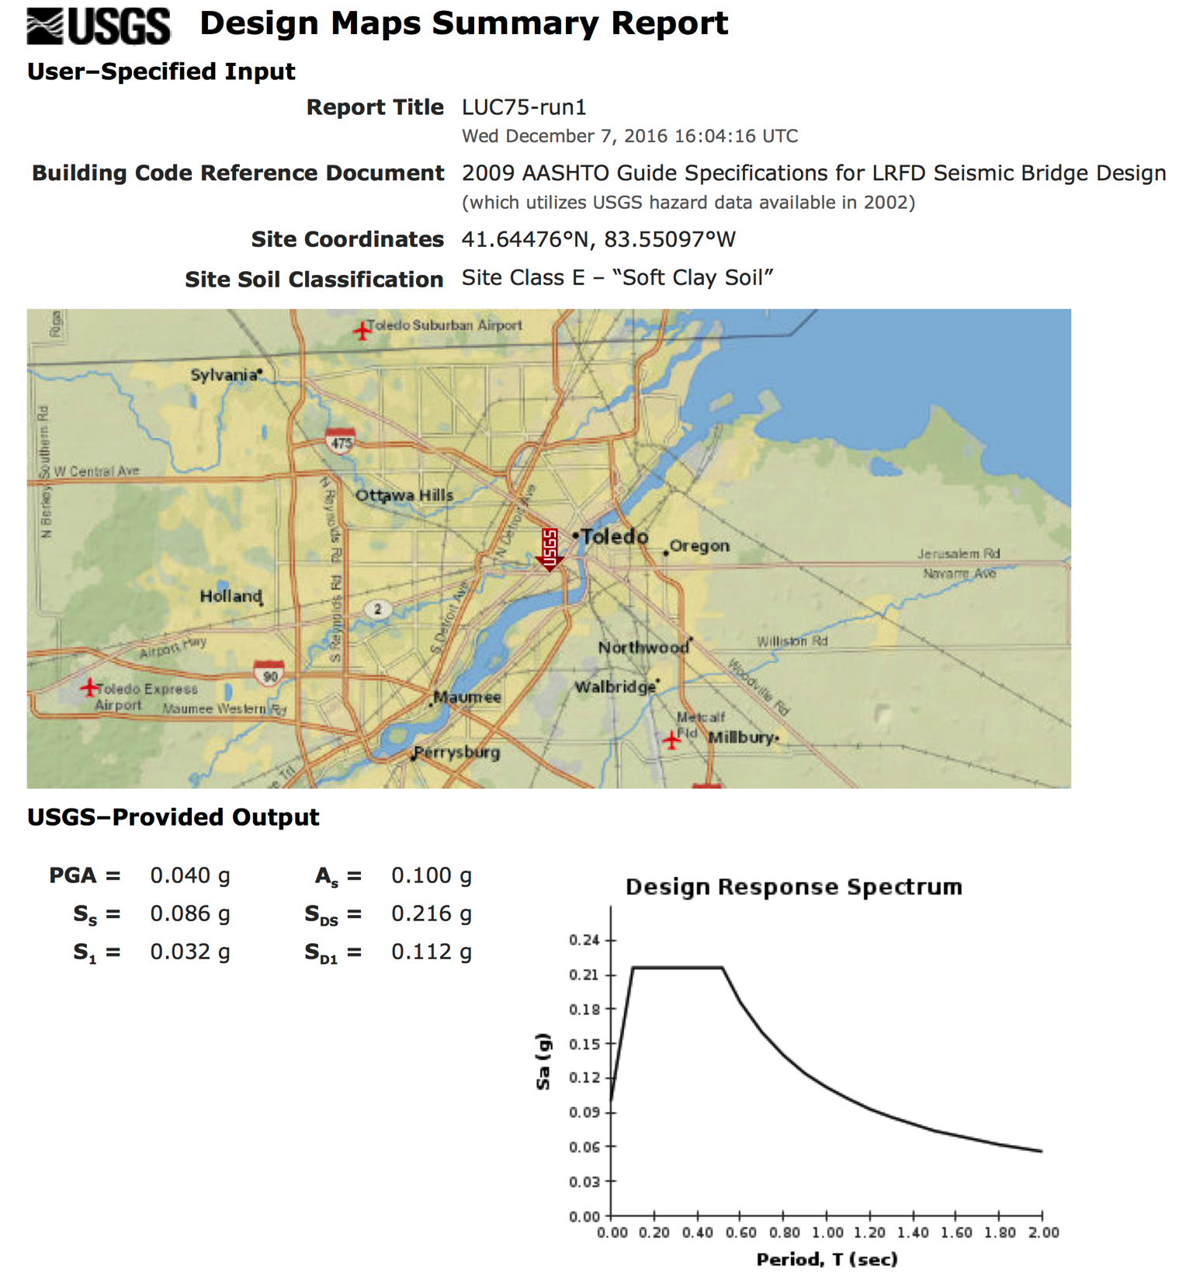

Slide 50
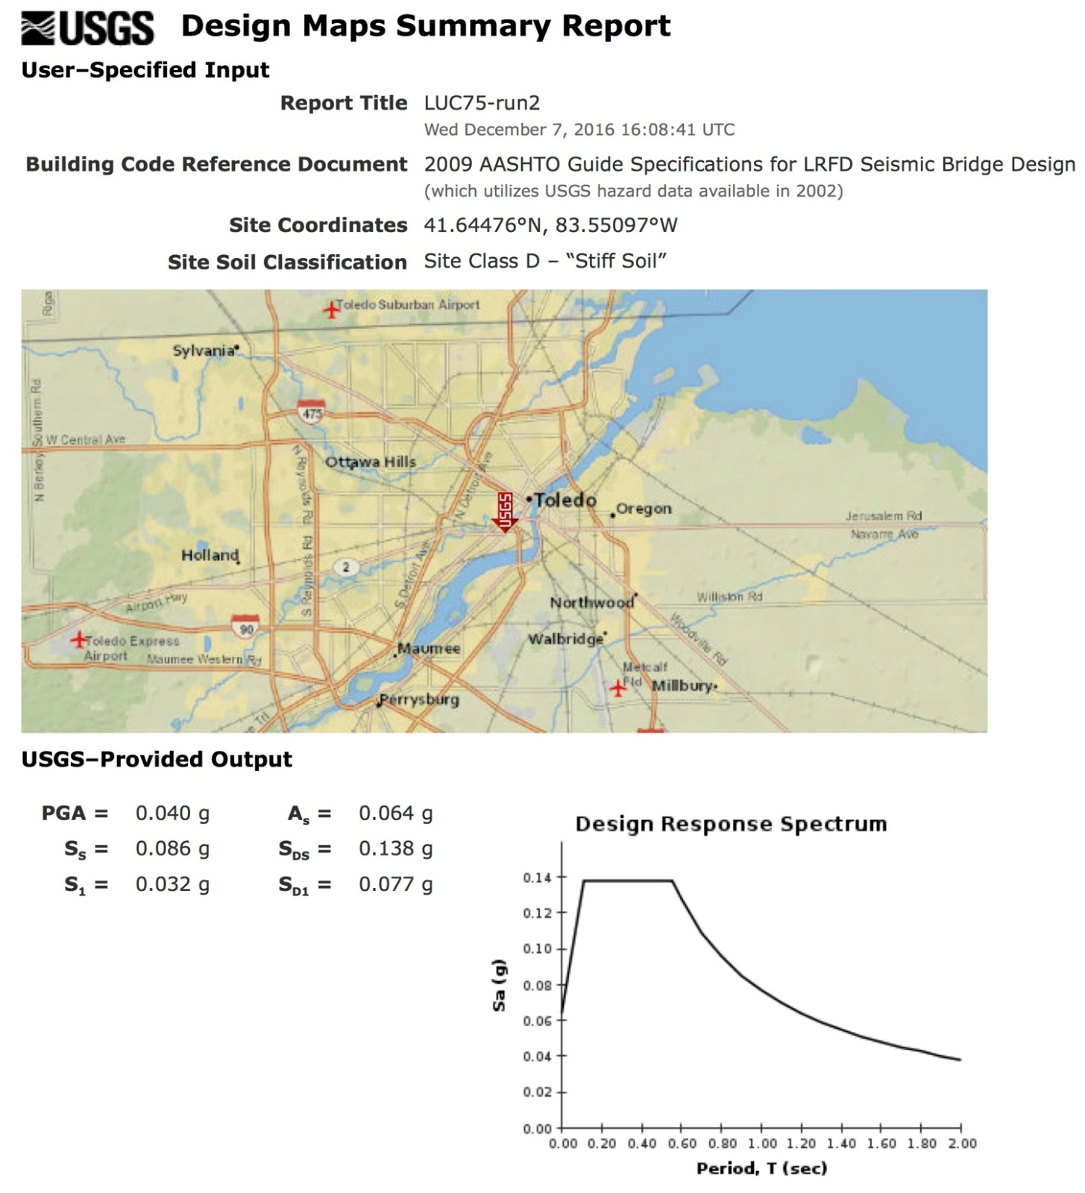

Slide 51
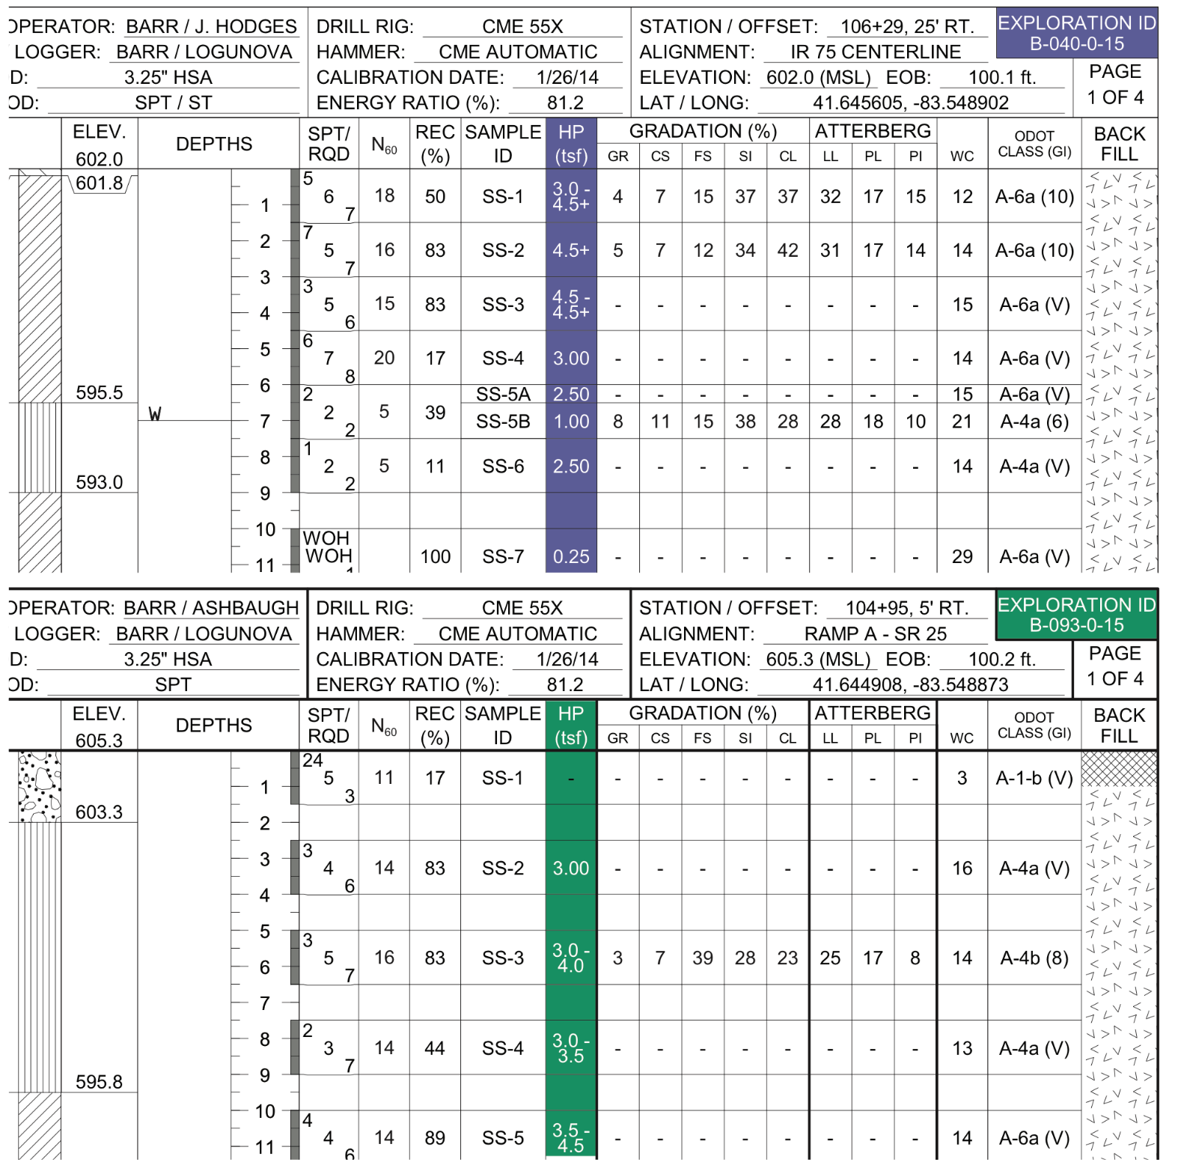
Depth | s_{u}
 | B-093 | B-040
0 | 3 | 3.75
 | 3.5 | 4.5
 | 3.2 | 4.5
 |  | 3
 |  | 2.5
10 | 4 | 1
 | 3.9 | 0.25
 | 3.4 | 0.25
 | 3.8 | 0.25
20 | 1.3 | 0.25
 | 0.75 | 0.25
 | 0.75 | 0.75
 | 0.62
30 | 0.75 | 1.1
 | 0.87 | 1
40 | 1.2 | 1.3
 | 1.7 | 2
50 | 1.7 | 2.6
 | 2.3 | 2.2
60 | 2.6 | 2.8
 | 2.3 | 1.25
70 | 0.5 | 1.1
 | 0.5 | 0.25
80 | 0.82 | 4.5
 | 4.5 | 4.5
90 | 4.5 | 4.5
 | 4.5 | 4.5
100 | 4.5
Lucas Bridge 75-0167

Slide 52
Summary by Layer
i | su_{i} | from | to | d_{i} | d_{i}/su_{i}
1 | 3.6 | 0 | 15 | 15 | 4.17
2 | 0.62 | 15 | 40 | 25 | 40.32
3 | 1.43 | 40 | 50 | 10 | 6.99
4 | 2.47 | 50 | 65 | 15 | 6.07
5 | 0.74 | 65 | 80 | 15 | 20.27
6 | 4.5 | 80 | 100 | 20 | 4.44
7 | - | - | - | - | -
 |  |  |  | Σ d_{i}/su _{i} | 82.27
 |  | Σ d_{i} | 100 | Class
 |  | Σ d_{i}/Σd_{i}/su_{i} Ave su _{i} | 1.22 | D
Note: For Cohesive soils, S_{u} is more reliable than N.
Lucas Bridge 75-0167

Slide 53
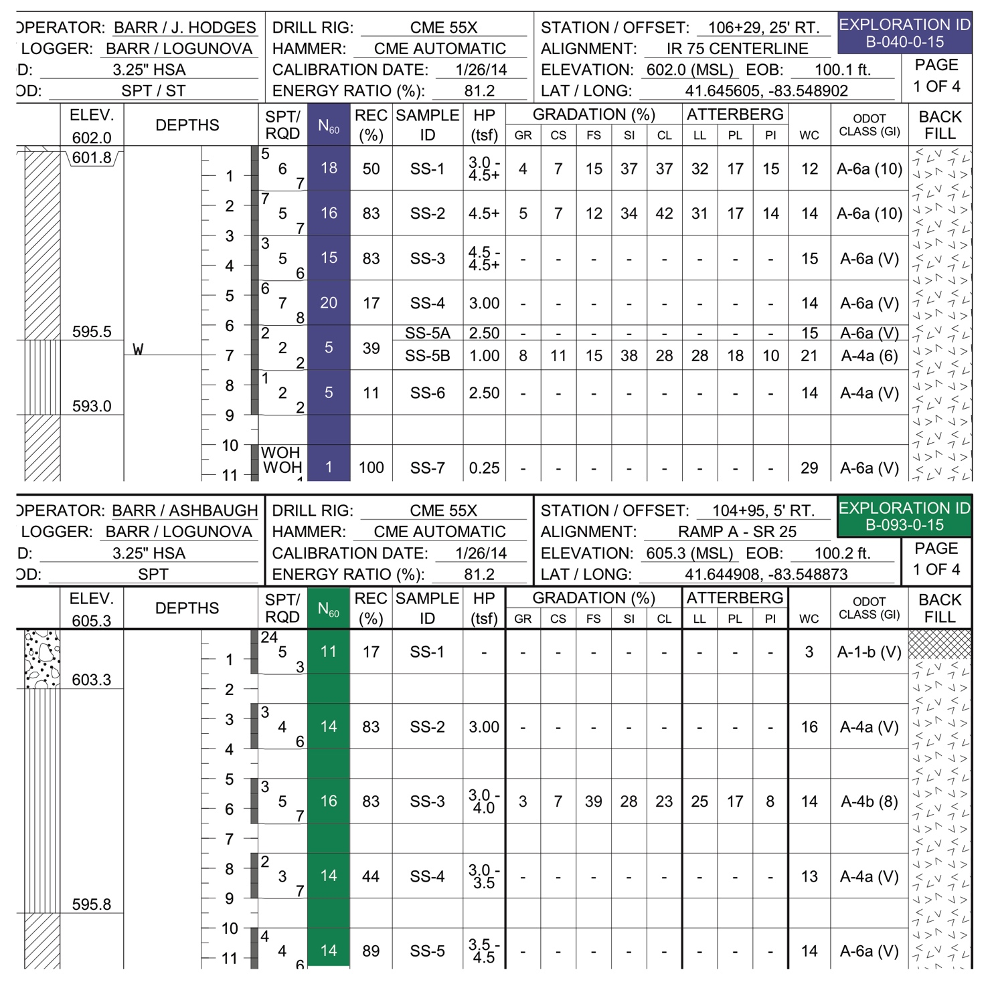
EXAMPLE 1
Site Classification
Depth | N₆₀
 | B-093 | B-040
0 | 11 | 18
 | 14 | 16
 | 16 | 15
 |  | 20
 |  | 5
10 | 14 | 5
 | 14 | 1
 | 16 | 3
 | 12 | 1
20 | 12 | 5
 | 8 | 4
 | 8 | 7
 | 9 | 8
30 | 8 | 9
 | 8 | 9
40 | 12 | 14
 | 12 | -
50 | 26 | 26
 | 20 | 24
60 | 24 | 30
 | 16 | 22
70 | 12 | 16
 | 3 | 1
80 | 12 | 34
 | 53 | 68
90 | 61 | 85
 | 53 | 80
100 | 100 | 72
Lucas Bridge 75-0167

Slide 54
Summary by Layer
i | N_{i} | from | to | d_{i} | d_{i}/N_{i}
1 | 15 | 0 | 15 | 15 | 1.00
2 | 6 | 15 | 40 | 25 | 4.17
3 | 13 | 40 | 50 | 10 | 0.77
4 | 22 | 50 | 75 | 25 | 1.14
5 | 2 | 75 | 80 | 5 | 2.50
6 | 62 | 80 | 100 | 20 | 0.32
7 | - | - | - | - | -
 |  |  |  | Σ d_{i}/N_{i} | 9.89
 |  | Σ d_{i} | 100 | Class
 |  | Σ d_{i}/Σd_{i}/N_{i} Ave N_{i} | 10 | E
Note: N_{i} should be based on the _{N60} not raw N values (BDM S.10.3.1).
Lucas Bridge 75-0167

Slide 55
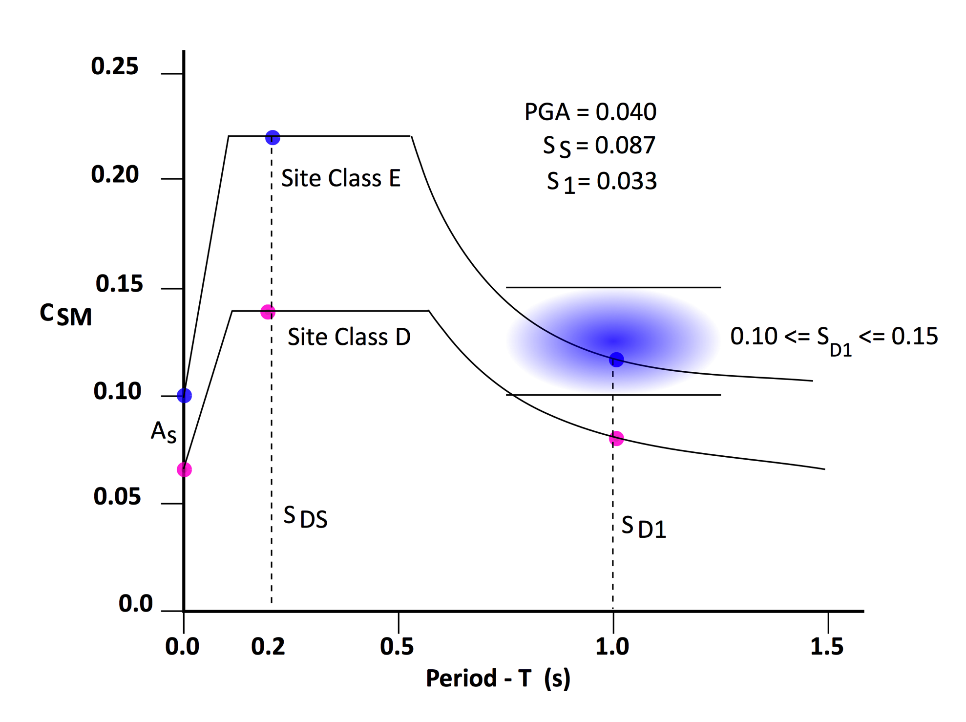
Lucas Bridge 75-0167
Design Response Spectrum

Slide 56
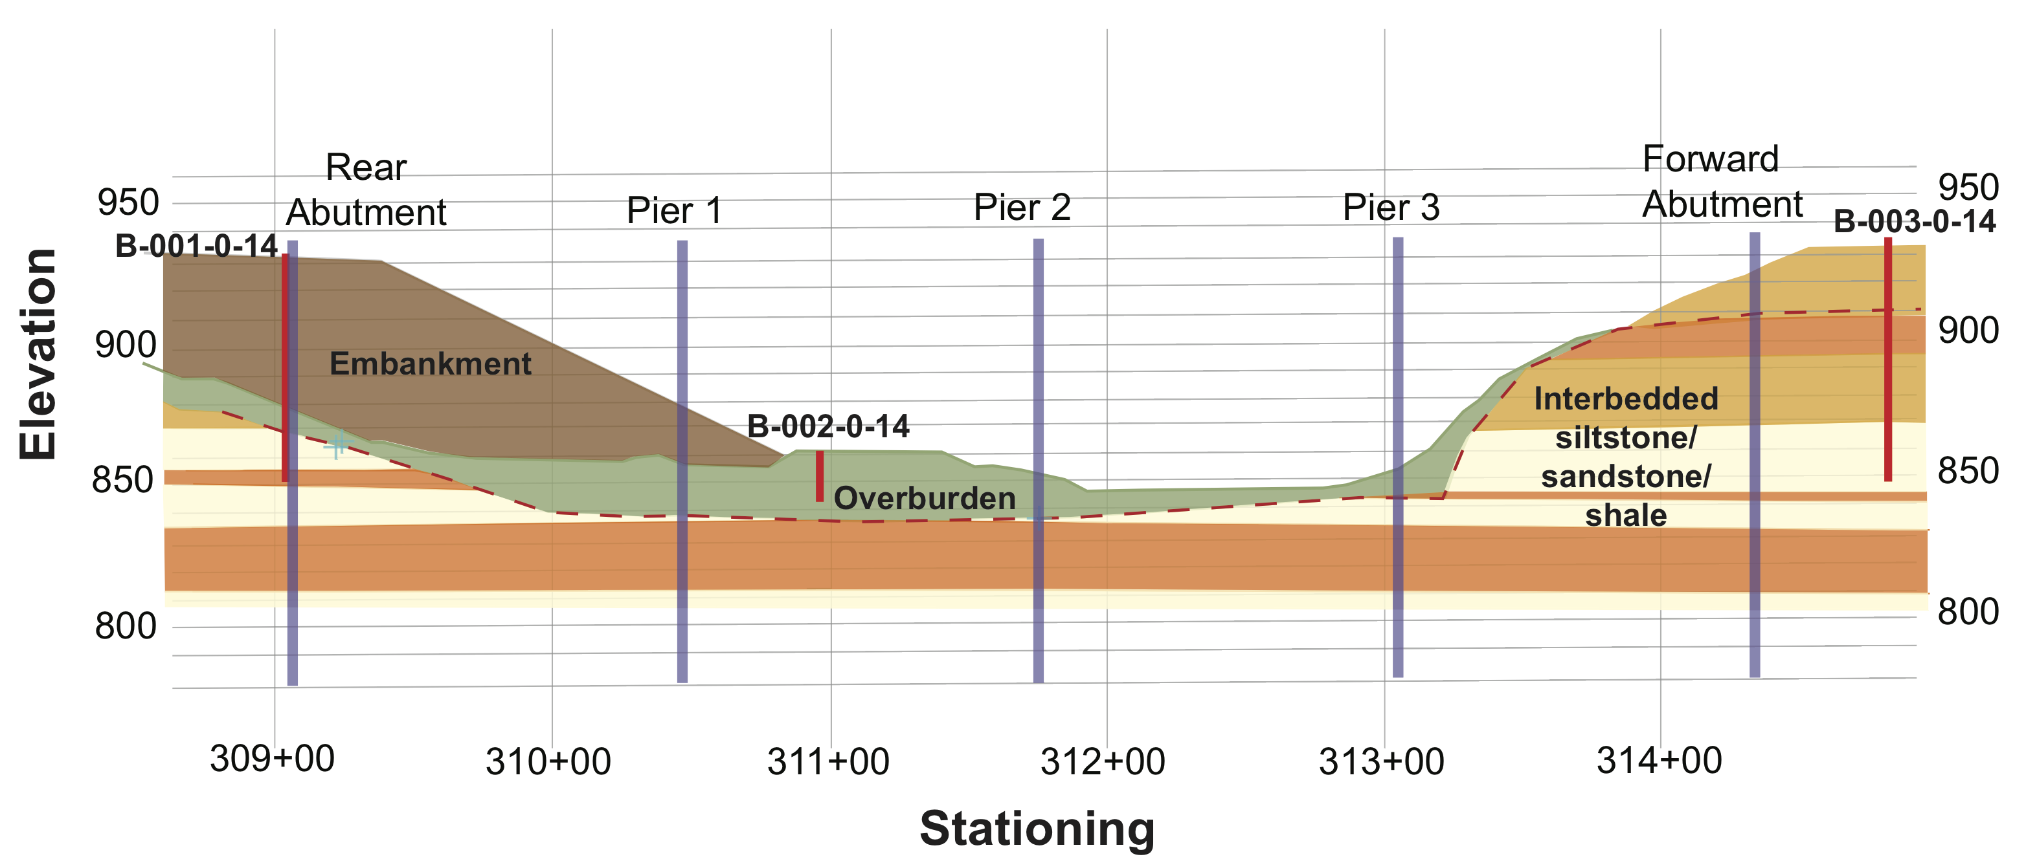
Fairfield County, Ohio

Slide 57
Forward Abutment – Rock (Sandstone)
2600 < V_{s} < 5900 ft/s – B
Rear Abutment – 50 ft embankment + overburden
50 ft rock (sandstone)
i | V_{si} | from | to | d_{i} | D_{i}/V_{si}
1 | 500 | 0 | 50 | 50 | 0.1
2 | 2500 | 50 | 100 | 50 | 0.02
 |  |  |  | Σd_{i}/V_{si} | 0.12
 |  | Σd_{i} | 100 | Class
 |  | Σd_{i}/Σd_{i}/V_{si}
 |  | Ave V_{s} | 833 ft/s | D
Fairfield County, Ohio

Slide 58
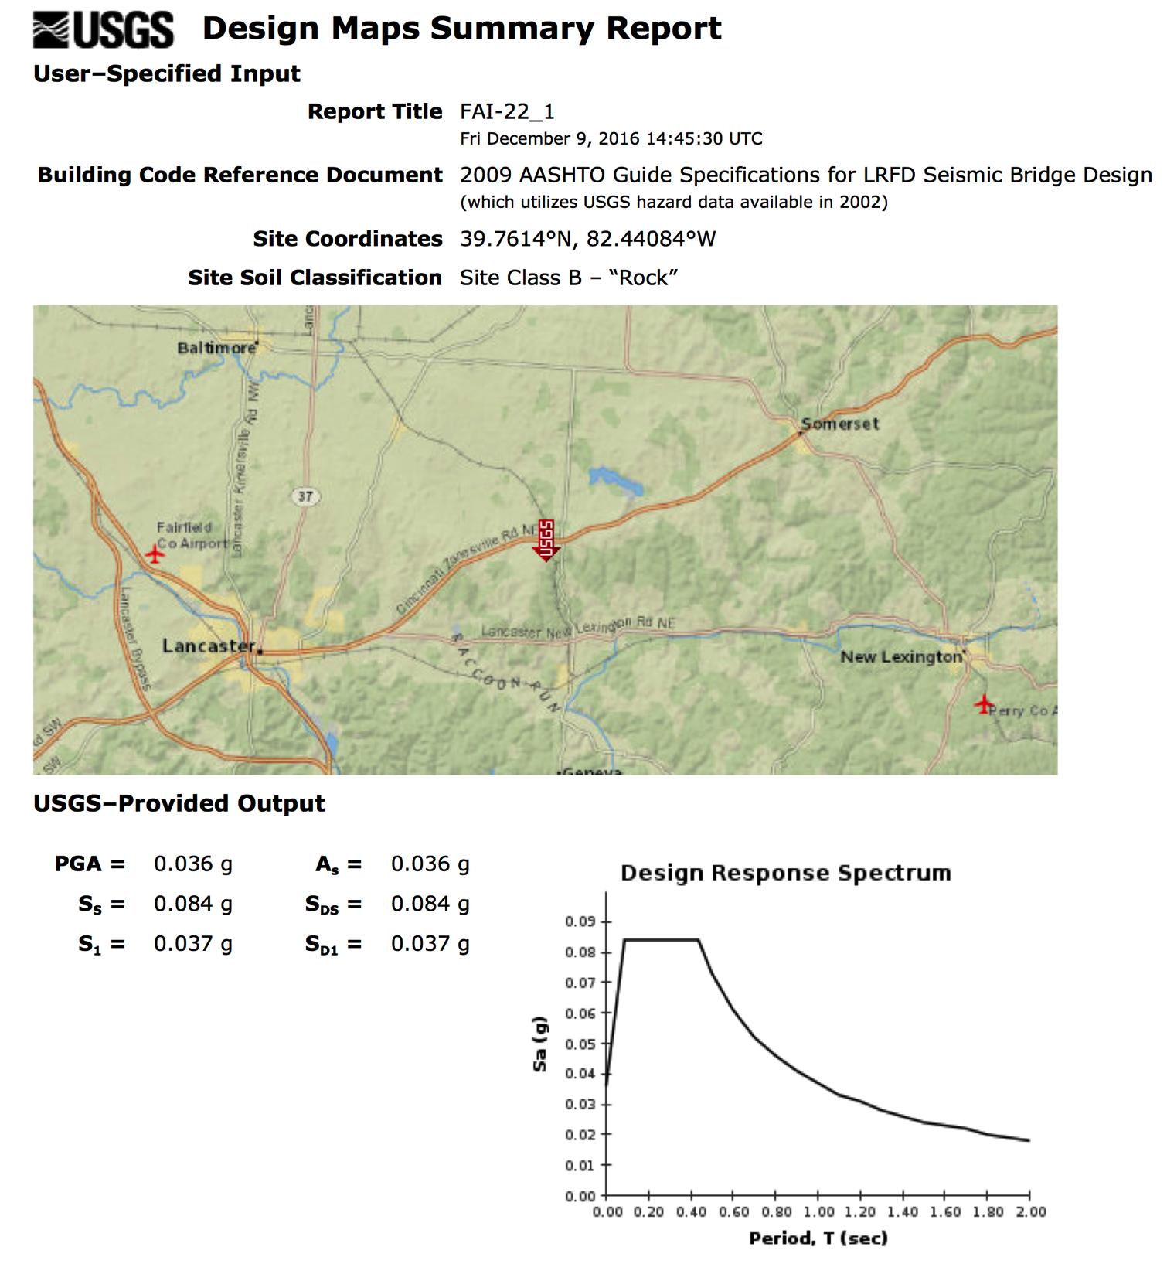

Slide 59
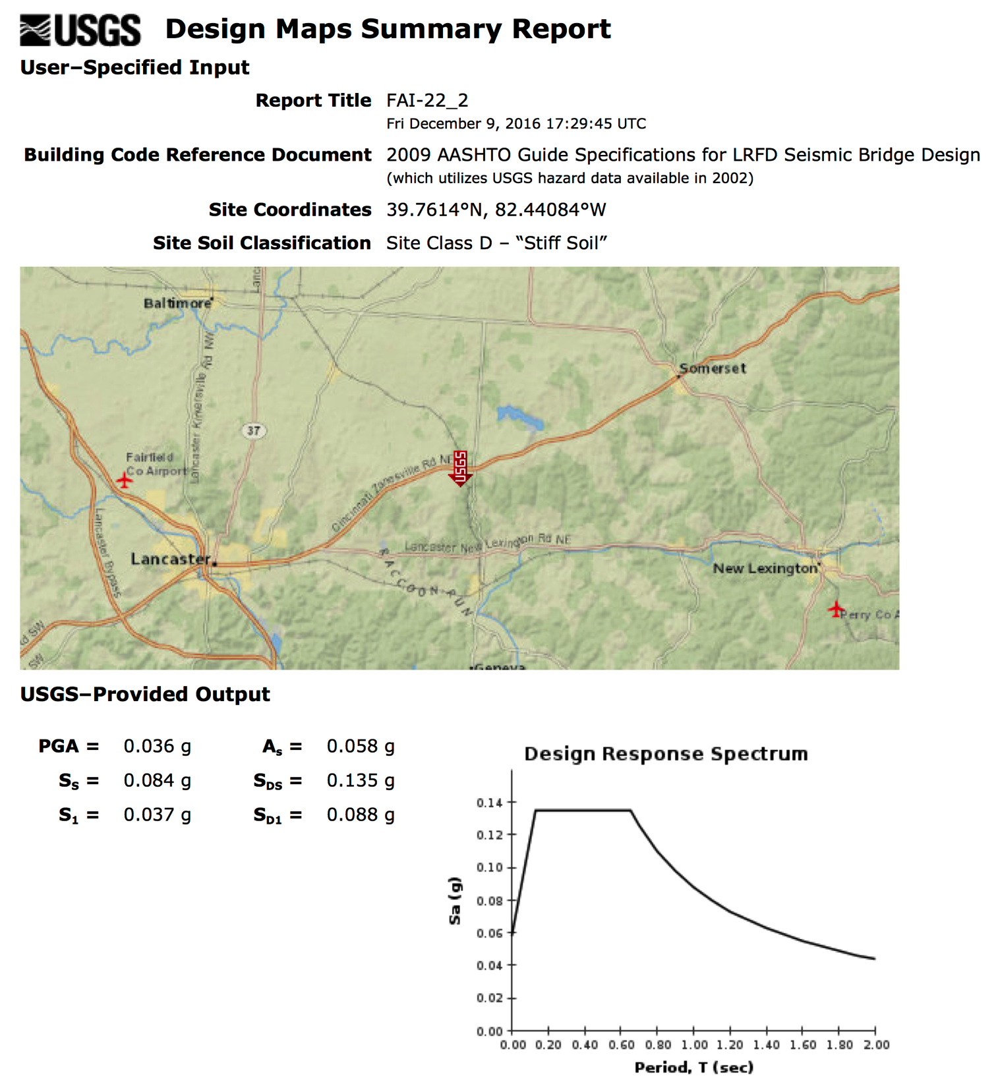

Slide 60
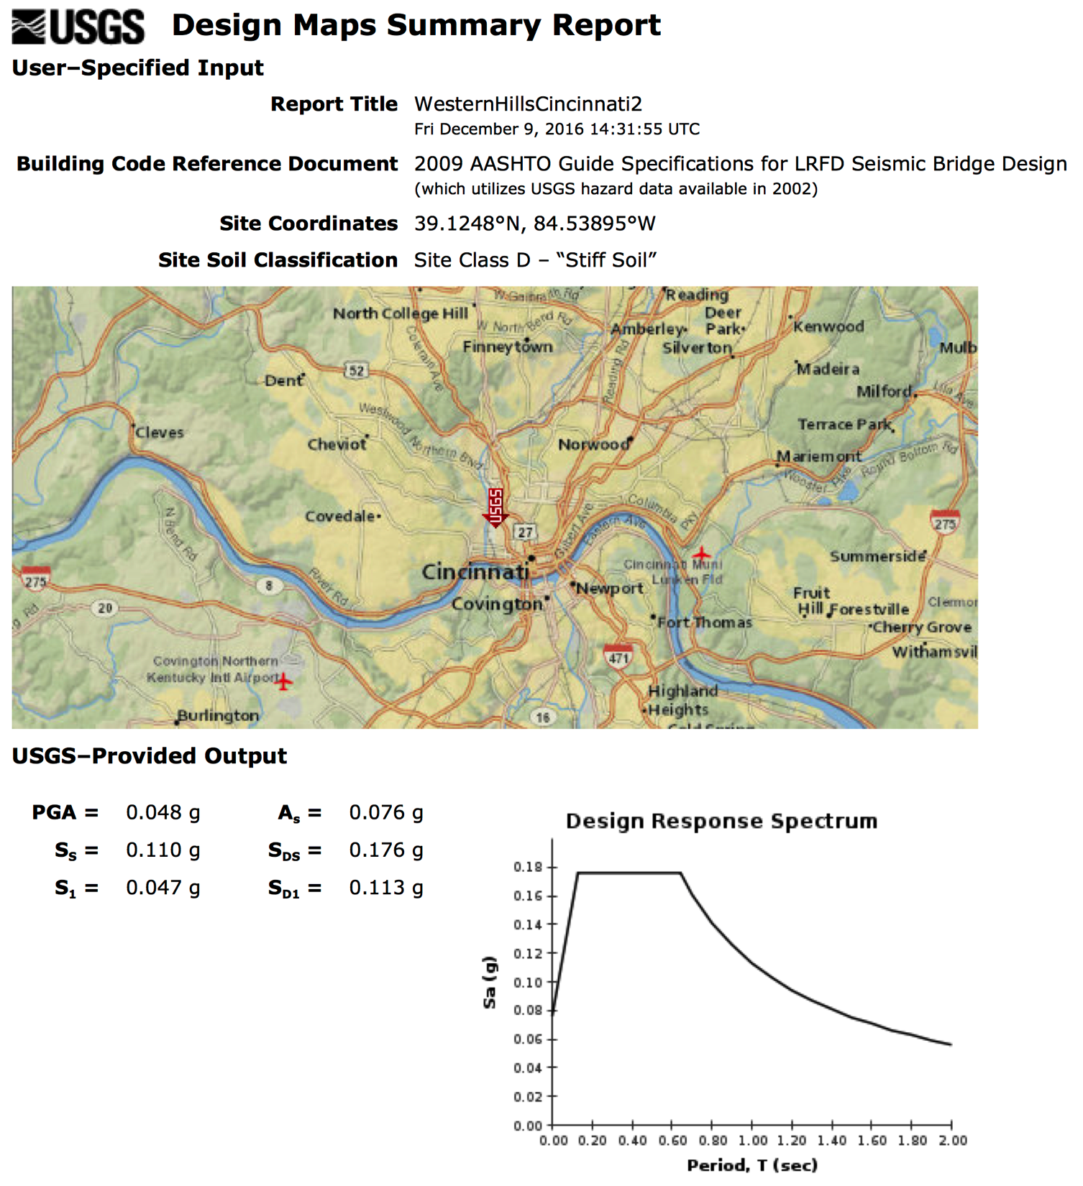

Slide 61


Slide 62
Mill Creek Crossing
Abutment – Rock (Shale)
V_{s} = 1700 ft/s
Soil Class C
Piers – soft clay – Soil Class E (AASHTO)
Soil Class D (ODOT)
Soil Class | S_{D1}
C | 0.080 | (<0.1)
D | 0.113 | (>0.1) (SPZ 1-BDM)
E | 0.165 | (SPZ 2 – AASHTO)
HAM-Western Hills Viaduct

Slide 63
What information should be provided by the Geotechnical Engineer?
In an ideal world……..
The Geotechnical Designer is responsible for providing geotechnical/seismic parameters to the Structural Engineers for their use in structural design. Specific elements include:
Design ground motion parameters
Site Response
Input for evaluation of soil-structure interaction (foundation response to seismic loading), earthquake induced earth pressures on retaining walls
Assessment of the impacts of geologic hazards on the structures

