Slide 1

Ohio’s Research Initiative for Locals (ORIL)
Research Funding for Locals
OTEC 2016
Vicky Fout
ODOT Statewide Planning & Research
Greg Butcher, P.E.
Violet Township
1

Slide 2






ORIL – What is it?
Providing real solutions to real problems… through research
Notes:
84% of OH’s center-lane miles resides w/OH’s locals
To the traveling public there is no difference between a state rt, county rd, township rd, city rd – they are all just a way for them to get around and they should be safe, reliable and efficiently maintained. – jurisdiction doesn’t matter
Research is a tool that can be used to make thing better, discover ways to be more efficient & effective
ODOT has been benefiting from research for decades, now it’s the locals turn
Program designed to provide practice-read solutions to real-world issues
For the locals designed by the locals
Concept of local-focused research has been around for a while
September 2011 Peer Exchange - Iowa (IHRB-1949), Minnesota (LRRB-1959), ODOT Research, Ohio LTAP Center, & CEAO – included focus group with various OH locals – interest was there – concept was pursed further – needed to be a collaborative approach to designing the program
July 2012 – ODOT Research received approval to move forward – reached out local organizations
OTA, CEAO, OML FHWA OH Division, LTAP, ODOT Research, & Academia working together to enhance OH’s transportation system

Slide 3
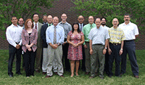
ORIL – How does it work?
ORIL Board
Organization | Voting Members
CEAO | Brett Boothe(Gallia) Bill Lozier (Licking) | Steve Luebbe (Fayette) Warren Schlatter (Defiance)
OML | Terry Lively (Marion) Paul Schmelzer (Findlay) | Leo Shanayda (Springfield) James Young(Columbus)
OTA | Greg Butcher* (Violet)
Academia | Rui Liu (Kent State University) | Eric Steinberg (Ohio University)
ODOT | Jennifer Elston (D8) Anna Kuzmich (D11) | Jack Noble (D4) Brian Olson (D4)
Non-Voting (Support) Members
ODOT Research | Ohio LTAP Center | FHWA
Vicky Fout Michelle Lucas | Mike Fitch | Frank Burkett
* Board Chair
Notes:
Explain how members are picked
Term limits – 4 years (inaugural board has staggered terms for knowledge retention)
Board responsibilities
Develop & oversee the program
Select and recommend projects for funding
Select researchers to conduct projects
Assign Technical Advisory Committees
Review progress of projects
Assess research results and implementation potential
Market the program

Slide 4


ORIL – How does it work?
Who’s bringing the checkbook?
Total Funding: $4,000,000
Over 8 fiscal years!
FY 2018-2021
FY 2013-2016
ORIL
2,000,000
ORIL
FUNDING RENEWED
2,000,000
Two million and zero cents
Two million and zero cents
Support local research during FY 2018-2021
Support local research during FY 2014-2017
ODOT Research Program
ODOT Research Program
Notes:
Seed money
Vision: ultimate goal is for ORIL to be self-sustaining
SP&R2 funds are 80% federal with a 20% match that is currently being provided by ODOT

Slide 5
ORIL – How does it work?
What has ORIL done with the money so far?
Projects: 17
Value: $2,144,861

Slide 6
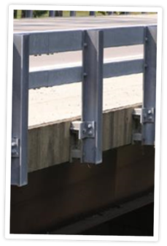
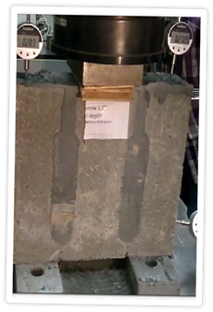

ORIL Projects
Evaluation and Design of a TL-3 Bridge
Guardrail System Mounted to Steel
Fascia Beams
  Completion Date: May 2017
Waterproofing Details of Connections
for Adjacent Precast Concrete
Box-Beam Bridges
  Completion Date: March 2017
Notes:
TL-3: FHWA approval of guardrail system that mounts to the steel fascia beam instead of the bridge deck – expected to include a retrofit – would allow for this type of connection on federally funded and credit bridge projects
Waterproofing: identify better ways to waterproof bridge decks to prevent premature ageing/corrosion brought about by water – includes looking at various grout mixes, key way joint designs, and waterproofing membranes

Slide 7
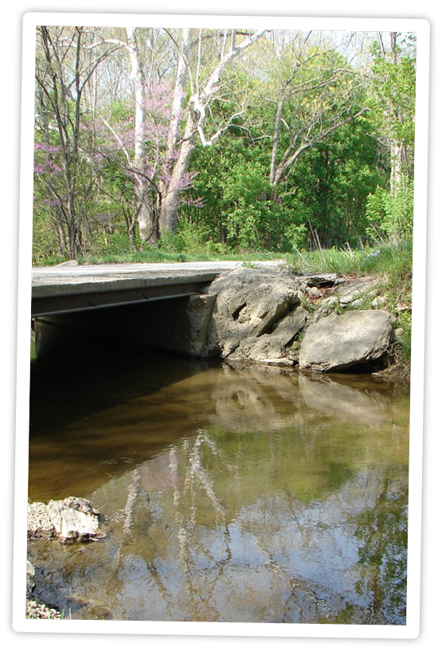
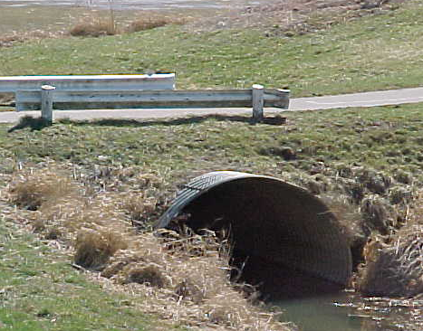
ORIL Projects
Practical Design Guidelines for
Replacement of Deficient Bridges
with Low Water Crossing in the
Rural Mid-West (Pooled Fund)
  Completion Date: May 2017
Structural Benefits of Concrete
Paving of Steel Culvert Inverts
  Completion Date: March 2017
Notes:
Low-Water: county and rural are bridges are deficient and in need of replacement- very expensive and only handful of people use the it – not a lot of scientific-based guidance on options – this pooled fund study with Kansas is attempting to develop that guidance
Steel Culvert: verify and validate the viability of the practice of poring concrete on to invert of steel culverts that has experienced material loss – provide scientific-based guidance on its proper application

Slide 8
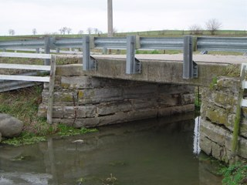
ORIL Projects
Synthesis of Research on Load Capacity of Concrete Slabs Without Plans
  Completion Date: May 2017
Inspection, Repair, Retrofit Procedures, and Design Recommendations for Non-Redundant Steel Structures
  Final Report Coming
  October 2016
Notes:
Capacity: identify simple, low-cost, reliable method for county engineers to use to evaluate the capacity of concrete slab bridges w/out plans – in-depth synthesis to identify current state-of-practice and if an establish method is available – if not then indicate future steps necessary to develop one
Non-Redundant: analyzing pony trusses in an effort to provide analytical evidence and protocols that allow for the reduction of the # of fracture crucial members requiring special arms-length inspections

Slide 9
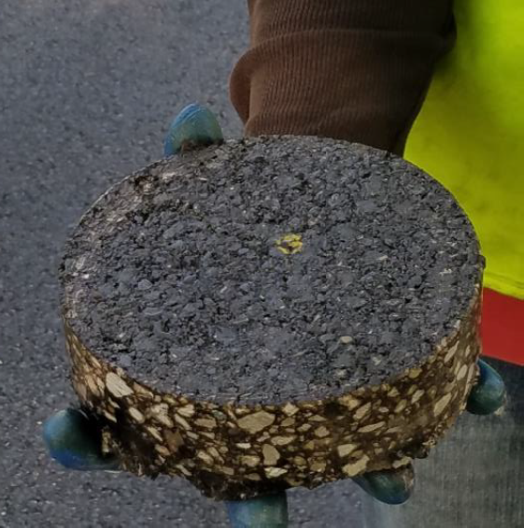
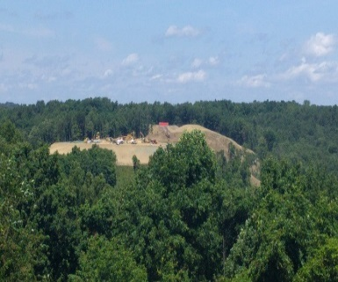
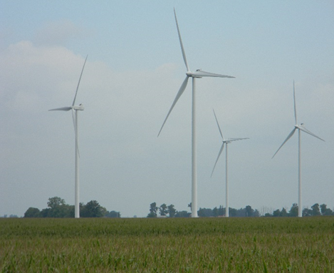
ORIL Projects
Analysis of Ground Tire Rubber in
Mix Design on Local Roadways
  Completion Date: September 2017
Best Practices of Road User Maintenance Agreements Amongst Local Government Agencies in Ohio
  Completion Date: January 2017

Slide 10
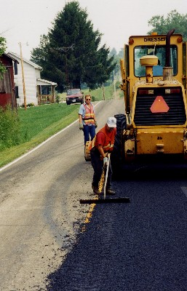
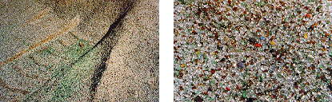
ORIL Projects
Optimizing the Effective Use of
RAP in Local Roadways
  Completion Date: October 2018
Use of Crushed Recycled Glass in Construction of Local Roadways
  Completion Date: October 2018

Slide 11
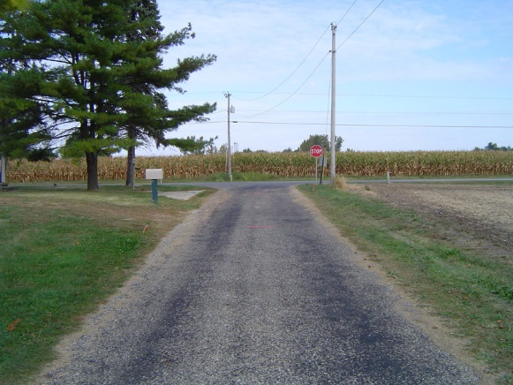
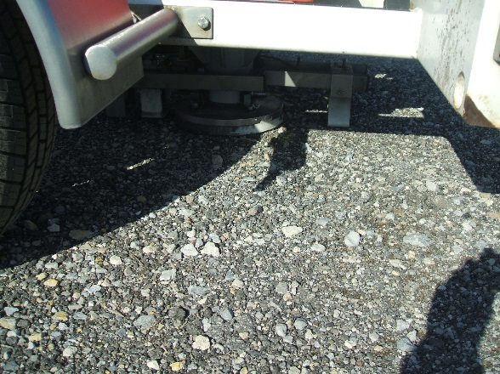
ORIL Projects
Best Practices for Chip Sealing
Low-Volume Roads in Ohio
  Completion Date: May 2018
Investigation of In-Situ Strength of Various Construction/Widening
Methods Utilized on Local
Roadways
  Final Report Available
  on ORIL website

Slide 12
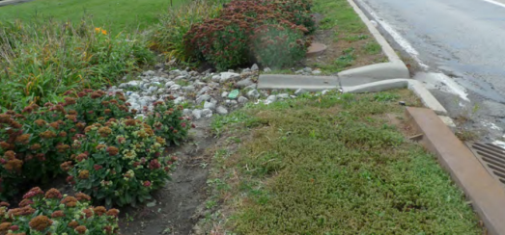

ORIL Projects
Storm Water Best Management Practices for Local Roadways
  Final Report Available
  on ORIL website
Storm Water BMP Tool
Implementation Testing
  Completion Date:
  December 2017
Notes:
BMPs: EPA requires them – ODOT L&D Vol2 manual lists them – not always applicable to local system (ROW issues, residences, business, etc.) – lot of info out there but hard to digest and sort through – developing a tool to assist locals in narrowing down the options to BMPs that are most appropriate to specific projects – developed an Excel based tool to assist in the selection process of BMPs

Slide 13
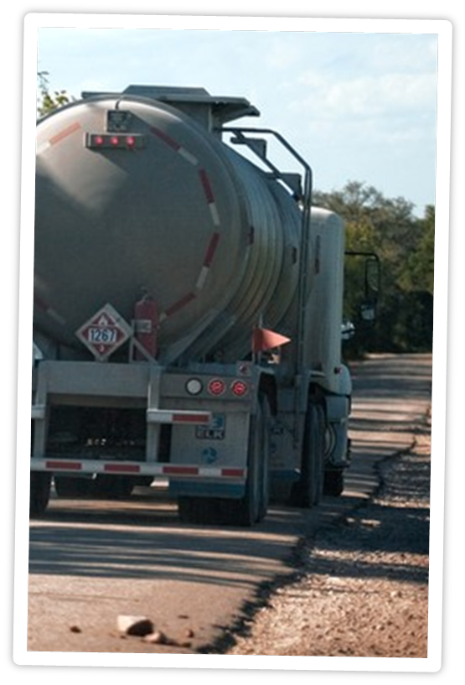
ORIL Projects
Assessment of IRP Truck Licensing
for Ohio Counties
  Final Report Available
  on ORIL website
Recommendations and Strategies for IRP Truck Licensing Impacts for Ohio Counties
  Completion Date: February 2017

Slide 14
A Local’s Perspective of ORIL
Greg Butcher, P.E.
Violet Township
14

Slide 15
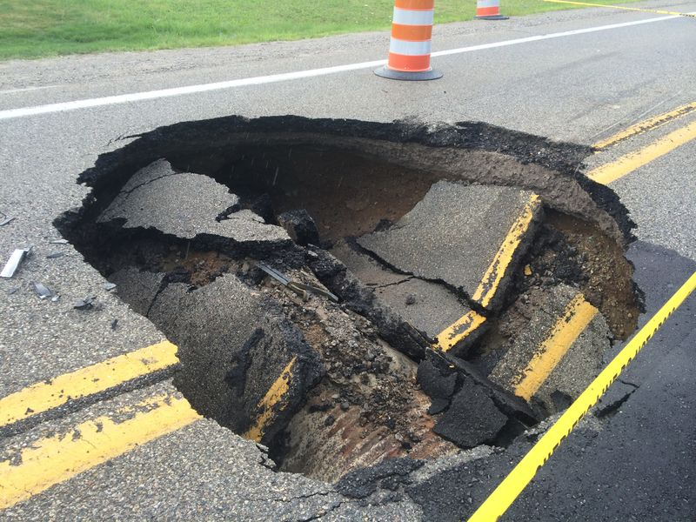
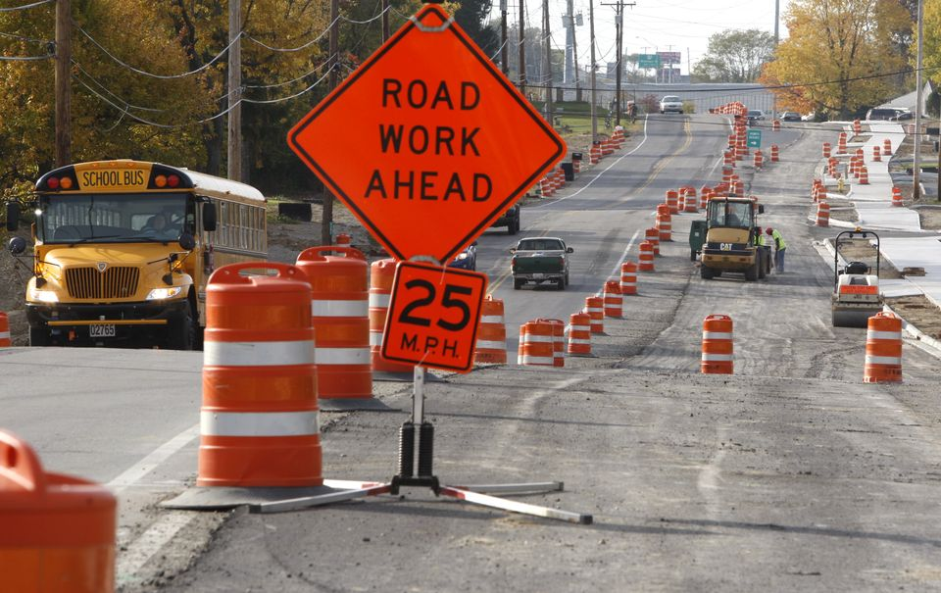


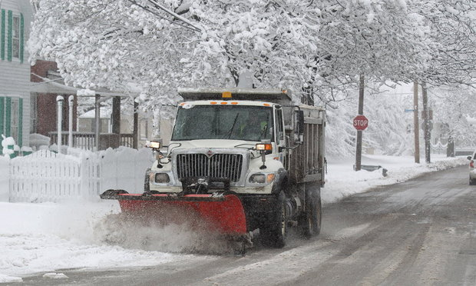

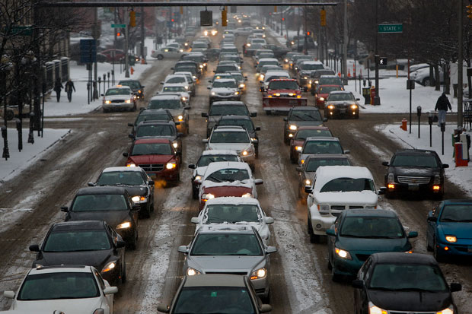
Submit An Idea!

Slide 16
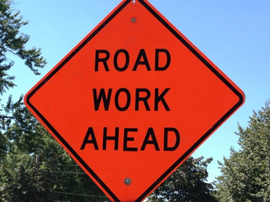
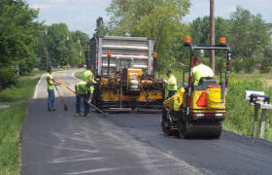
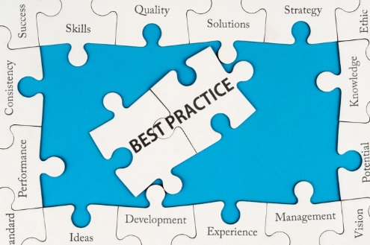
ORIL – Idea Solicitation
Strategic Research Plan 2017-2018
3 Focus Areas
    Safety
    Renewal/Infrastructure
    Operations & Business Practices
Notes:
Ideas being submitted must relate to at least one of these focus areas.
Can relate to more than one.
Don’t have to relate to all at once.

Slide 17
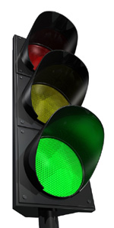
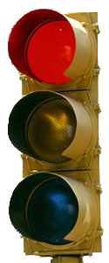
ORIL – Idea Solicitation
How does the money work?
Used for research expenses only
Contracted research projects
Funds & contracts managed by ODOT
Not for capital improvements
Not for standard maintenance activities
Not a grant program

Slide 18

ORIL – Idea Solicitation
FY 2018 Idea Solicitation is OPEN
Submit an Idea:
http://www.dot.state.oh.us/groups/oril/IdeaSessions/Pages/Research-Idea-Form.aspx
Deadline: November 4, 2016 @ 3PM

Slide 19
ORIL – Idea Solicitation

Slide 20

ORIL – Idea Solicitation
What is your problem/idea?
  Magnitude = How could it be addressed?
What is the benefit?
  Potential gain
  Potential impact
Notes:
Click #2 – what is the benefit

Slide 21
ORIL – Idea Solicitation
TAC recommendations
  Demonstrates support and need
Estimated duration and funding
  Not set in stone
  Shows how extensive/involved
Notes:
Click #2 – duration and funding

Slide 22
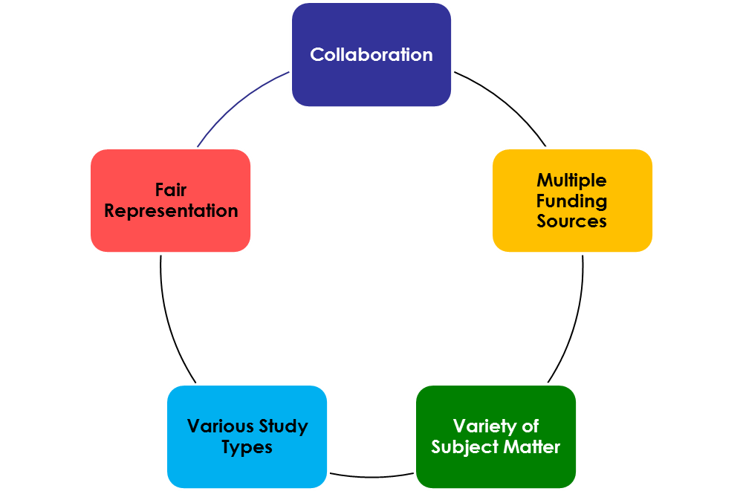

ORIL – Idea Solicitation
What happens to my idea?
Notes:
This is how the projects come to be
<click 2xs – each bullet is a separate click>
Idea submitted by locals
ORIL board selects ideas for project development
Request for Proposals are developed and solicitation issued to research community
Transportation researchers develop and submit proposals
Proposals are reviewed by TACs and the Board selects researchers to conduct the projects
Contract is negotiated then work begins
So how does the Board select it’s ideas – how is my idea going to be judged?
During selection process board strives to have a balanced portfolio

Slide 23
ORIL – Idea Solicitation
Category: | Weight | Points (Value = 0-5)
Alignment / Relevance to ORIL | 20%
Potential Benefit of Research | 30%
Potential Application / Implementability of Research Results | 25%
Champion for Project / TAC Development | 15%
General Consideration Items | 10%
TOTAL | 100%
Notes:
Alignment
Is it responsive to ORIL strategic plan?
What is the overall value of this research to ORIL’s mission and strategic direction?
Is it in the best interest of Ohio’s locals
What is the urgency?
Benefit
How beneficial will this idea be to Ohio’s locals if funded?
What kind of benefit will it produce – tangible/intangible – state-of-the-art / state-of-the-practice?
Application
What are the opportunities for success? Risk of failure?
Likelihood of producing implementable results?
Realistically how long will it take to get results?
Early payback potential?
Champions for implementation?
Who will find it relevant?
Foreseeable challenges with acceptance/adoption/use of findings?
TAC
Clear champion identified?
Can an adequate TAC be assembled?
General Items
Is problem clearly identified?
Is goal clear?
Are specific deliverables identified?
Is research likely to require assistance and can it be obtained?
Realistically how much funding will be required to do this work and is it available?

Slide 24
ORIL – Idea Solicitation
ORIL
Proposal
ORIL RFP Posted!
Notes:
This is how the projects come to be
<click 2xs – each bullet is a separate click>
Idea submitted by locals
ORIL board selects ideas for project development
Request for Proposals are developed and solicitation issued to research community
Transportation researchers develop and submit proposals
Proposals are reviewed by TACs and the Board selects researchers to conduct the projects
Contract is negotiated then work begins

Slide 25
ORIL – Idea Solicitation
ORIL Board
Oversees Program
ODOT Research Section
Manages Adminstrative Tasks
TACs
Oversees Technical Direction
Researchers
Executes Scope of Work
Notes:
Collaborative effort
3 steps in Project Execution:
1 – Project Initiation
2 – Project Management
3 – Project Closeout

Slide 26
ORIL – Idea Solicitation
Visit the Website:
  http://oril.transportation.ohio.gov
Email us:
  ORIL@dot.state.oh.us
Idea Submission Deadline:
November 4, 2016 @ 3PM
Open Discussion for Ideas & Questions
Thank You!

