Slide 1
Ohio Department of Transportation
PCC JMF SUBMITTAL FORM INSTRUCTIONS

Slide 2
The JMF SUBMITTAL FORM was developed for submitting concrete mix designs for analysis, acceptance, and ultimately the issuing a Job Mix Formula (JMF) number. It is specifically designed for the 2013 CM&S 499 - Concrete Mix Designs and for providing a more consistent and efficient method of processing the Job Mix Formula (JMF) requests. Using this form for submitting mix designs is required according to Supplement 1126, as referenced in CM&S 499.

Slide 3

ODOT Materials Management
JMF Submittal Form Home Page

Slide 4
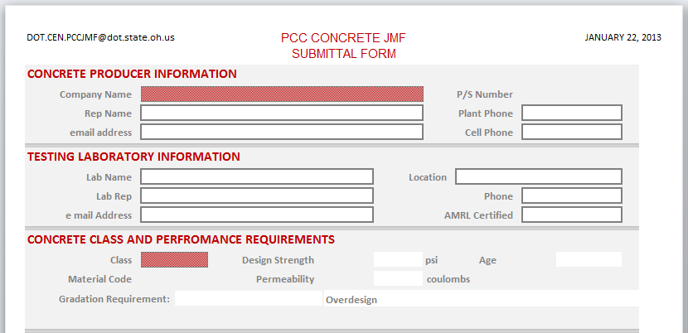
A RED cell indicates that there is a drop-down list from which to select the input. It is important that the input in these fields EXACTLY matches what is on the drop-down list to enable the form to find related information from the database.
If the drop-down list does not contain the input value that you need, that means the name or material is not in our database. This may be because the list is not up to date, a material is not certified, or it’s a special material or source that is not on any list. If the drop-down does not contain the desired value, type the value in the cell and provide an explanation in the REMARKS. OMM will follow-up as needed based on the information in the remarks.
A WHITE cell indicates that information is requested, but the user is free to fill in the information as needed.

Slide 5
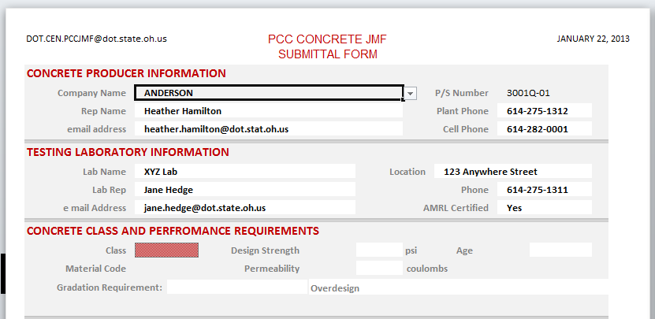

The Company Name field is a drop down menu which correlates with the P/S Number Field. After you select your Company Name, verify the correct P/S Number populated in the field. The white fields containing information above are blank text fields, allowing you to type your information directly into each field.

Slide 6
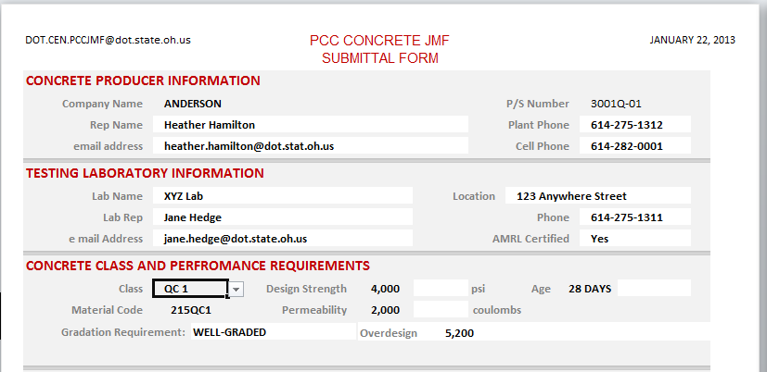
Using the Class drop-down list, select the class of concrete for the submittal. The performance requirements will be automatically displayed when the Class is selected for the following: QC1, QC2, QCMISC, QCMS, QCFS.

Slide 7
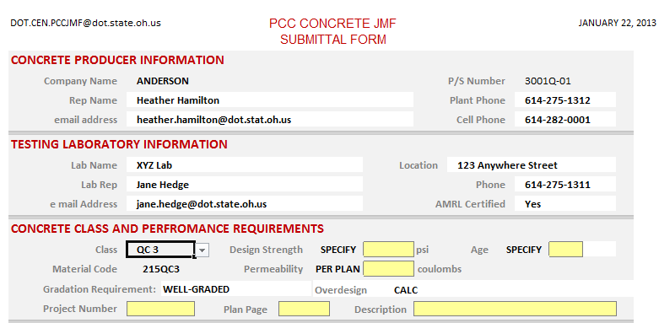

For project specific designs, QC3 and QC4, the plan requirements need to be added (required).
A YELLOW cell is either a prompt for information to be entered by the user; or an indication that the value in the cell does not meet specifications. Make sure that all yellow cells are addressed before submitting the form. Once a value is entered or non-specification issue is addressed, the yellow will disappear. If an issue cannot be resolved and the cell remains yellow, provide an explanation in the REMARKS.

Slide 8
JMF Submittal Type’s
•A NEW MIX DESIGN is simply a new concrete design developed and tested to meet the 2013 CM&S 499 requirements.
•Select the UPGRADE MIX DESIGN button when, as specified in Supplement 1126, a SS 898 QSC 1 or QSC 2 JMF is submitted for conversion to 2013 CM&S 499 QC 1 or QC 2.
•Select the UPGRADE MIX DESIGN button when, as specified in Supplement 1126, a formerly approved Class C mix is submitted for conversion to a QC MISC JMF.
•Select the MATERIAL CHANGE TO JMF button when there is a change in the cementitious, aggregate or admixture sources of an approved JMF. The type, size, grade, etc. must remain the same in order to use this option.
NOTE: When UPGRADE MIX DESIGN or MATERIAL CHANGE TO JMF is selected, the RELATED JMF cell appears in yellow. Enter the approved JMF # for which the change is being submitted.

Slide 9
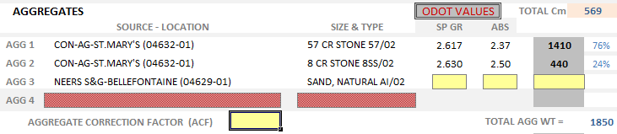
Concrete Mix Design
Aggregates
Use the drop-down list to select the aggregate Source-Location. The Size and Type drop-down is available ONLY after the Source-Location has been selected, as these are the materials that are certified for each Source/Location. The required information fields will turn yellow, Specific Gravity (SP GR), Absorption (ABS), data may be obtained from supplier if available or use ODOT’s published yearly average values.
The Specific Gravity list provides the specific gravities as well as the absorptions of the aggregates by supplier and size. This list can be found on the JMF SUBMITTAL Home Page or by the following link:
http://www.dot.state.oh.us/Divisions/ConstructionMgt/Materials/Aggregate1/2014_Specific_Gravity_list.pdf
Test the Aggregate Correction Factor (ACF) for the listed aggregate combination according to ASTM C231 and enter the value. Document the test results and submit it with the submittal package.
Note: The preferred order for listing the Aggregate materials is the order that they’re listed in the drop-down: from largest aggregate being used to the smallest size.

Slide 10
Aggregate Analysis
COMPASS is the preferred software for data analysis
  Contact OMM before submittal if different software is utilized
Submit the complete analysis, including the Coarseness Factor Chart
  Identify aggregate sources in the analysis
Submit 15 of the most recent gradations

Slide 11
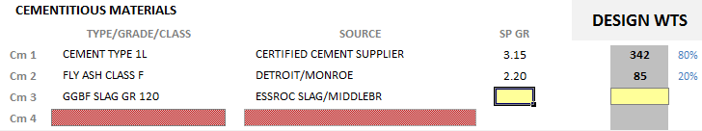
Concrete Mix Design
Cementitious Materials
Use the drop-down lists to enter the TYPE/GRADE/CLASS and the SOURCE of each material. Each line needs to be completed from left to right. Selecting the TYPE of material provides a list of SOURCES for that specific material. If a TYPE is not selected, a drop-down list for the SOURCE is not available.
Once the SOURCE is selected, you are prompted (with a yellow cell) to enter the specific gravity (SP GR) and then the design weights.
To the right of the DESIGN WEIGHT column, the form calculates the PERCENTAGE by weight of each of the cementitious materials. The form validates that the percentages are within the specification limits (TABLE 499.03-2) for each of the classes of concrete. If the percentage exceeds these limits, the cell will turn yellow with red font ( ). If this happens, make corrections as needed.
The form calculates the total amount of cementitious material ( ) and will create a “flag”
( ) if there is insufficient cementitious material according to the requirements of TABLE 99.03-1. Make appropriate changes to the amount of cement to eliminate the yellow.
Note: The preferred order for listing the Cementitious materials is the order that they’re listed in the drop-down: Cement → Fly Ash → GGBF Slag → Micro Silica → Special

Slide 12


Concrete Mix Design
Air/Slump/Water
The Design Air and Design Slump are required fields.
Design Air – A 1” Nominal Maximum Size aggregate is specified in CM&S 499 and should have a DESIGN AIR of 6.0%. If a smaller nominal maximum size of the aggregate is required by plan note or special provision, higher air content may be needed. This is a Design Air; do not enter the air “as tested”.
Design Slump - The nominal DESIGN SLUMP is limited by the requirements of Table 499.03-3. Designs using superplasticizer may go up to 6”. Designs without superplasticizer or designs specifically for slipforming will be less.
Water – Enter the WEIGHT for Water in pounds. The form will Automatically calculate the W/Cm Ratio.
Design Air 6% W/Cm Ratio Automatically Calculated

Slide 13
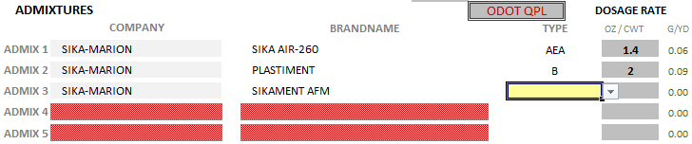
Concrete Mix Design
Admixtures
Use the drop-down list to select the Admixture Company and then select the Brandname of the product being used in the design.
The Type field will turn yellow indicating it is a required field BUT this field also has a drop-down menu. DO NOT MANUALLY ENTER TEXT INTO THIS FIELD. The QPL lists if help is needed to determine for what Type each admixture is qualified is accessed by the JMF SUBMITTAL Home Page or by following this link: http://www.dot.state.oh.us/Divisions/ConstructionMgt/Materials/Pages/QPL.aspx
Manually enter the Dosage Rate, which should follow Manufacturer's recommendations for the type certified .
Note: 6” slump is allowable when using Admixture Type F or G. Refer to the slump table in Item 499.
QPL Products with an asterisk (*) indicates that the admixtures contains chlorides>50ppm and must be approved before use
The preferred order for listing the Admixtures is the order that they’re listed in the drop-down:
AEA → A → B → etc.
Notes:
Add link to qpl

Slide 14
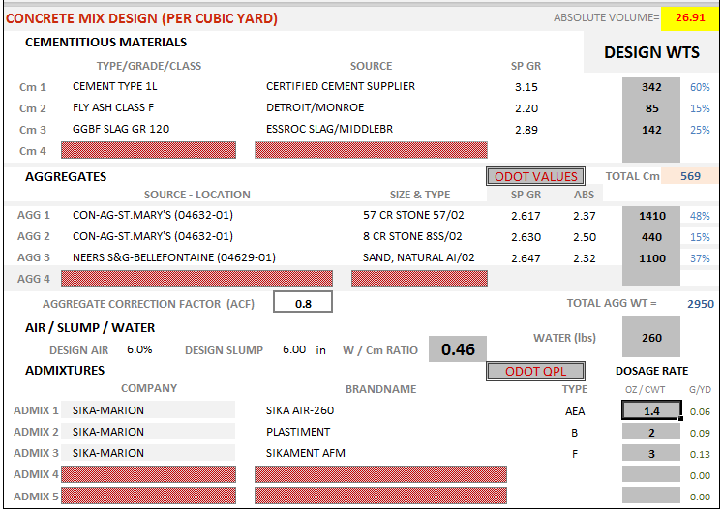
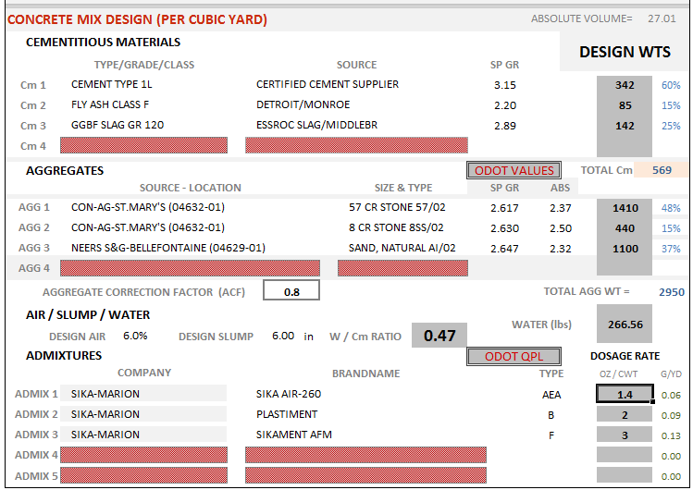
Concrete Mix Design
Absolute Volume
The form calculates the ABSOLUTE VOLUME of the mix as the material properties and weights are entered. Once all of the materials are entered, the absolute volume of the mix should be 27.00 with a tolerance of + or – 0.05, which is less than the customary 1%. Variances outside of this range will require adjustments as needed.
The Absolute Volume Field will remain highlighted in yellow until the mix volume falls within range.

Slide 15
Test Data
Indicate what type of testing was performed on the mix design required by Supplement 1126 to verify compliance with Table 499.03-1.
NO DATA
Select this NO DATA button when no strength or permeability test data is required for the submittal. Generally this is used when there is a change to a material source(s) while keeping the same mix design; and types, sizes and grades of material. If changing aggregate sources for a well-graded mix, a COMPASS analysis is necessary. There is no place on the form to input the gradation information, but a copy of the COMPASS analysis and gradation records should be attached to the e-mail.
SINGLE MIX
When a single mix is used to verify compliance to the specifications, select the SINGLE MIX button.
3-POINT CURVE
When a 3-point curve is used to verify compliance to the specifications, select the 3-POINT CURVE button.
FIELD DATA
The field test data can be used for several purposes:
Verification that a mix design meets the ACI strength overdesign requirements of a QC 1, 2, 3 or 4 class of concrete .
Tabulation of existing test results of a Class C mix for conversion to a QC MISC mix, or
Establishing a Standard Deviation for a plant in order to lower the required ACI overdesign. The Standard Deviation is specific to a plant.
This section can be used in conjunction with one of the other sections to show compliance to the strength requirements of the 2013 CM&S 499 specification.

Slide 16
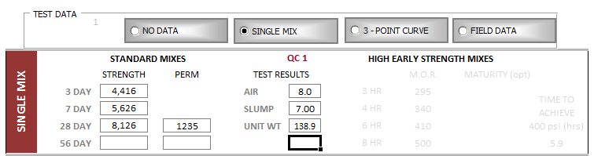
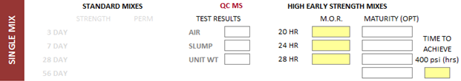
Test Data
Single Mix
The STRENGTH data should include the 3, 7 and 28 DAY results. The 28 day results are used for acceptance of the mix; the 3 and 7 day results are for information on the strength gain.
The 56 DAY STRENGTH and PERMEABILITY are available for Mass Concrete designs.
  This is not needed for other mixes, unless required by plan note.
Include the AIR, SLUMP, UNIT WEIGHT of the mix as tested.
When submitting for a High-Early Strength design (QC MS or QC FS), the right side of the form will appear. Enter the strengths at all the appropriate ages and an estimate of the amount of time that it takes to reach a Modulus of Rupture (center-point) of 400 psi at standard lab temperatures.
  MATURITY values are optional for the QC MS and QC FS mixes.
  An M.O.R. of 400 psi should be achieved within 8 hours for QC FS mixes and 28 hours for QC MS mixes.

Slide 17
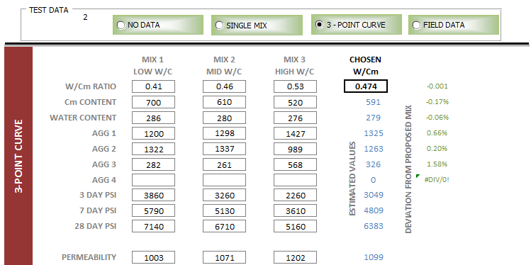
Test Data
3-Point Curve
Include the mix design information as well as the strength and permeability results for each W/Cm Ratio tested. As in the single mix, include the 3, 7 and 28 day strength results for each mix.
If 56 day strength and permeability results are used for acceptance of a QC 4 Mass Concrete design, put those results values in the 28 DAY cells, and explain in the REMARKS.
When submitting for a High-Early Strength design (QC MS or QC FS), the daily strengths will disappear and TIME TO 400 M.O.R. will appear. Likewise the TIME TO 400 M.O.R. will disappear when a non-high-early strength (QC 1, QC 2, etc.) is submitted. Enter the strengths at all the appropriate ages or an estimate of the amount of time that it takes to reach a Modulus of Rupture (center-point) of 400 psi at standard lab temperatures. An M.O.R of 400 psi should be achieved within 8 hours for QC FS mixes and 28 hours for QC MS mixes.
Once the design and test result information is filled in, determine the desired water-cementitious ratio for the mix and enter it in the CHOSEN W/Cm cell. The form will estimate the material proportions, strengths and permeability for the selected W/Cm ratio. It also compares the weights provided in the mix design (above) with the estimated values. The 28-day strength and permeability should meet design requirements; and the batch weights should be within a few percent of the estimated weights.

Slide 18
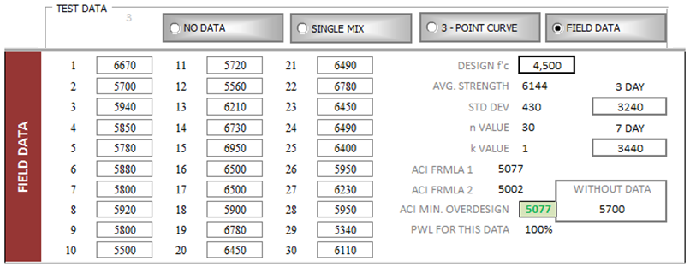
Test Data
Field Data
Enter the STRENGTH values in cells numbered 1 thru 30. At least 15 values are needed to be considered valid data, and to establish a standard deviation.
Enter the required strength in the DESIGN f’c cell (i.e. QC 1 = 4,000; QC 2 = 4,500, etc.). With the STRENGTH values and the DESIGN f’c values entered, the form will calculate:
  The AVG STRENGTH and the standard deviation (STD DEV) of the strength values entered.
  It determines the ACI MINIMUM OVERDESIGN based on the DESIGN f’c and the STD DEV according to formulas in ACI 301, sect 4.2.3.3. The overdesign value will turn green if the average strength exceeds the required overdesign. Data submitted should be from one plant; proof the standard deviation (equal to or lower than the data submitted) from other plants will need to be determined before approving the design for use at other plants. Include this information in the body of the email and attach supporting data.
  The ACI overdesign strength requirements WITHOUT DATA is also provided so that this value can be compared to the value with data. If the WITHOUT DATA value is lower than the value calculated using the data, one may want to choose to not use the data for acceptance. The quality control of the plant should be reviewed however.
  The percent within limits, PWL FOR THIS DATA, is calculated. This value can be used when submitting data for a QC MISC mix design. According to Supplement 1126, historical ODOT data needs to comply with an 85% within limits.

Slide 19
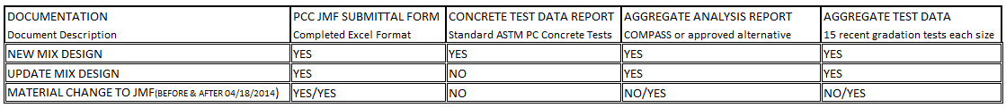
Preparing your
JMF Submittal
Subject Line of Email
  Description of Mix Design
  Supplier Name if submitted by Test Lab
Email Contents
  Attach PCC JMF form (saved in Excel file)
  Attach supporting documentation
Notes:
Yes/No?

Slide 20
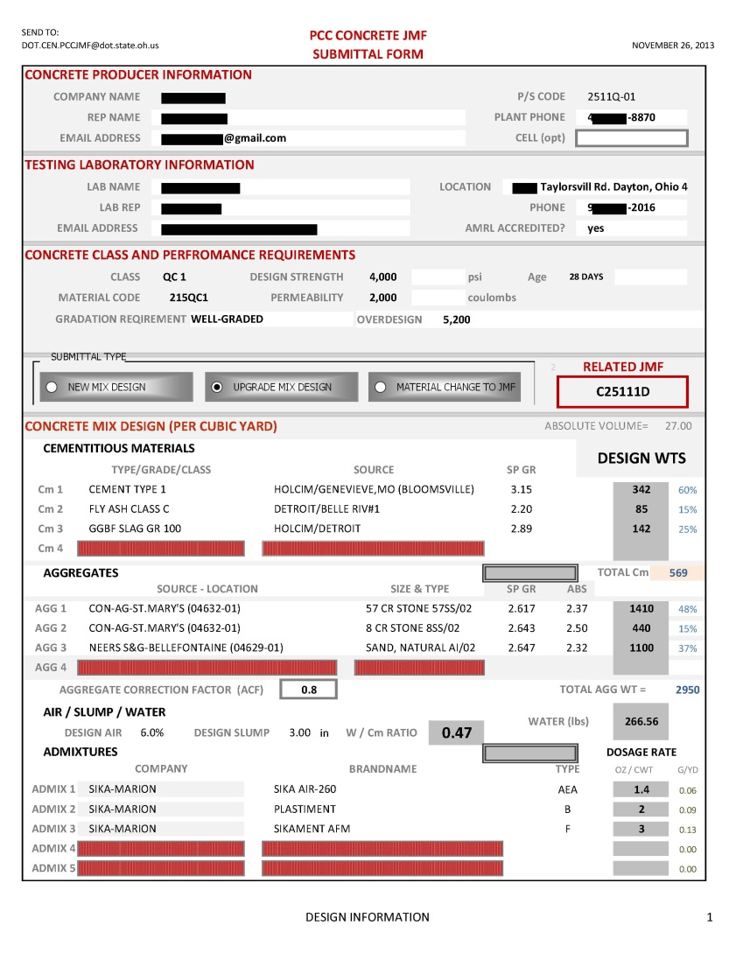
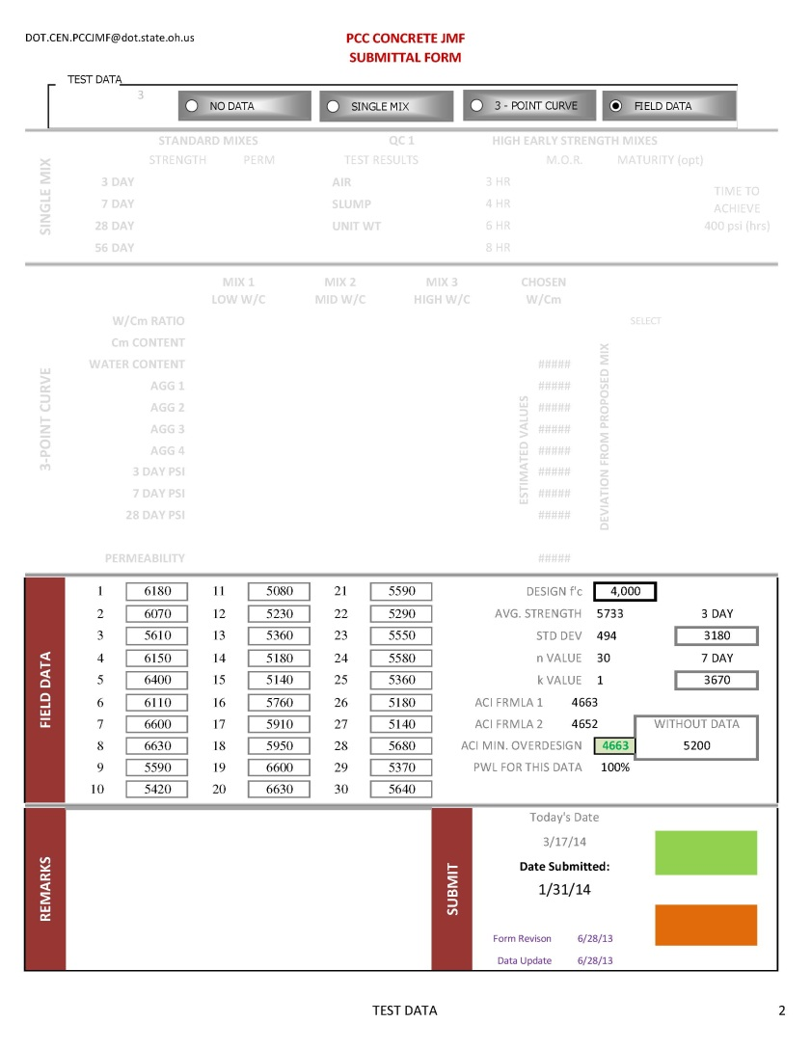
Completed/Approved JMF Form

Slide 21
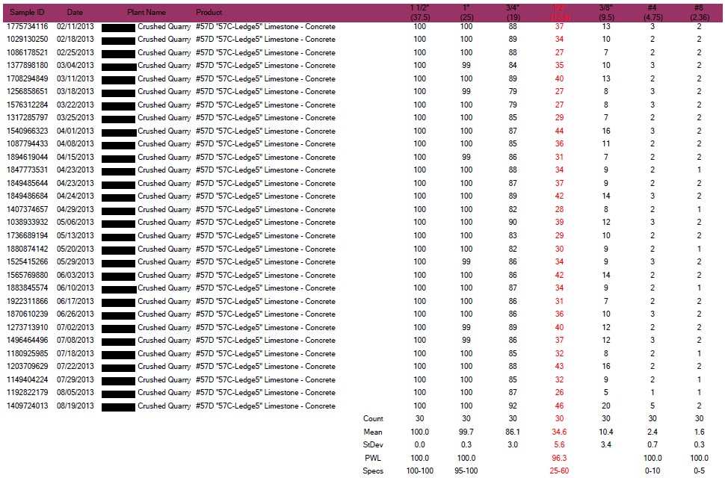
Percent within Limits (PWL)
Required with JMF Submittal Package
Notes:
Easier to read and understand than the next slide? Keep this one? Both?

Slide 22
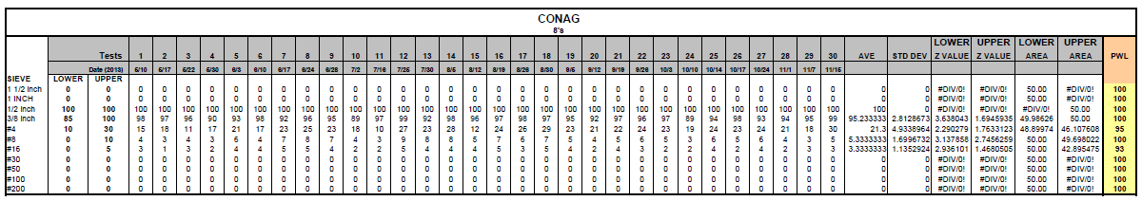
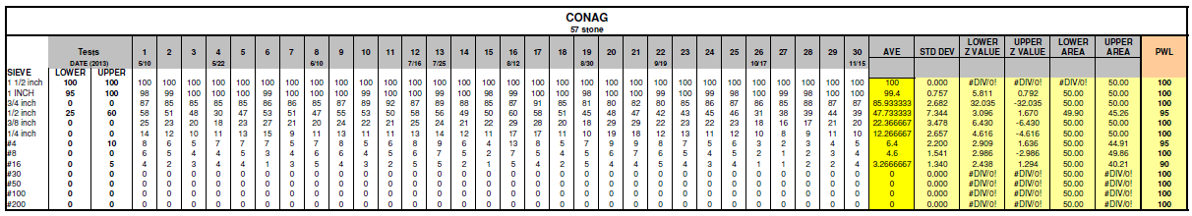
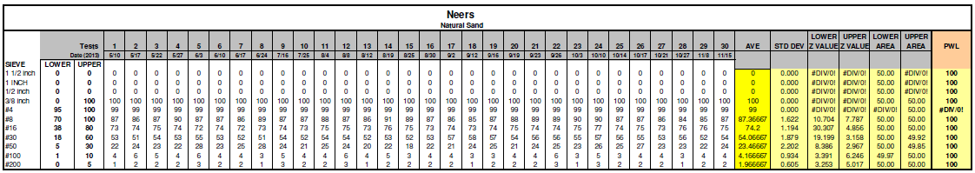
Percent within Limits (PWL)
Required with JMF Submittal Package
Examples shown are 8’s, 57’s and Natural Sand

Slide 23
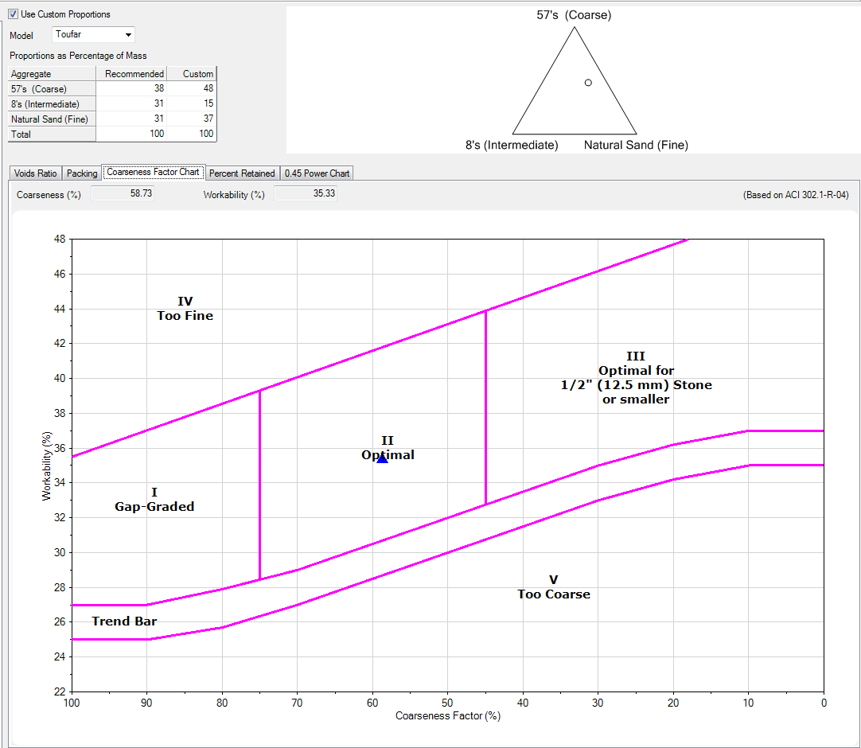
COMPASS-Aggregate Analysis Program
Required With JMF Submittal Package
Coarseness Factor Chart (shown below)
Note:
COMPASS software is preferred. The complete 9 page report must be submitted in either a .pdf or .cmpgrd file
If COMPASS software is not used, contact Materials Management prior to submittal.
Notes:
Should this slide be deleted since we have the Aggregate Analysis Report with the chart included?

Slide 24
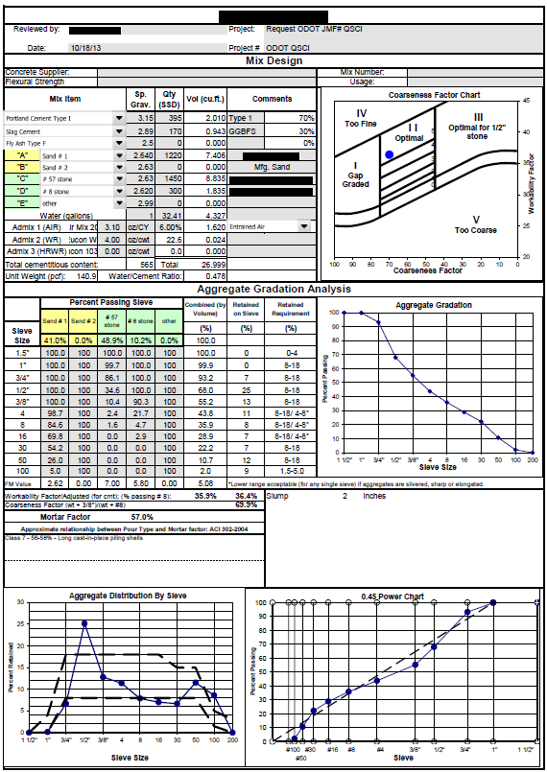
Alternative
Aggregate
Analysis Report
Required With JMF Submittal Package
Note: If COMPASS software is not used, contact Materials Management prior to submittal.

Slide 25
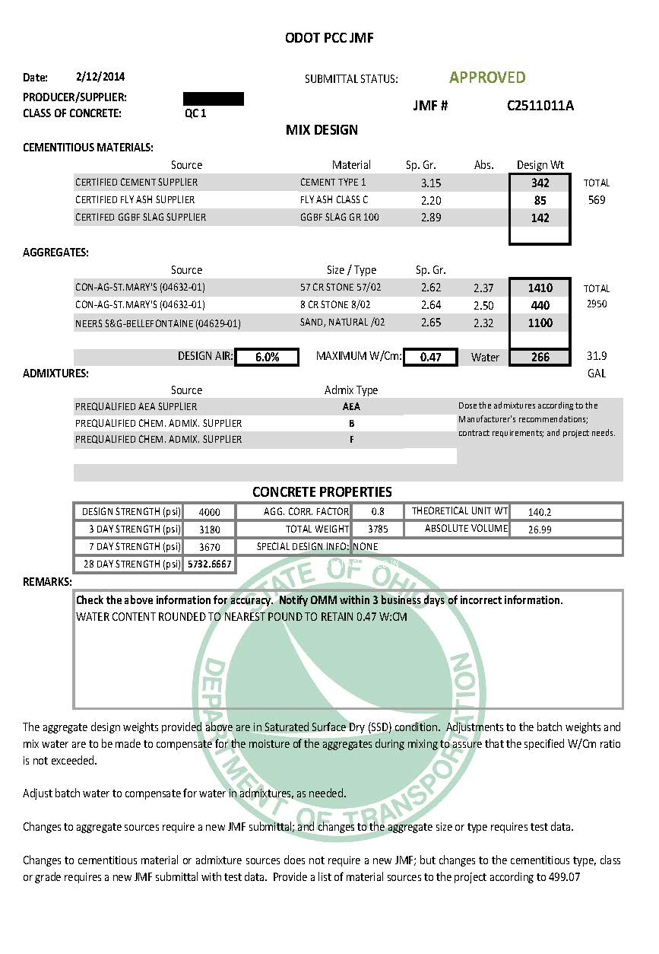
ODOT Approval of JMF Submittal

Slide 26
Helpful Links & Email
PCC JMF Website (JMF Submittal Form and Instruction, Supplement 1126, Specific Gravity, QPL)
http://www.dot.state.oh.us/Divisions/ConstructionMgt/Materials/Pages/JMF-SUBMITTAL-FORM.aspx
COMPASS (Computer-based guidelines for paving concrete optimization)
http://www.pccmix.com/
Submitting mix designs or inquiring on their status
DOT.CEN.PCCJMF@dot.ohio.gov

Slide 27
Questions???
Daniel Miller (614) 275-1325
daniel.miller@dot.ohio.gov
Klaire Mason (614) 275-1326
klaire.mason@dot.ohio.gov
Amir Tehrani (614) 275-1397
amir.tehrani@dot.ohio.gov

