Slide 1
SiteXchange (C-92)
Tina Collins
Office of Contracts

Slide 2
Items for Discussion
Terms: SiteXchange, C-92, Request for Sublet
What is SiteXchange? Why Change?
Timelines: How long using SiteXchange?
What everyone needs to know
Prequalication checks, subcontracting limits
Tie-in with SiteManager
Old projects, already running in CMS
Feedback to date
SiteXchange in action
Notes:
Run through list of items for discussion

Slide 3
Terms to know
SiteXchange: software package
Prime contractor use
C-92 (Request for Sublet): hard copy form for submission of subs
Get used to these terms
Use them interchangeably
Like EBS, Online Bidding & Expedite
Notes:
SiteXchange is available for download and use by prime contractors for submission of C-92s.
Use the terms C-92, SiteXchange and Request for Sublet interchangeably.

Slide 4
SiteXchange? Why change?
SiteXchange is another AASHTO product
Expedite, SiteManager
Written on same platform as Expedite
Online bidding software
Familiar interface
Old process manual, antiquated
Time savings for contractor and department
Notes:
SiteXchange is software program that utilizes the same interface as Expedite. For those of you that do not know what Expedite is, Expedite has been used to submit bids by primes since the mid-90’s with online bidding use Expedite and Bid Express for the past 6 years.
Familiar interface makes getting up to speed quick in most cases. Dan and Diane spend quite a bit of time walking contractors through use if necessary.
As with most manual to electronic implementations, reduction of errors should be an immediate realization. Time savings is also a benefit and already being realized.

Slide 5
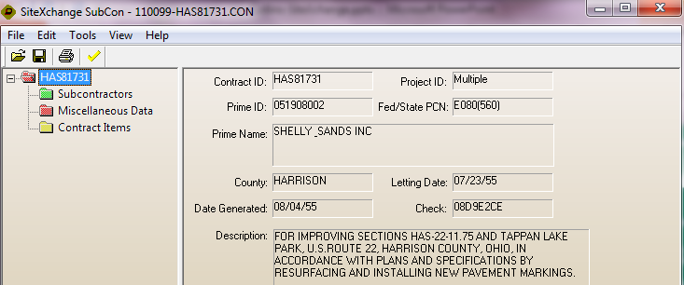
Look and Feel
Notes:
When you open the SiteXchange file it should look very familiar to those who have bid with ODOT. The first screen has general project information and some folders.
To add a subcontractor right-click and click add subcontractor.

Slide 6
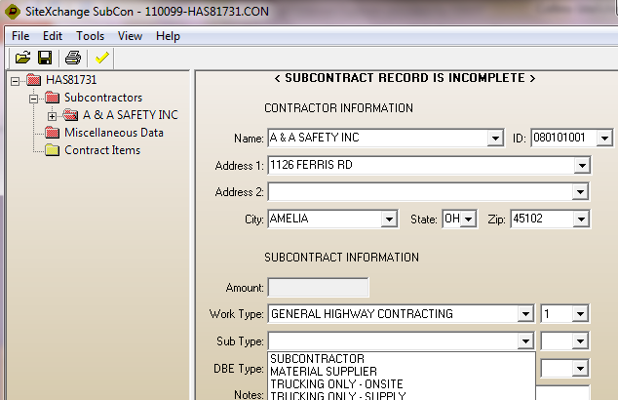
Look and Feel
Notes:
Select contractor, work type, DBE type and subcontractor type of work. This would be where trucking versus consultant versus materials supplier would be indicated.

Slide 7
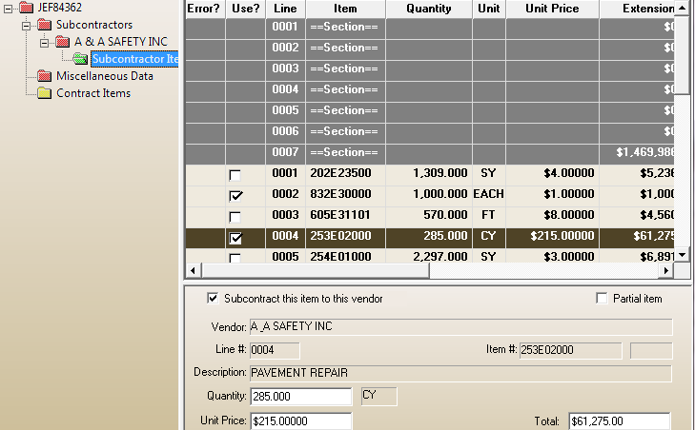
Look and Feel
Notes:
Check items to subcontract.

Slide 8
Timelines for SiteXchange?
Last spring started process
Processes defined, prequalification checks coded
Late summer, early fall did training
September, sending out files to prime contractors
Notes:
Started working with Diane who processes all C-92s currently last spring. Diane has some pretty stringent requirements and part of the point of making the move is to eliminate re-entering C-92 data to save time, be more efficient and eliminate errors.

Slide 9
Dollar Verification
Wrote interface to load SiteXchange file, then do prequalification checks
Ensure contractors under prequalification dollar amounts
Subcontracting limits
DBE/EDGE Goals
Notes:
Diane receives SiteXchange files from prime contractors and loads the file. Interface checks for errors.
Checks prequalification limits.
Checks subcontracting limits, under $500,000 as well as DBE and EDGE thresholds.

Slide 10
Workflow
Project is awarded
SiteXchange files created within 48 hours of award
Email sent to prime contractor
Timing aligns with contract for signature email
Notes:
Upon project award prime contractors will be sent email notification at the same time contract is sent.
Within 48 hours of award, prime contractors will receive another email with SiteXchange files.
Currently SiteXchange files are being emailed. Will be switching to sending a link so files can be downloaded at any time by the prime. This helps avoid any issues with SPAM filters or email messages getting missed.

Slide 11
More Workflow
Contract is signed
Subcontract agreements submitted
C-92/SiteXchange file submitted
Prequalification checks performed
Errors corrected
Notes:
A few different things are happening in the same timeframe with contracts being signed, subcontract agreements submitted and C-92s being submitted and approved.
Upon receipt of SiteXchange files, prequalification checks are being performed.
Subcontracting limits and DBE/EDGE thresholds performed.
Any errors corrected by Diane who will contact prime contractor to work through any issues.

Slide 12
Workflow
Project is loaded into SiteManager and keyed into CMS
Data from SiteXchange file used to populate reports on contracts web page
Approved subcontract notification sent to prime
Process repeated upon submission of additional subs
Notes:
Currently only a small subset of projects are being loaded into SiteManager. On those projects the SiteXchange data is loaded directly into SiteManager.
For CMS, project data is keyed by Diane.
Subcontract data on Contracts web is updated nightly. One file per project with links to subcontract agreements.
While it might seem like this is many steps, loading SiteXchange files and performing the checks only takes a few seconds given there are no issues.

Slide 13
Subcontract Agreements
Used to indicate how prime is going to meet project goal
Submit materials suppliers, consultant and trucking services with purchase order
Notes:
Currently PN 046 contains subcontract agreement requirements. The prime contractor must only furnish to the Department subcontract agreements from the DBE subcontractors with whom they propose to utilize to fulfill the project goal.
For materials suppliers, consultant and trucking services the C-92 needs to be submitted with the purchase order. These items do not count against prequalification or subcontracting limits such as onsite trucking and subcontracts for work and should not be submitted separately.
C-92s must be submitted prior to the DBE commencing work. At the time of submission of the C-92 the DBE subcontractor must have sufficient dollar and work type qualifications to perform the work.

Slide 14
Site Manager
While interfaces with SiteManager, not entirely dependent
Currently using with and without SiteManager projects
Notes:
Only running about 40 or so projects in SiteManager right now. Another 35-40 being added this construction season.

Slide 15
Old Projects
Getting requests to create SiteXchange projects on active projects
Possible to do, missing extra work items
Notes:
I have been creating SiteXchange files for currently active projects that are running entirely through CMS.
Any extra work items would be missing as the projects are not in SiteManager. Still working through this to see if can come up with a solution.

Slide 16
Feedback To Date
Positive feedback so far
Worked out kinks in process
Getting pretty much all new projects via SiteXchange
Notes:
Overall we are getting positive feedback. Contractors that use SiteXchange one time want to keep using it.

Slide 17
What everyone needs to know
Full instructions on contracts web site
Also sent via email
Two files, SiteXchange file (110099-HAS81731.CON) and vendor.bin file
Notes:
To start download SiteXchange file into directory (such as c:\siteXchange)
SiteXchange files will have a .CON extension and named with project number-county and pid combination
Make sure vendor.bin file is in the same directory with the SiteXchange file

Slide 18
What everyone needs to know
Change does impact both contractors as well as districts
Overall different look and feel
Instead of scanning actual C-92, data from SiteXchange files used on web
Data or report you would like to see just let me know
Notes:
Looks totally different which has been a little bit of an adjustment.
If something you are used to having in the scanned C-92, let me know and we’ll get it added to the new reports.

Slide 19
Future considerations
Working on automating approval notification
All projects will be ran through SiteManager
Notes:
Started working with Diane who processes all C-92s currently last spring. Diane has some pretty stringent requirements and part of the point of making the move is to eliminate re-entering C-92 data to save time, be more efficient and eliminate errors.

Slide 20
Questions????
Tina Collins
Tina.collins@dot.state.oh.us
614-466-2314
Or
Dan stacy
Dan.stacy@dot.state.oh.us
614-466-2314
Notes:
Or you can always call Diane

Slide 21
Thank You
Diane Hupp
Prequalification
614-466-2824
Contracts.c92@dot.state.oh.us
Notes:
Started working with Diane who processes all C-92s currently last spring. Diane has some pretty stringent requirements and part of the point of making the move is to eliminate re-entering C-92 data to save time, be more efficient and eliminate errors.

