Slide 1
HAM-75-7.85 (PID 77889)• March 31, 2022
Notes:
Meeting is being recorded.
Please hold all questions until the end of the presentation.

Slide 2
HAM-75-7.85 prebid meeting
Stephanie Otten, P.E.
ODOT Project Manager

Slide 3
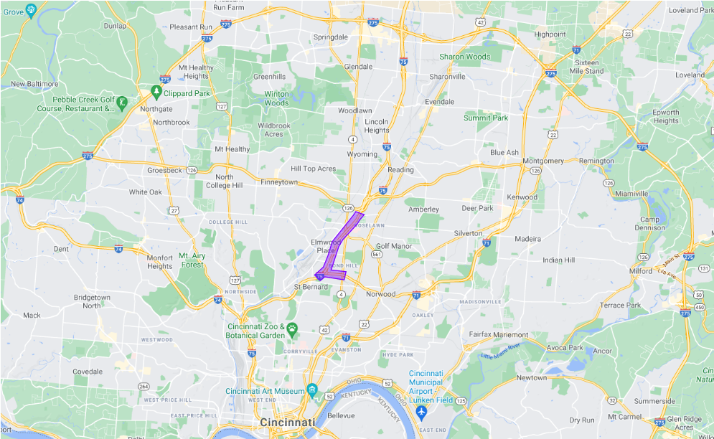
Project location
HAM-75-7.85
PID 77889
Project Location

Slide 4
Project manager & engineers
Stephanie Otten, P.E., Project Manager
Joe Smithson, District Design Engineer
Scott LeBlanc, District Construction Engineer
Kelly Wessels, P.E. Construction Area Engineer
Sam Beyer, P.E., Construction Project Engineer
Abby Cueva, P.E, EMH&T Designer’s Project Manager

Slide 5
overview
Intent
Bring to attention aspects of the project that are unique.
All information presented can be found in the construction plans.
Agenda
Pump Station
Railroad Bridges
Structures
Geotech
Real Estate
Notes:
The purpose of this meeting is to go over certain aspects of the project that we’d like to bring to your attention.

Slide 6
Pump station
Heath Brendlinger, P.E.
EMH&T Roadway Lead

Slide 7
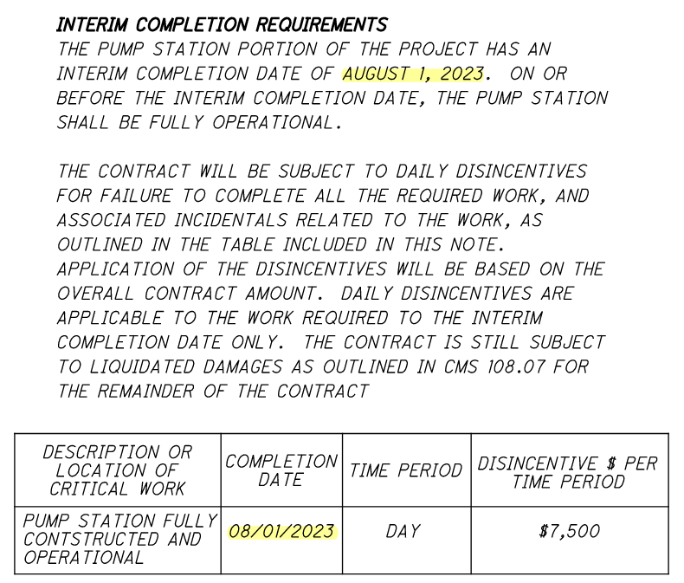
Pump station
Proposed Pump Station
Lead times for pumps – 28-30 weeks.
Interim Completion Date: August 1, 2023.
Sheet 59
Notes:
The project includes a pump station that will be constructed in Phase 1 of the project which will convey drainage north to the Mill Creek.
The interim completion date note on sheet 59 indicates that the pump station portion of the project shall be fully constructed and operational by August 1, 2023.

Slide 8
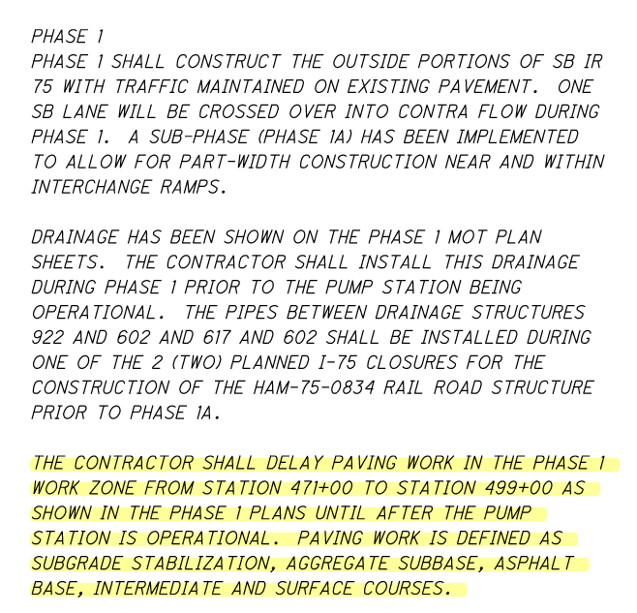
Pump station
Minimize impacts to MSD CSO.
Sheet 59
Notes:
As indicated in the plan note on sheet 59, paving of the Phase 1 MOT cannot occur until after the pump station is operational.
The restricted paving is from Sta. 471+00 to 498+00
“Paving” will include subgrade stabilization, subbase, and asphalt base, intermediate and surface courses.
The paving restriction is done as part of an effort to reduce storm water runoff to combined sewers during construction.

Slide 9
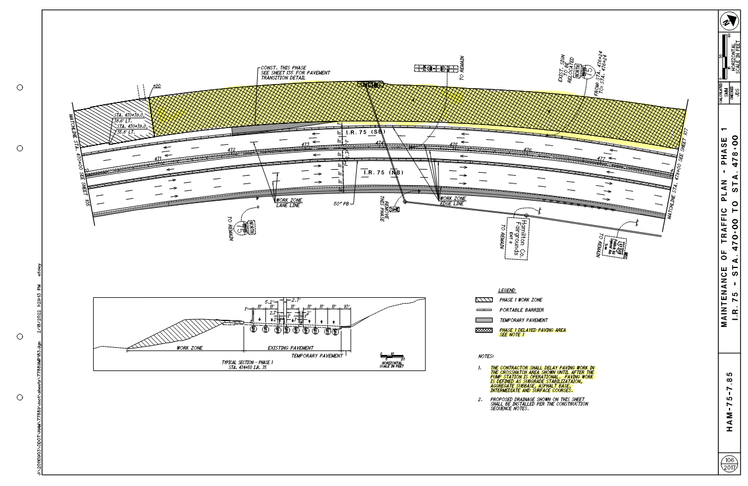
Pump station
Minimize impacts to MSD CSO.
Sheet 106
Notes:
The MOT phasing plans depict the restricted paving areas with a cross hatch pattern.

Slide 10
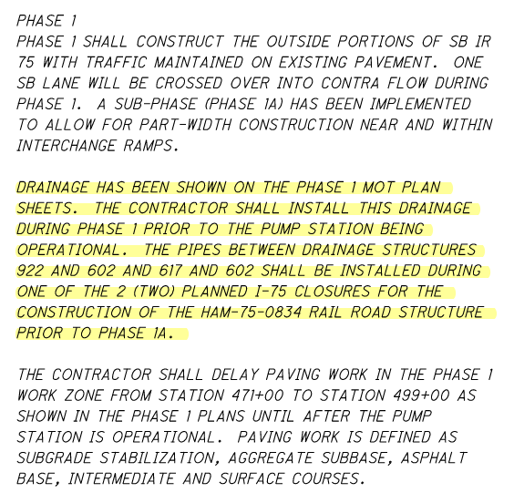
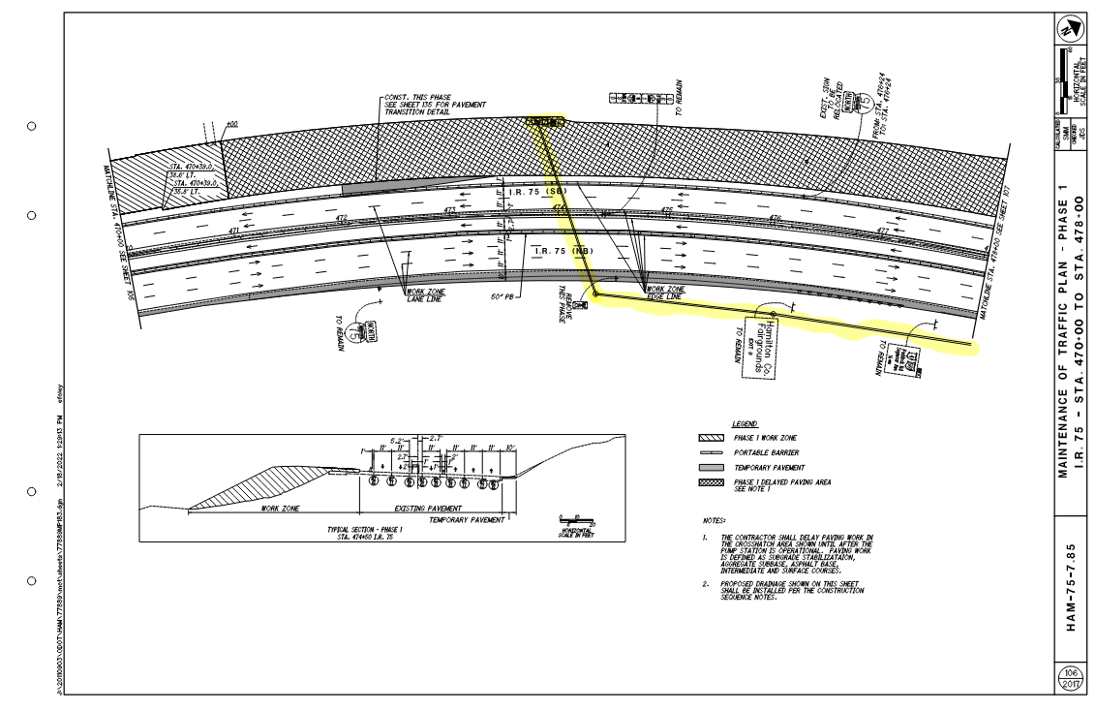
Pump station
Temporary Drainage
MOT Phasing shows drainage constructed in each phase.
Sheet 59
Sheet 107

Slide 11
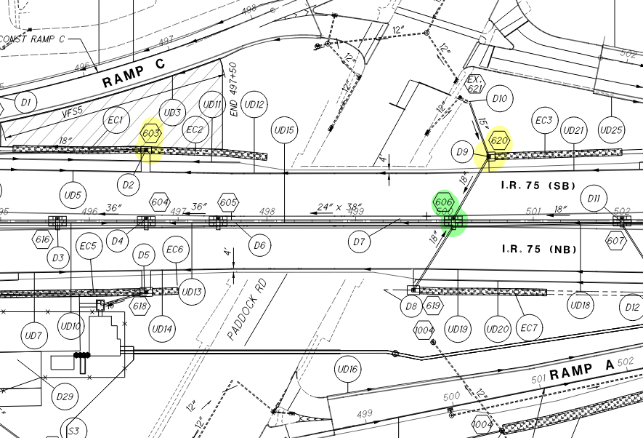
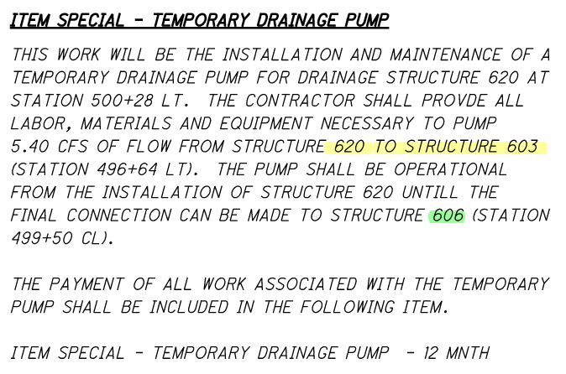
Pump station
Temporary Pump
Sheet 39
Sheet 816
Notes:
There is a drainage structure near Paddock Road that will need to be temporarily pumped until the final drainage connection can be made in Phase 2.
The plan note on sheet 39 describes that drainage structure 620 will need to be pumped to structure 603 (both shown in yellow) until the final connection can be made to structure 606 (shown in green)
The note details the size, location, and duration in months.
A pay item for this work is included in the general summary.

Slide 12
Railroad
Abby Cueva, P.E.
EMH&T Project Manager

Slide 13
Railroad - Norfolk southern
HAM-562-0026
Construct part width while maintaining rail traffic.
Track work to be done by Norfolk Southern crews.
Pre-Phase A Track Removal.
Post-Phase B/Pre-Phase C Track Const.
Notes:
The HAM-562-0026 Norfolk Southern bridge over SR 562 (Norwood Lateral) will be constructed part with while maintaining rail traffic. In summary, there are 4 phases to the construction of the bridge:
A. Remove east side
B. Construct east side
C. Remove west side
D. Construct west side
Norfolk Southern will be completing track work with their own crews. Two time frames to be aware of are the track removal on the east side of the bridge, and the track construction on the newly constructed east side of the bridge.

Slide 14
Railroad - Norfolk southern
HAM-75-0834 & Prosser
Bridges are constructed offline.
Lack of splices in girders in 0834 bridge. Consider shipping and crane size.
Preloading of RR embankment with settlement platforms.
Prior to the demo of existing bridge, NS crews relocate tracks.
Notes:
The HAM-75-0834 Norfolk Southern bridge over I-75 will be constructed offline while maintaining rail traffic on the existing bridge.
Due to a lack of splices, the girders are very long. Consider shipping and crane size.
Railroad embankment shall be preloaded with settlement platforms.
Before the existing bridge is demolished, Norfolk Southern crews will relocate tracks onto the new bridge. This schedule will drive when I-75 phasing can switch.

Slide 15
structures
Craig Schrader, P.E.
EMH&T Structures Lead

Slide 16
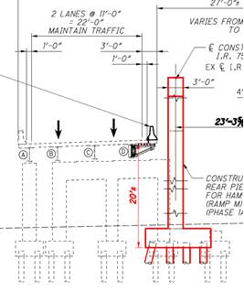
Structures
HAM-75-0791
Phase 1
Temporary deck cantilever support.
Sheet 1340 (8 of 57)
Notes:
As shown on this slide, a temporary deck cantilever support is required on the HAM-75-0791 bridge carrying I-75 southbound traffic in Phase 1 construction. See Sheet 1340 (8 of 57).

Slide 17
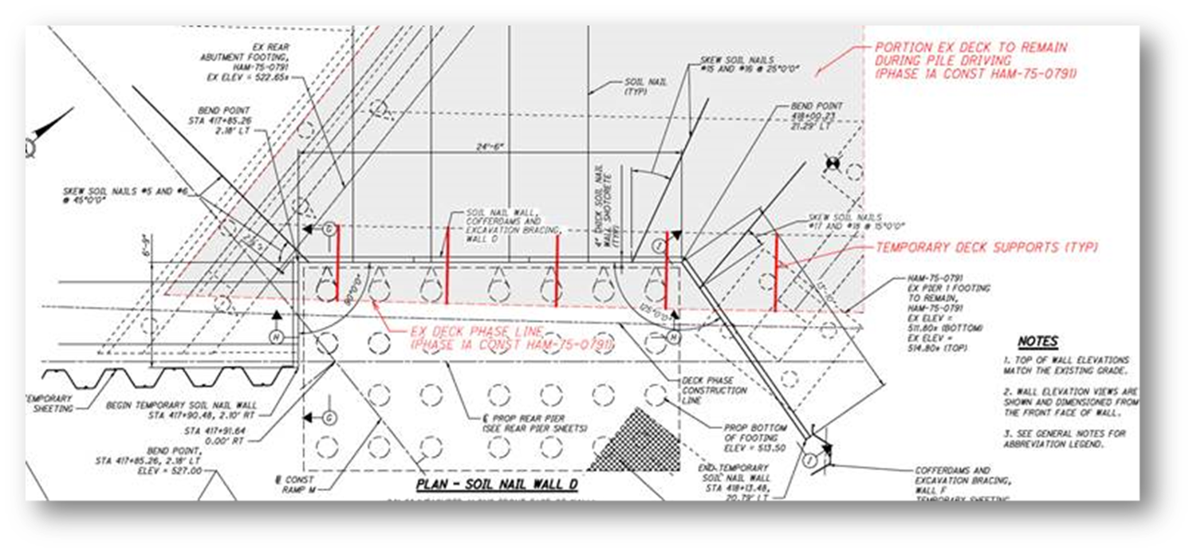
Structures
HAM-562-0004
Temp shoring walls; battered piles; SS reinforcing.
Sheet 1288 (20 of 64)
Notes:
Multiple temporary shoring walls required to be constructed to access to the proposed HAM-562-0004 (WB to SB) (Ramp M) rear pier location. This includes the anchored walls along I-75 as well as the temporary soil nail wall to be constructed underneath the existing HAM-75-0791 bridge (mainline over SB to EB ramp). See Sheet 1288 (20 of 64) for details.
The northern-most row of piles for the HAM-562-0004 rear pier are battered at 1:4 and constructed under the remaining portion of the existing HAM-75-0791 bridge carrying southbound traffic in Phase 1A construction. The contractor will need to ensure that the pile driving equipment will be able to maintain a safe clear distance from the existing deck edge to drive to the piles to the proposed locations.
This bridge will be constructed with stainless steel reinforcing to extend the life of the bridge.

Slide 18
Geotechnical items
Joe Smithson, P.E.
District Design Engineer / District Geotechnical Engineer

Slide 19
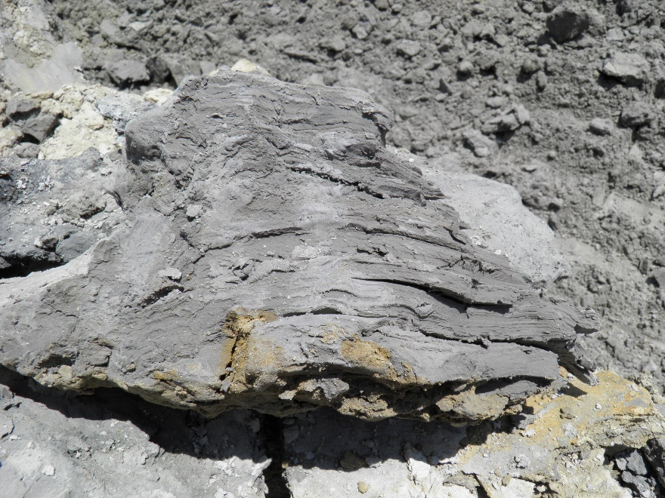
General subsurface conditions
Deep lacustrine and outwash soil profile
Lakebed clay
Silt – very susceptible to strength loss
Outwash sand and gravel
Variable groundwater table
Dewatering note on Sheet 40
See geotechnical data presented in Plans and online at the Traffic Information Management System (TIMS)

Slide 20
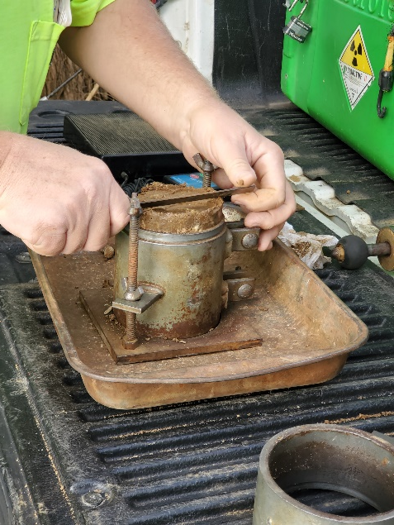
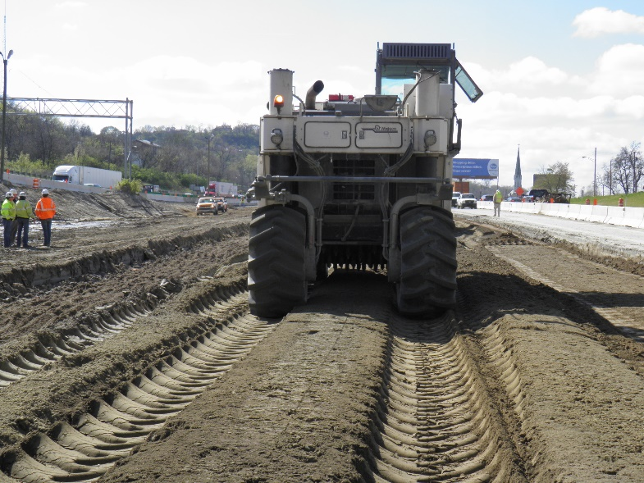
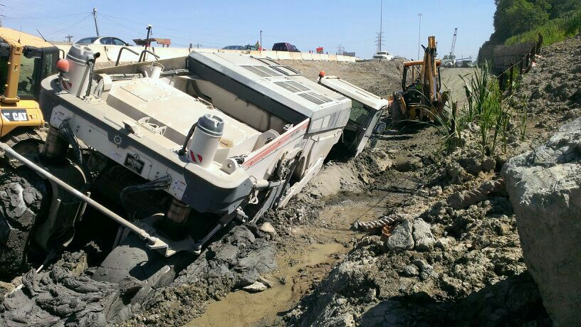
General geotechnical items
Project includes SS 878 – Inspection and Compaction Testing of Unbound Materials
Global subgrade treatment – Item 206 – Cement Stabilized Subgrade, 14 inches deep
Do not perform stabilization in zone of MSE walls where SGB is present

Slide 21
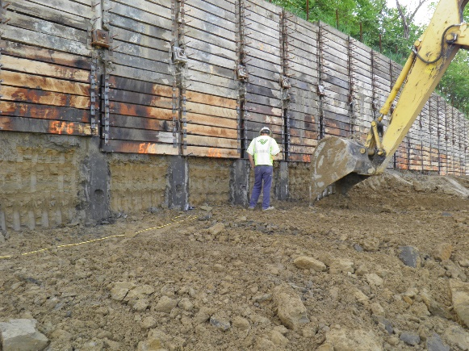
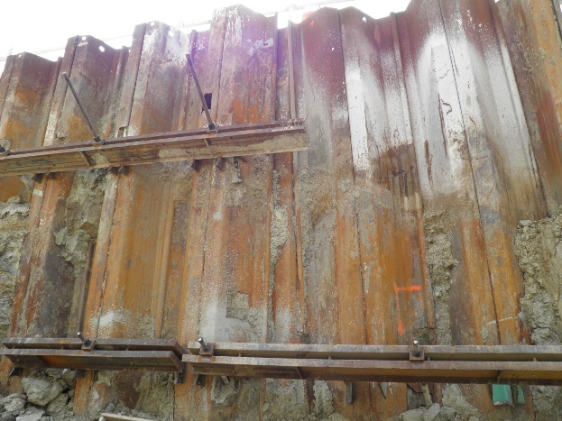
Retaining walls
Item 840 - MSE Walls
Item 867 – Temporary MSE Walls
Soldier Pile and lagging walls
Permanent and temporary (some complex for phased construction)
Tangent Drilled Shaft wall at the HAM-75-0384 bridge (NS RR)
Item 866 – Anchors
Combination barrier / CIP walls

Slide 22
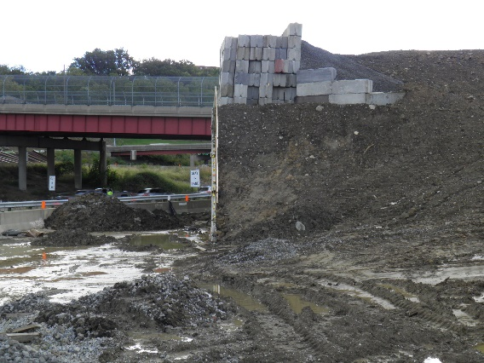
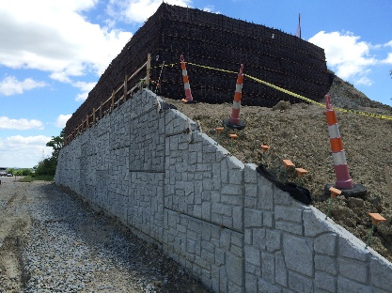
Structure foundations
Many pile foundations are using pile setup
Waiting period
Dynamic load testing
Restrike testing
MSE wall abutments require a settlement waiting period to mitigate downdrag
Temporary Surcharge at MSE wall abutments

Slide 23
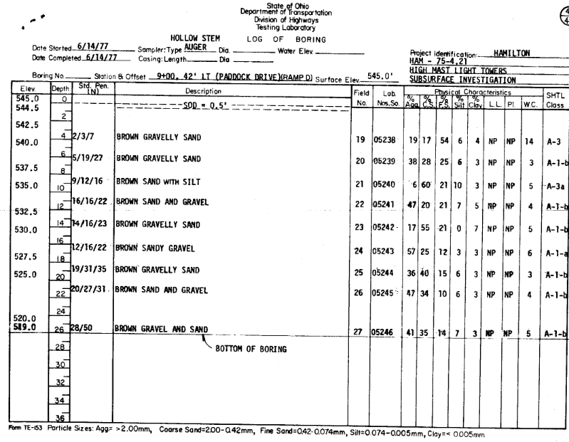
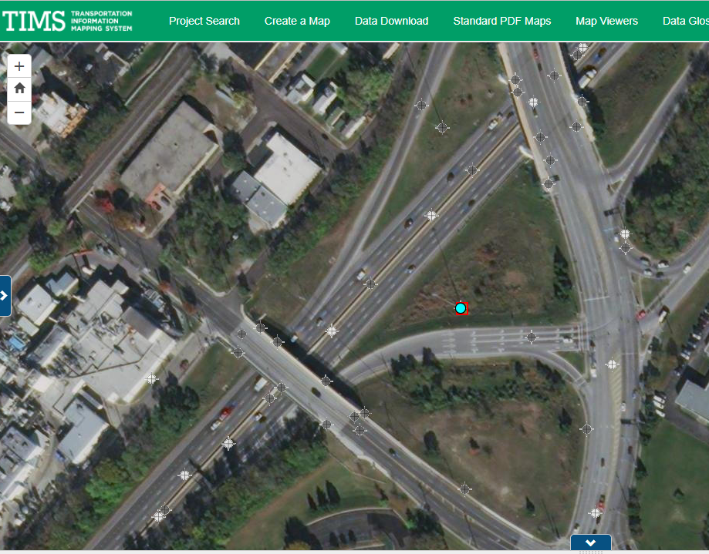
Geotech
Temporary Shoring
Granular Profile
Deeper sand and gravel dense to very dense
Variable groundwater elevation
Archive boring information online in TIMS

Slide 24
Real estate
Stephanie Otten, P.E.
ODOT Project Manager

Slide 25
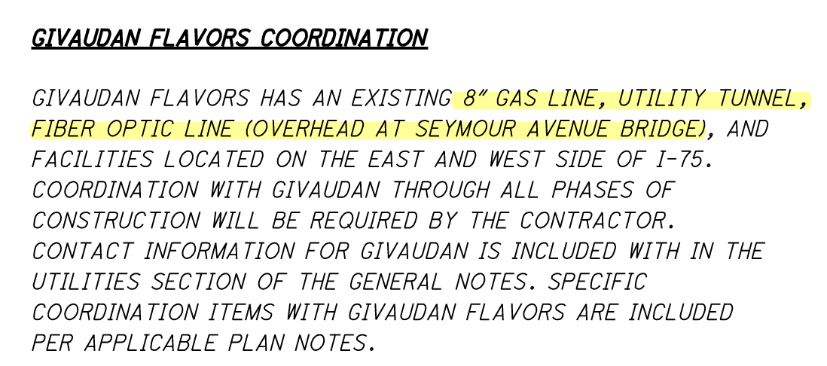
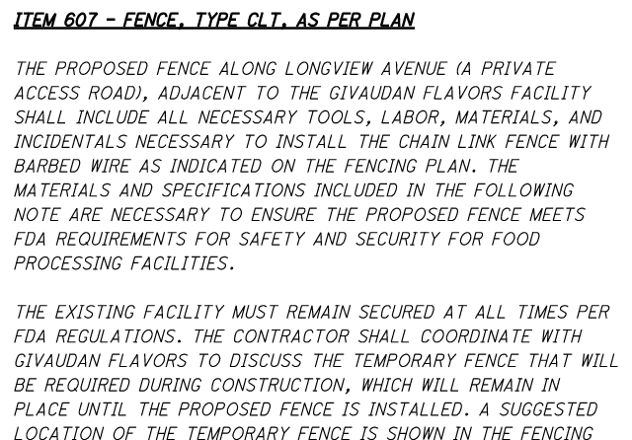
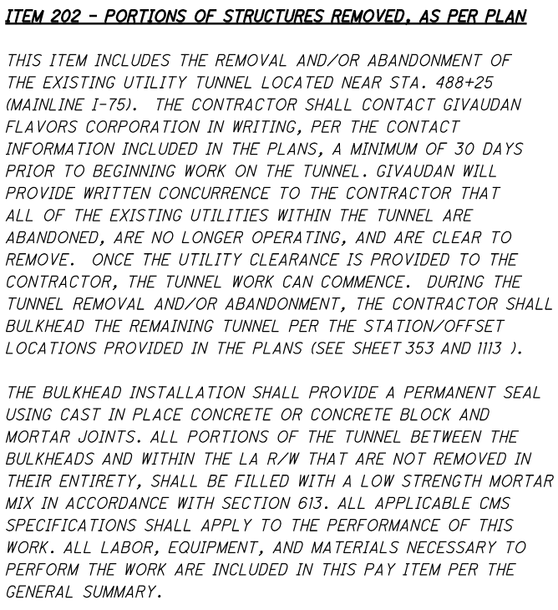
Real estate
Givaudan
Sheet 38
Sheet 41
Sheet 43
Notes:
Givaudan is a company that develops and manufactures flavors. They own property on both sides of I-75.
Givaudan has an 8” gas line, utility tunnel, and overhead fiber optic line crossing I-75.
Contact information can be found under utility contacts.
A Fence, Type CLT, As Per plan note can be found on sheet 41. This note is quite extensive and details Givaudan’s fencing requirements.
A note covering the removal and or abandonment of the existing utility tunnel can be found on sheet 43.

Slide 26
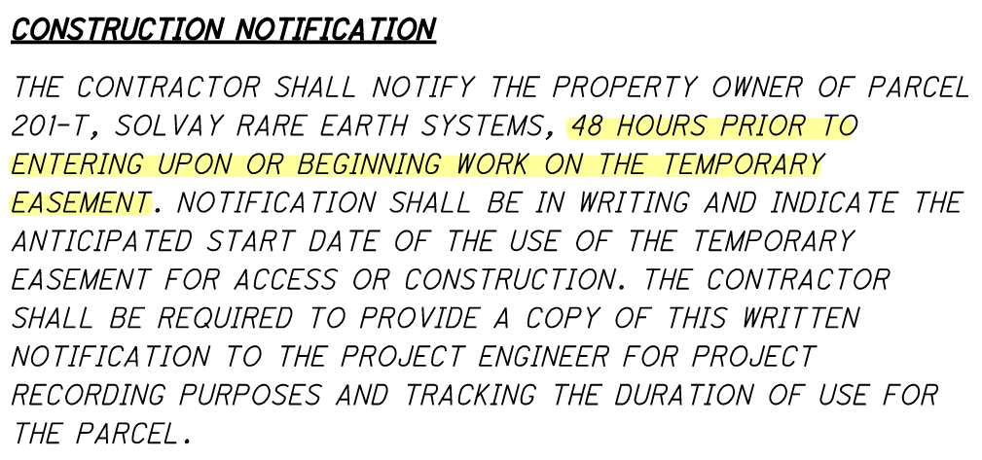
Real estate
Solvay
Sheet 38
Notes:
Solvay is a chemical company located south of SR 562. A plan note on sheet 38 indicates that a 48-hour written notification is required prior to entering the temporary easement.

Slide 27
Questions
?
Last updated 3/30/2022
Notes:
This concludes our presentation. If you have any questions, you can type them in the chat, or raise your hand, or start speaking if you have called in over the phone. Please state your name before asking your question.
Additionally, questions can be asked on the prebid site.

