Slide 1

ODOT’s Seismic Update
Sean Meddles, P.E.
Assistant Administrator
Office of Structural Engineering
Stuart Edwards, P.E.
Technical Manager - Geotech
Michael Baker Int’l
Ed Baznik, P.E.
Bridge Engineer
Michael Baker Int’l
Jeff Broadwater, P.E.
Project Manager
Michael Baker Int’l

Slide 2
Session Outline
Introduction to Seismology
Ohio’s Seismic History
AASHTO’s Design Philosophy
Determine Seismic Hazard
Design Impact on New Structures
Design Impact on Existing Structures
Wrap-up

Slide 3
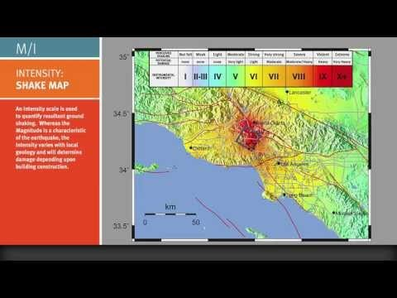
Introduction to Seismology
Source: YouTube, California Institute of Technology, Jun 10, 2013

Slide 4
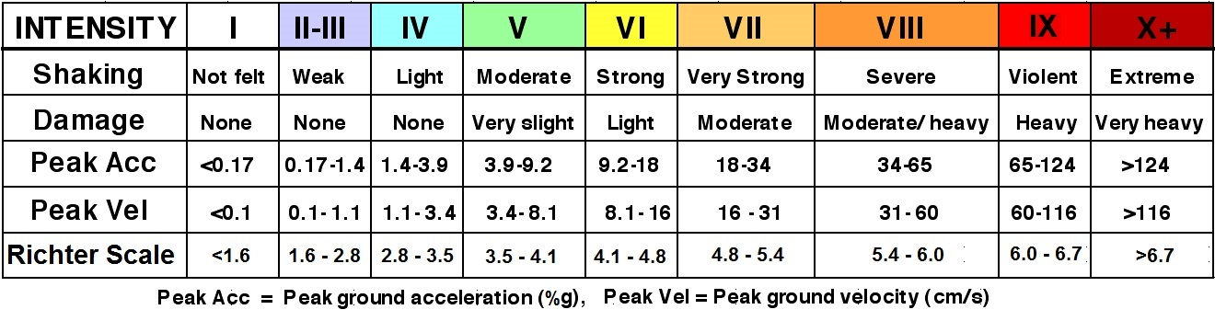
Introduction to Seismology
Notes:
This chart was shown briefly in the video. It shows a comparison between intensity, damage, ground acceleration, peak velocity and magnitude of an earthquake. The purpose for showing this chart leads into the next series of video clips you will see which illustrate the intensity scale for earthquakes. Please note that peak acceleration is a value used by AASHTO to determine seismic design impact to structures.

Slide 5
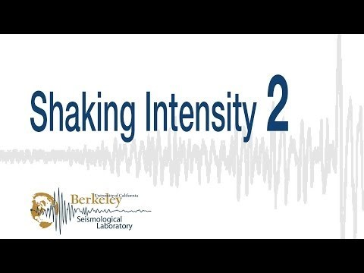
Introduction to Seismology
Approximate Magnitude = 1.6 – 2.4 (Richter Scale)

Slide 6

Introduction to Seismology
Approximate Magnitude = 2.4 – 2.8 (Richter Scale)

Slide 7
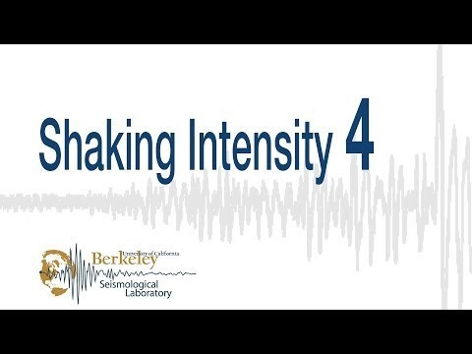
Introduction to Seismology
Approximate Magnitude = 2.8 – 3.5 (Richter Scale)

Slide 8
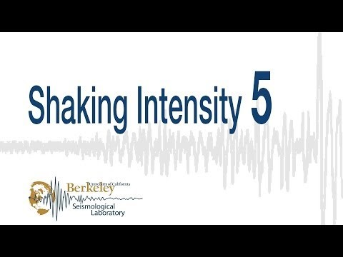
Introduction to Seismology
Approximate Magnitude = 3.5 – 4.1 (Richter Scale)

Slide 9
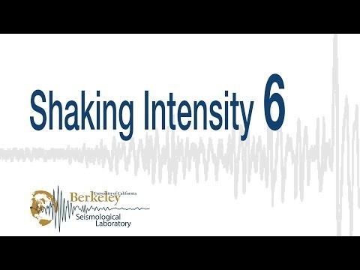
Introduction to Seismology
Approximate Magnitude = 4.1 – 4.8 (Richter Scale)

Slide 10
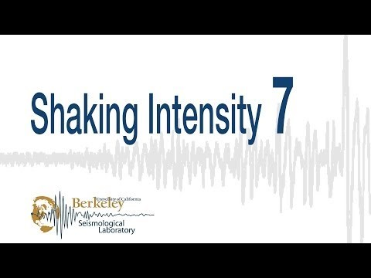
Introduction to Seismology
Approximate Magnitude = 4.8 – 5.4 (Richter Scale)

Slide 11

Introduction to Seismology
Approximate Magnitude = 5.4 – 6.0 (Richter Scale)

Slide 12

Introduction to Seismology
Approximate Magnitude = 6.0 – 6.7 (Richter Scale)

Slide 13
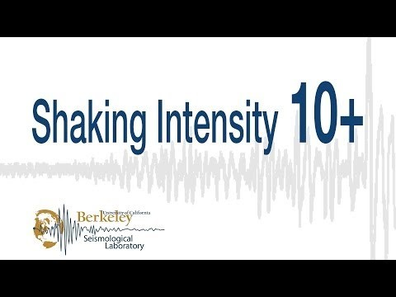
Introduction to Seismology
Approximate Magnitude > 7.3 (Richter Scale)

Slide 14


What is Ohio’s Seismic History?

Slide 15

Ohio’s Seismic History
Since 1776: At least 200 earthquakes > Magnitude 2.0
No Deaths & only minor injuries
Two primary seismic areas of Ohio
  Anna Seismogenic Zone (40 since 1875)
  Northeastern Ohio (80 since 1836)
Source: “Earthquakes in Ohio”, Michael C. Hansen, Educational Leaflet No. 9, Revised Edition 2007, State of Ohio, Department of Natural Resources, Division of Geological Survey
Notes:
Designers typically think of Ohio as a seismically inactive state. That earthquakes happen elsewhere but not here. That perception is not completely accurate. Since 1776, Ohio has experienced at least 200 earthquakes with a 2.0 magnitude or greater. Luckily, there have been only minor injuries and no deaths. There have been numerous events that have caused minor to moderate structural damage. But Ohio has not experienced a major earthquake in recorded history.
Seismic risk in Ohio, and in the eastern U.S. in general, is difficult to evaluate because earthquakes are infrequent and active faults do not reach the surface. Major earthquakes in our region of the United States recur on the order of hundreds or even thousands of years. Earthquakes in the eastern U.S. do tend to travel for very long distances and affect areas up to 10 times larger than similar sized quakes in California as a result of our geology.
The brief historic seismic record for Ohio suggests that the risk of moderately damaging earthquakes are found in the western and northeastern regions of the State.

Slide 16
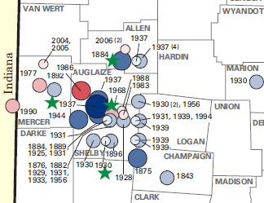
Ohio’s Seismic History
Source: “Earthquakes in Ohio”, Michael C. Hansen, Educational Leaflet No. 9, Revised Edition 2007, State of Ohio, Department of Natural Resources, Division of Geological Survey
Notes:
In western Ohio, the Fort Wayne Rift valley traverses northwest to southeast primarily through Mercer, Auglaize and Shelby counties. This area of the state has experienced more than 40 earthquakes since 1875. The epicenter is located near the town of Anna which is centered over a 400-ft deep buried valley formed by the Teays River nearly 800 million years ago.
In northeastern Ohio, seismic activity has been attributed to a deep, now abandoned, Class I injection well in Ashtabula County along the Akron Magnetic Boundary. A Class I injection well is drilled thousands of feet below sources of underground drinking water in order to dispose of hazardous and non-hazardous waste.
As you can see the largest earthquake magnitudes ever recorded in Ohio are in the 4.0 – 5.0 range. From the description of damage caused by some of these events, the intensity of these quakes would probably be estimated as VII on the MMI scale (Very Strong).

Slide 17
Ohio’s Seismic History
Source: USGS Earthquake Hazards Program, Hazard Maps & Data Lower 48
Notes:
This map shows the seismic ground accelerations used for the determination of seismic performance zones. It illustrates Ohio’s susceptibility to a design earthquake as compared to other areas of the United States. Ohio’s seismic accelerations are similar to the New England states, the upper Midwest states, Texas, Louisiana and Florida.
Missouri’s New Madrid fault is probably most influential in contributing to Ohio’s seismic accelerations with Anna’s Seismogenic Zone providing a slight influence in the western part of the state.

Slide 18
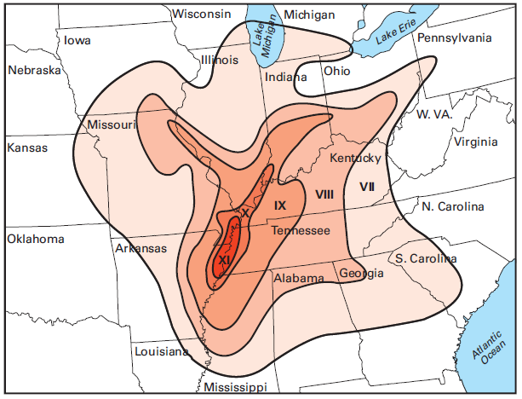
Ohio’s Seismic History
New Madrid, MO
Ohio’s biggest threat to produce high intensity quakes
Source: “Earthquakes in Ohio”, Michael C. Hansen, Educational Leaflet No. 9, Revised Edition 2007, State of Ohio, Department of Natural Resources, Division of Geological Survey
Notes:
From December 1811 to February 1812, the largest earthquakes ever to strike the continental United States, with estimated magnitudes ranging from 7.0 to 8.6, occurred along a fault line near New Madrid, Missouri. These events were felt throughout an area of about 2 million square miles.
This image shows the potential earthquake intensities affecting Ohio for a magnitude 8.0 event occurring on the New Madrid fault.

Slide 19
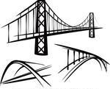

What is AASHTO’s Approach?
Notes:
So…What is the design approach assumed by AASHTO?

Slide 20
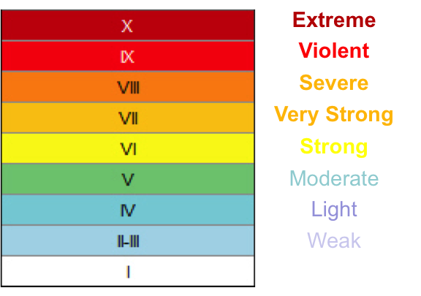
AASHTO’s Design Philosophy
Is it possible to design a bridge to remain undamaged during moderate-to-strong earthquakes?
Answer: Not Economically
Notes:
Is it possible to design a bridge to remain undamaged during moderate-to-strong earthquakes?
If we define undamaged to mean the load effects imposed on a structure by a seismic event stay within the elastic range of the structural members of the bridge, then is it possible to design a bridge in the elastic range for earthquake loadings in the same manner as wind, vehicular and earth loadings?
The answer is: Not really.
The forces acting on structures, even for the moderate intensity seismic events, are extremely large and would lead to extremely robust designs. Maybe you could design one bridge to withstand these forces, but not an inventory of bridges.

Slide 21
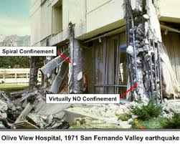
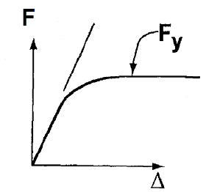
AASHTO’s Design Philosophy
How can bridges be designed to permit damage and remain safe?
Answer: Ductility
Notes:
So, if bridges cannot be economically designed in the elastic range, how can bridges be designed to yield without failing or even collapsing?
The answer is to ensure designs are ductile. That structural members can deform beyond their elastic limits without failing. This can be accomplished through proper attention to detailing.
As shown in this image, the ductility provided by the spiral reinforcement allowed the center column to remain supportive even when damaged while the columns without confinement failed completely.
Another benefit to ductile design is that applied forces can be limited. Once yielding occurs, the forces in the structure will not exceed the those forces in the yielding members regardless of the intensity of the earthquake.

Slide 22

AASHTO’s Design Philosophy
Weak-to-moderate earthquakes:
Seismic analysis unnecessary
Detail for ductility
Prevent unseating of spans
Notes:
For Weak – to – Moderate earthquakes (those with ground accelerations less than 0.15 g), AASHTO does not require seismic analysis of structures. Bridges should be able to withstand these smaller events in their elastic range. To make the no analysis philosophy possible, AASHTO makes an assumption that the ductility provided by the specifications will provide adequate inelastic capacity should a larger event occur. As an added degree of protection, measures shall be taken to ensure unseating of spans is not permitted.

Slide 23
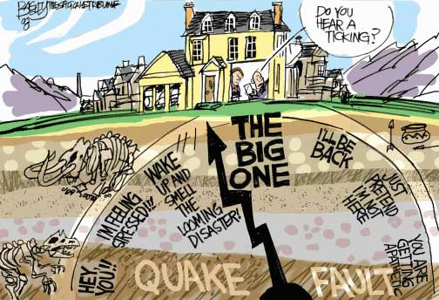
AASHTO’s Design Philosophy
Moderate-to-Extreme earthquakes:
No collapse
Ductile damage located in readily detectable and accessible locations
Notes:
For larger earthquakes with peak ground accelerations greater than 0.15 g, AASHTO’s philosophy requires:
No Collapse
Damage to be ductile & located in readily detectable and accessible locations. Typically, these ductile areas are referred to as “Plastic Hinges”.
In these more seismically active zones, an analysis of the structure is required to determine how the structure will respond to a seismic event. Typically these analyses will require 3D computer modeling of the entire structure.

Slide 24
AASHTO’s Design Philosophy
Capacity Protection – Design critical elements with capacity exceeding that of fuse element
Ductile Behavior: F_{d} < each F_{ib}
Brittle Behavior: One F_{ib} < F_{d}
Notes:
Once the location of a “Plastic Hinge” is determined, all other critical elements are designed to a capacity exceeding the yielded strength of the “Plastic Hinge”.
Using a steel chain as an analogy, if one of the steel links were to replaced with a bungie cord to represent the plastic hinge, none of the remaining steel links would break when the chain is loaded because the bungie cord prevents excessive force in the steel.
If however, the chain was made of paper instead of steel and the same bungie cord link were inserted, the chain would fail suddenly under applied load at one of the paper links because its capacity less than the plastic hinge - bungie cord.

Slide 25

AASHTO’s Design Philosophy
Design Return Period:
1000 years
7% probability of exceedance in 75 years
Notes:
Lastly, AASHTO needed to provide a definition of a Design Event that was reasonable and realistic. In 2007, AASHTO adopted the “Design Earthquake” with a return period of 1000 years. This correlates to a 7% probability that a more intense earthquake will occur in a structure’s exposure period or design life defined as 75 years.
The annual risk level associated with a 1000-year return period is actually lower than other natural hazards like high winds, flooding and scour. This difference can be attributed to the public reaction following loss of life, damage and business disruption in recent earthquakes such as the 1989 Loma Prieta, 1994 Northridge, 1995 Kobe and 1999 Chi-chi earthquakes.
Also, owners may want to consider a longer exposure period for major structures that exceeds 75 years. This makes sense when considering a bridge such as the Manhattan Bridge in New York City which was built in 1909. The bridge has been in service for more than 100 years and with routine maintenance, it should last for at least another 50 years. For a 150 year exposure, the return period would need to be 2000 years for the same 7% probability of exceedance.
Conversely, an owner may want to consider that a rehabilitated structure will see a shorter exposure period like say 30-years. The probability of exceedance is therefore less than half of that for a 75-year exposure.

Slide 26
AASHTO’s Design Process
Determine the Seismic Input:
  USGS Seismic Parameters – Proximity to active faults
  Site Classification – Soil profile overlying rock
  Categorize Seismic Hazard – Seismic Performance Zone
Determine Dynamic Response of the Structure
Design Ductile Members (Zones 2, 3 & 4)
Force-Based vs. Displacement-Based
Notes:
Now that we’ve addressed the philosophy that goes into the AASHTO design specifications, I want to briefly describe the design process that AASHTO defines.
The first step is to determine the seismic characteristics of the project location. This requires input from a subsurface investigation and analysis of geotechnical parameters.
The next step occurs after the structural members have been sized for AASHTO’s other governing load effects. The structure can then be analyzed to determine its dynamic response to a seismic event. The level of analysis depends upon the level of seismic hazard. The higher the hazard, the more analysis is required.
Lastly, the structural system needs to be designed for ductility. This can be done on a Force-Based or Displacement-Based approach.

Slide 27
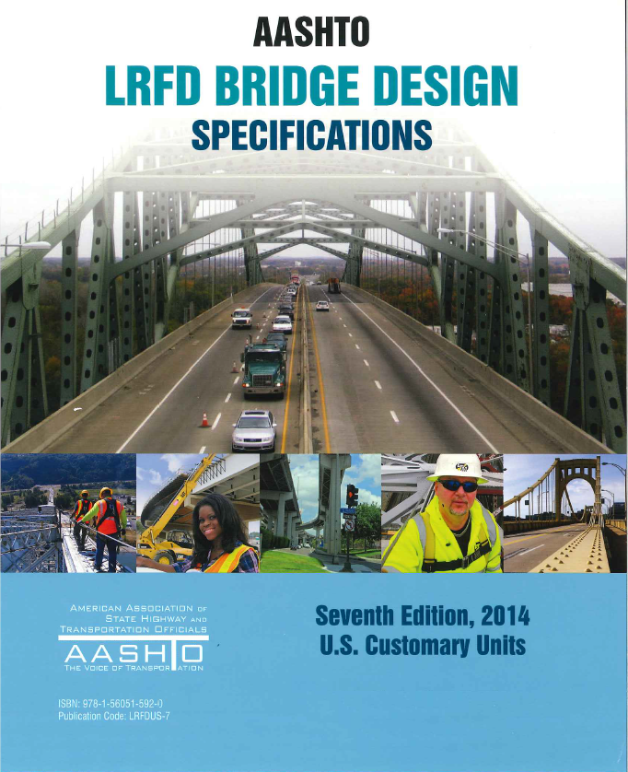
AASHTO’s Design Specifications
LRFD Bridge Design Spec.’s
  Force-based analysis
  Uses R-factors to reduce seismic forces based on ductile response
  Assumes plastic hinge forms thus capping applied seismic forces used to design the elements
Notes:
The AASHTO LRFD Bridge Design Specifications define the Force-Based approach.
This approach uses R-factors, or Response Modification Factors, to reduce seismic design forces to account for ductile hinging.

Slide 28
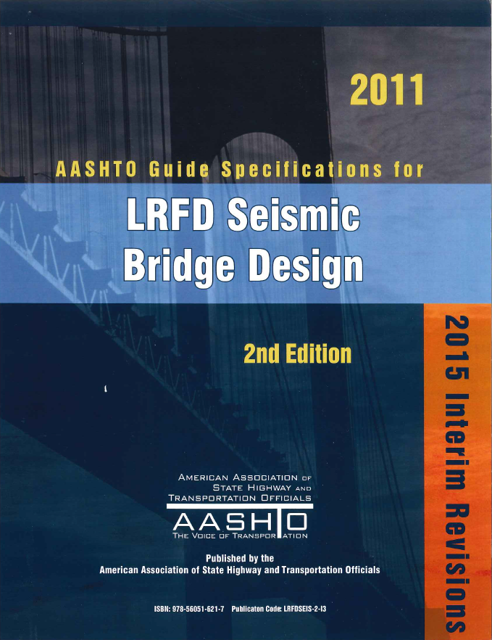
AASHTO’s Design Specifications
LRFD Seismic Guide Spec.’s
  Displacement-based analysis
  Design inelastic movement of the structure due to seismic loads to be less than the inelastic deformation capacity
Notes:
The AASHTO Guide Specifications for LRFD Seismic Bridge Design define a Displacement-based approach.
In this approach, the designer determines the structure’s inelastic deformation capacity then ensures that the deformation under seismic loading is within that limit.

Slide 29

So…Why Make Policy Changes Now?

Slide 30
So…Why Make Policy Changes Now?
2011 AASHTO SCOBS Agenda Item #17:
Article 3.10.9.2 – Seismic Zone 1
“The horizontal design connection force shall be addressed from the point of application through the substructure and into the foundation elements.”
Notes:
So…Why make policy changes now?
In 2011, the AASHTO Subcommittee on Bridges and Structures, approved a revision to Article 3.10.9.2 for Seismic Zone 1 that read: “The horizontal design connection force shall be addressed from the point of application through the substructure and into the foundation elements.”
Prior to the 2012 release of the 6th Edition of the AASHTO LRFD Bridge Design Specifications, Article 3.10.9.2 did not require a load path analysis and design for the horizontal connection force. In some structure designs, this connection force may be immense. I’m sure a designer somewhere asked the question, “How does a load that large get transferred to the foundation without damage?” – which ultimately led to a change in the specifications.
I know for sure, our office began fielding questions on this issue when projects required additional rows of pier piling to carry the overturning loads caused by the connection force.
Reflecting back on AASHTO’s Philosophy, an owner should utilize the structure’s inelastic capacity and allow damage and not design for these loads elastically. Designing beyond elastic capacity is a new concept for ODOT.

Slide 31
So…Why Make Policy Changes Now?
2014 AASHTO SCOBS Agenda Item #42:
Article 3.10.9.2 – Seismic Zone 1
“The horizontal design connection force shall be addressed from the point of application through the substructure and into the foundation elements.”
Notes:
In 2014, AASHTO reversed course somewhat and eliminated the load path provision for the seismic connection force.

Slide 32
So…Why Make Policy Changes Now?
2014 AASHTO SCOBS Agenda Item #42:
Article C3.10.9.2
“The minimum connection forces specified in this Article are not intended to be minimum design forces for the bridge, because the main elements of the bridge in Zone 1 should generally be capable of resisting the expected lateral seismic forces by virtue of satisfying the nonseismic design req’mts.”
Notes:
AASHTO did however provide some clarifying language in the commentary to Article 3.10.9.2 for Zone 1 structures:
“The minimum connection forces specified in this Article are not intended to be minimum design forces for the bridge, because the main elements of the bridge in Zone 1 should generally be capable of resisting the expected lateral seismic forces by virtue of satisfying the non-seismic design requirements.”
Put another way: if the bridge design is in complete accordance with the AASHTO LRFD Specifications, then the structure will have sufficient inelastic capacity to survive a seismic event with isolated ductile damage.

Slide 33
So…Why Make Policy Changes Now?
Ohio needs to enforce AASHTO provisions previously avoided to ensure ductility
Enables ODOT designers to avoid more sophisticated seismic analysis
Provides a consistent approach to resolving seismic loads
Has benefits to other Extreme Events (e.g. Vehicle Impacts)
Notes:
As noted earlier, Ohio needs to enforce the AASHTO provisions for ductility, especially those in concrete columns, in order to avoid more sophisticated seismic analysis to ensure designs are appropriate for a design event.
By doing so, ODOT will provide a more consistent approach to resolving seismic loading than we have in the past.
These changes will also produce side benefits for other Extreme Event loading like vehicle impacts.

Slide 34

Questions?

