Slide 1

Seismic Design Impact to
Existing Structures
Jeff Broadwater
Michael Baker International
December 14, 2016

Slide 2
Outline
Philosophy
Retrofit Strategies
Case Studies
Final Thoughts & Questions

Slide 3



Philosophy
“For existing structures, the key is to improve a structure’s response to a seismic event”

Slide 4
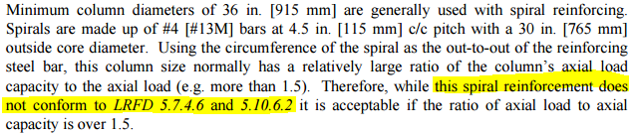
Philosophy
Column Ductility
Historical BDM 303.3.2.1 Provision Relaxed Ductility Requirements

Slide 5
Philosophy
Strength & Ductility
BDM 301.4.3.1.b
  “Because a structure in Seismic Performance Zone 1 is assumed to be able to carry the loads within the elastic range of its members…”
  “…or is assumed to be properly detailed to prevent the collapse beyond the elastic strength range of its members…”
  “…analysis of the superstructure, substructure and foundation…for the connection force is not required.”

Slide 6
Philosophy
Load Path from Ground to Bridge Deck
Provide crossframes to transfer load from bearings to deck at locations of horizontal restraint
Ensure horizontal connection forces are transferred between superstructure and substructure
Ensure column ductility where horizontal connection forces are to be resisted

Slide 7

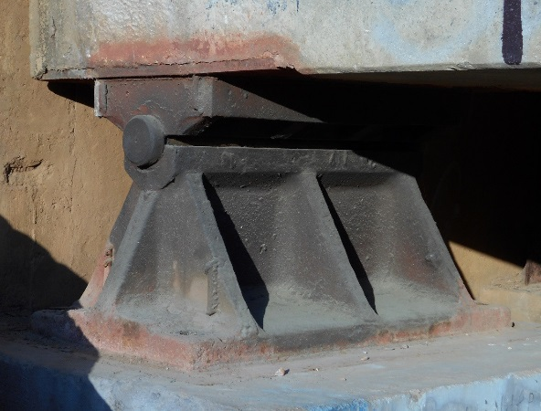
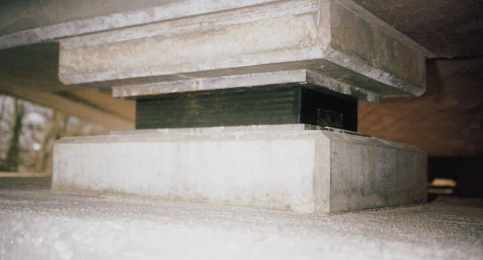
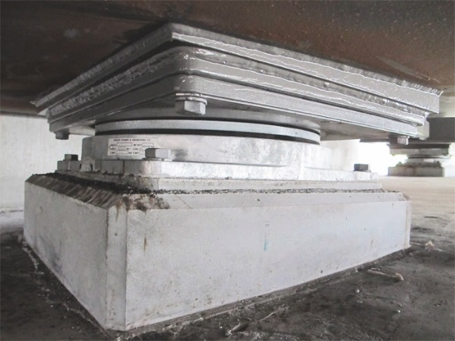
Philosophy
Bearings
ROCKER
BOLSTER
ELASTOMERIC
Transverse
Transverse & Longitudinal
Unrestrained in both directions
In which directions is movement restrained?
What are the consequences of restrained movement in bearings?
POT
Must ensure continuity of load path at locations of restraint
Transverse &/or Longitudinal

Slide 8
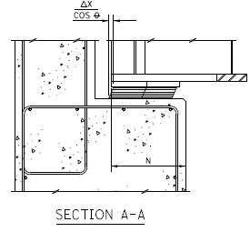
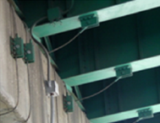
Philosophy
Prevent Unseating of Spans
Minimum support length per 100%N = LRFD 4.7.4.4-1 and BDM 301.4.3.1.a
  Note: No reduction of N per BDM
Seismic restrainers designed for horizontal connection force where seat length requirements won’t be met

Slide 9
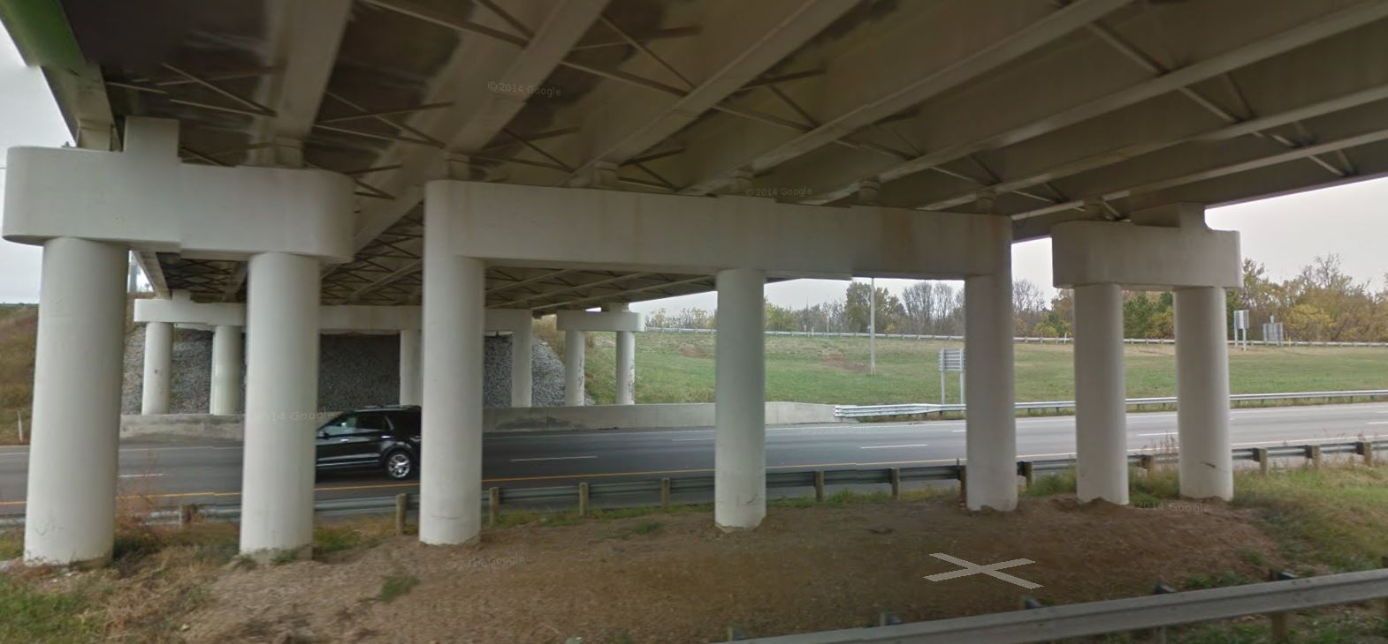
Philosophy
Bridge Widening
New substructure elements shall be designed in accordance with new column reinforcing detailing provisions.

Slide 10
RETROFIT STRATEGIES

Slide 11
Retrofit Strategies
Guiding Questions
Are relevant BDM and LRFD specs satisfied?
Will structure’s seismic response improve in the final condition?
What is the scope of rehabilitation?
  Deck replacement?
  Superstructure replacement?
  Widening and/or Substructure replacement?

Slide 12
Retrofit Strategies
Connection Type Considerations
Address existing structure connection by connection
  Will connection be restrained in its final condition?
  How does restraint / fixity play a role in column ductility?

Slide 13
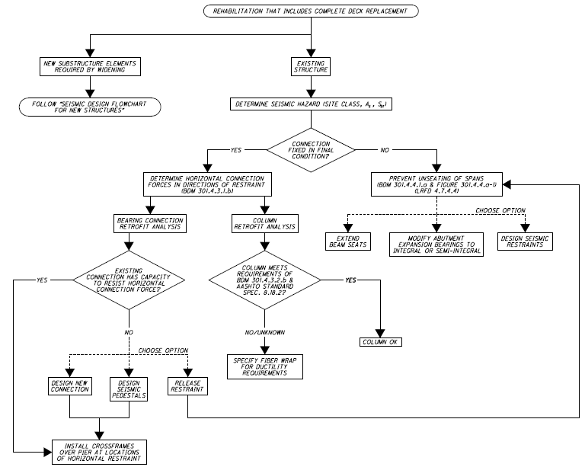
Possible Paths
Preferred Paths

Slide 14
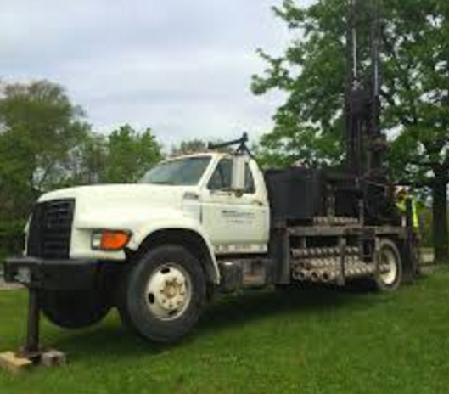
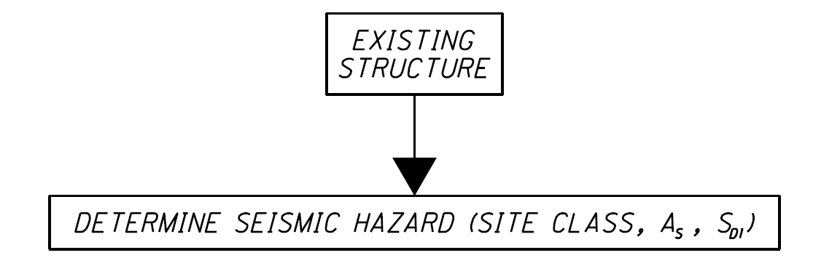
Retrofit Strategies
Determine Seismic Hazard
For rehabilitation projects involving new substructure work, use geotech investigations to establish site class parameters

Slide 15
Retrofit Strategies
Determine Seismic Hazard
Conduct geotechnical investigations in accordance with traditional scope for widening or new substructure units
If sufficient geotech info isn’t available, designers may assume:
  A_{s} > 0.05
  S_{D1}<0.10
➔ horizontal connection force = 25% of tributary dead load

Slide 16
Retrofit Strategies
Evaluate Column Ductility
Ensure ductility where horizontal connection force is transferred to columns
  Review existing plans to check existing column spiral confinement versus AASHTO requirements.
  Specify fiber wrap for ductility improvements to columns

Slide 17
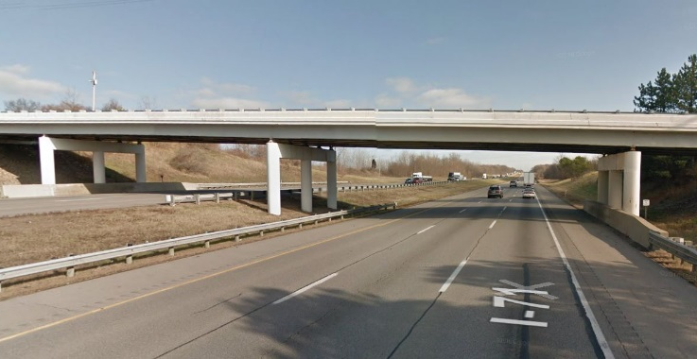
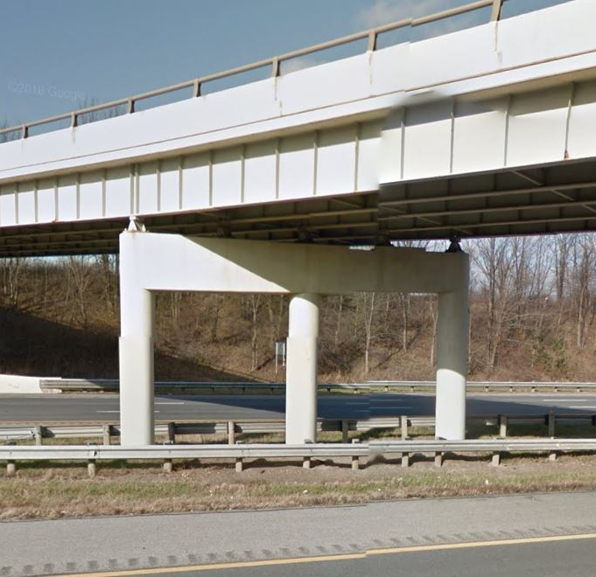
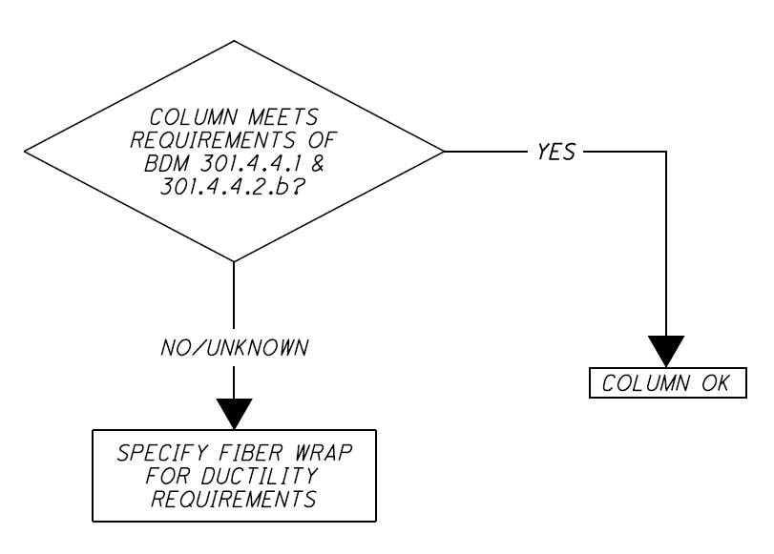
Retrofit Strategies
Evaluate Column Ductility
FIX
Notes:
Replace fixed bolsters with elastomeric expansion bearings?

Slide 18
Retrofit Strategies
Bearing Connection Analysis
Design connection between substructure and superstructure for the horizontal connection force
Install crossframes over pier at locations of transverse horizontal restraint

Slide 19
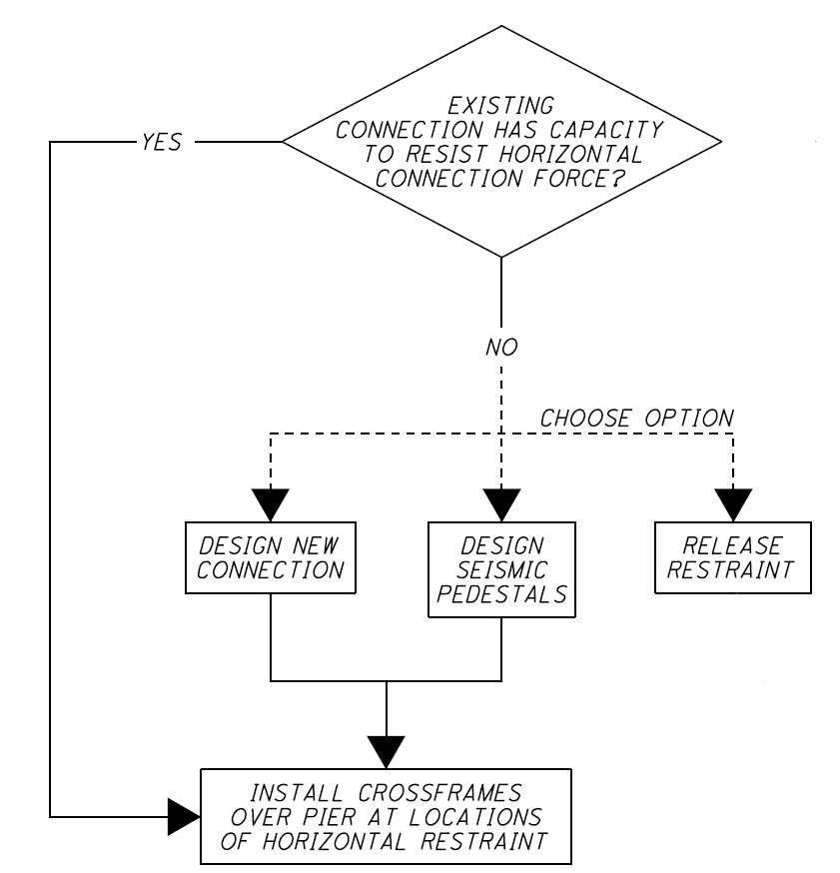
Retrofit Strategies
Bearing Restraint Analysis
INSTALL CROSSFRAMES OVER PIER
EXP
SEISMIC PEDESTALS REQUIRED?

Slide 20
Retrofit Strategies
Bearing Release Analysis
EXP
Replace Rockers with Elastomeric Bearings

Slide 21
Retrofit Strategies
Prevent Unseating of Spans
Modify abutment expansion bearings to integral or semi-integral
Extend beam seats
Design seismic restraints

Slide 22
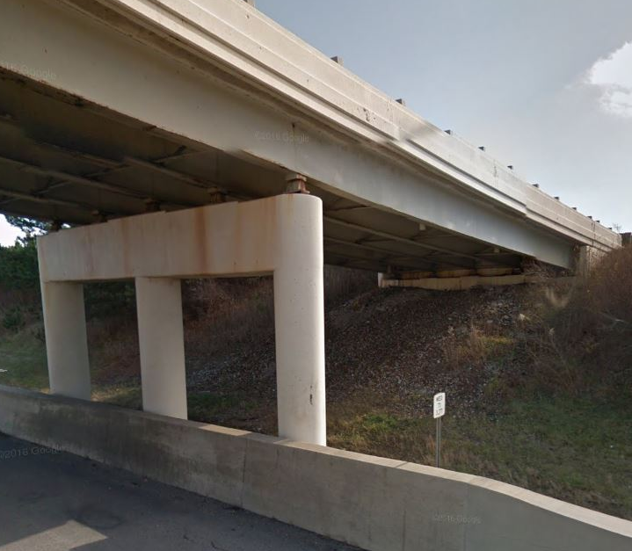
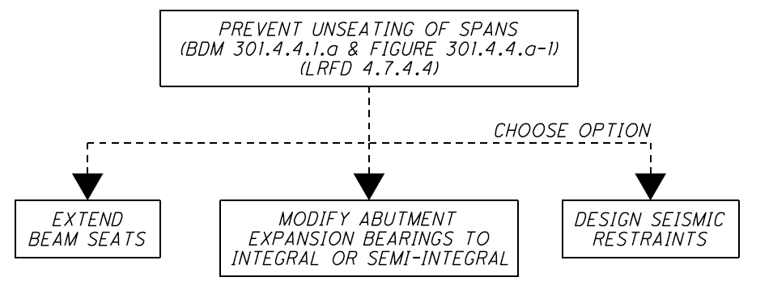
Retrofit Strategies
Prevent Unseating of Spans
EXP
EXP
SUPPORT LENGTH ADEQUATE?

Slide 23
Retrofit Strategies
Structure Type Considerations
Is the bridge integral or semi-integral?
Can it be converted to integral or semi-integral?
Other?

Slide 24
Bridge IS Integral or Semi-Integral
  Identify existing bearing restraints
    Bolsters = transverse and longitudinal restraint
    Rocker bearings = transverse restraint
  Release intermediate bearing restraints by replacing rockers and bolsters with elastomeric bearings, or;
  Provide column ductility and load path at bearing restraints
    Verify columns meet spiral confinement ductility provisions; or
    Fiber wrap columns
    Verify / provide crossframes at piers with transverse restraint

Slide 25
Bridge CAN BE Integral or Semi-Integral
  Convert abutments to integral or semi-integral
  Identify existing bearing restraints
  Release intermediate bearing restraints by replacing rockers and bolsters with elastomeric bearings, or;
  Provide column ductility and load path at bearing restraints
    Verify columns meet spiral confinement ductility provisions; or
    Fiber wrap columns
    Verify / provide crossframes at piers with transverse restraint

Slide 26
Bridge NOT SUITED to Integral or Semi-Integral
  Determine restraint locations (longitudinal and horizontal)
  Determine horizontal connection force
    Evaluate bearing restraint (locations and forces)
    Design connection for horizontal connection force
    Evaluate/address column ductility at restraint locations
    Provide load path at transverse restraint locations with crossframes
  Prevent unseating of spans at expansion joints

Slide 27

Retrofit Strategies
Typical 4-Span Deck Replacement
EXP
EXP
EXP
FIX
EXP
Combining retrofit strategies for a typical highway bridge

Slide 28
Retrofit Strategies
Typical 4-Span Deck Replacement
Is it Integral or Semi-Integral?...Yes➔
  Keep rockers and bolsters?...Yes➔
    Fiber wrap columns
    Design for horizontal connection
    Verify / install crossframes above piers
EXP
EXP
FIX
EXP
EXP

Slide 29
Retrofit Strategies
Typical 4-Span Deck Replacement
Can it be Converted to Integral or Semi-Integral?...Yes➔
  Convert abutments to integral or semi-integral
  Release intermediate bearing restraints by replacing rockers and bolsters with elastomeric bearings
EXP
EXP
FIX
EXP
EXP
EXP

Slide 30
Retrofit Strategies
Typical 4-Span Deck Replacement
Keep rocker/bolster bearings
EXP
EXP
FIX
EXP
EXP
Retrofit with elastomeric bearings
EXP
EXP
EXP
EXP
EXP

Slide 31
CASE STUDIES

Slide 32
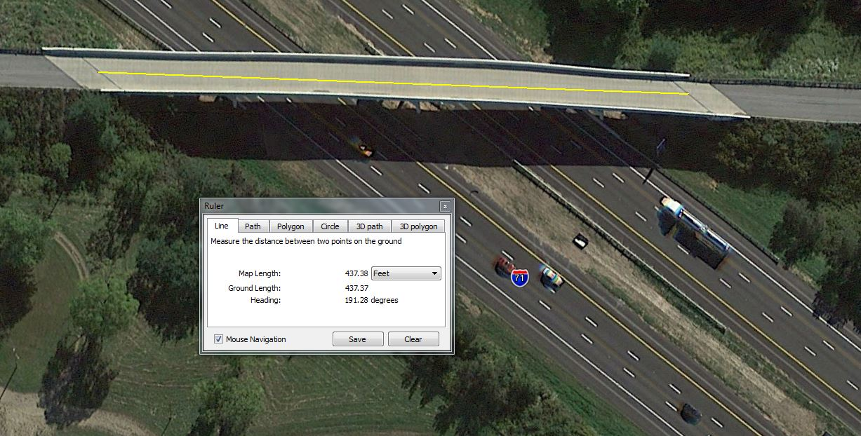
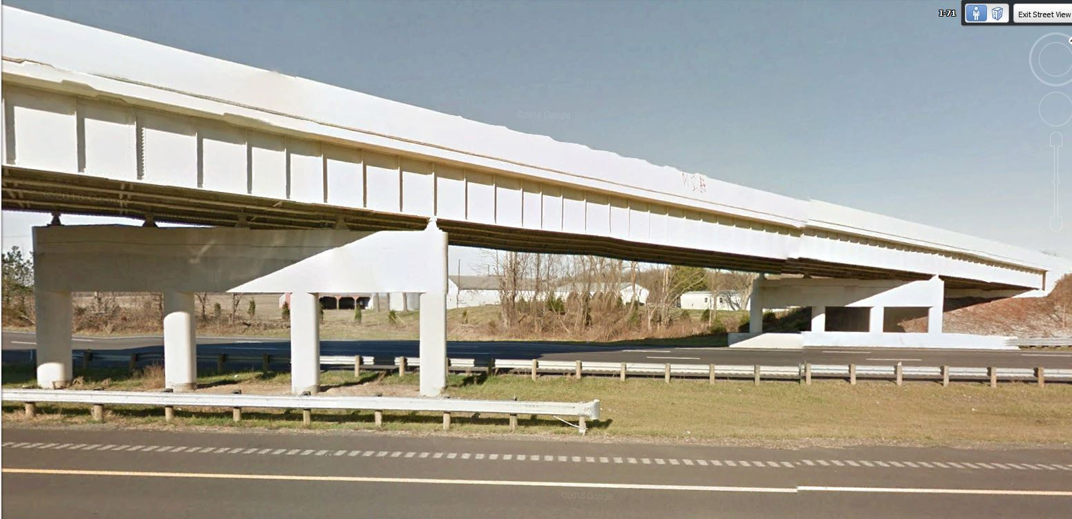
Case Study 1
Long Deck Replacement
Scope of Services:
Deck Replacement

Slide 33
Case Study 1
Long Deck Replacement
Total Length = 437’ > 400’
Exceeds Length for Semi-Integral Construction - BDM

Slide 34

Case Study 1
Long Bridge Deck Replacement
Provide pedestals at the abutments
Check bolsters for long. & transverse horizontal connection force – retrofit or replace if needed
Fiber wrap fixed pier columns
Verify Crossframes at fixed pier
Replace rockers w/ elastomeric bearings?
  If not, rockers considered fixed in the transverse direction; requires fiber wrap and crossframes at pier

Slide 35
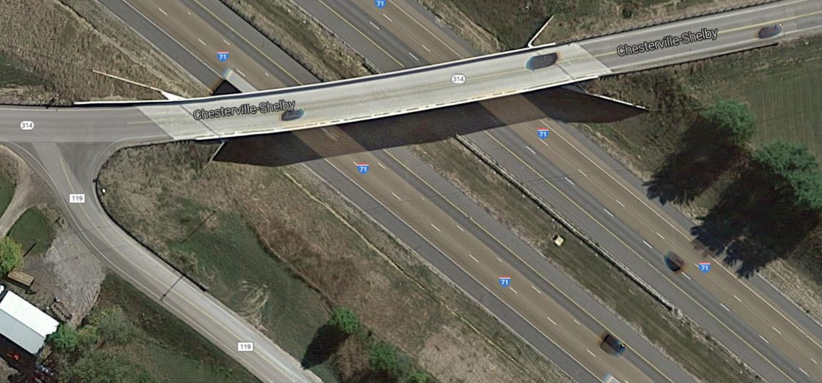
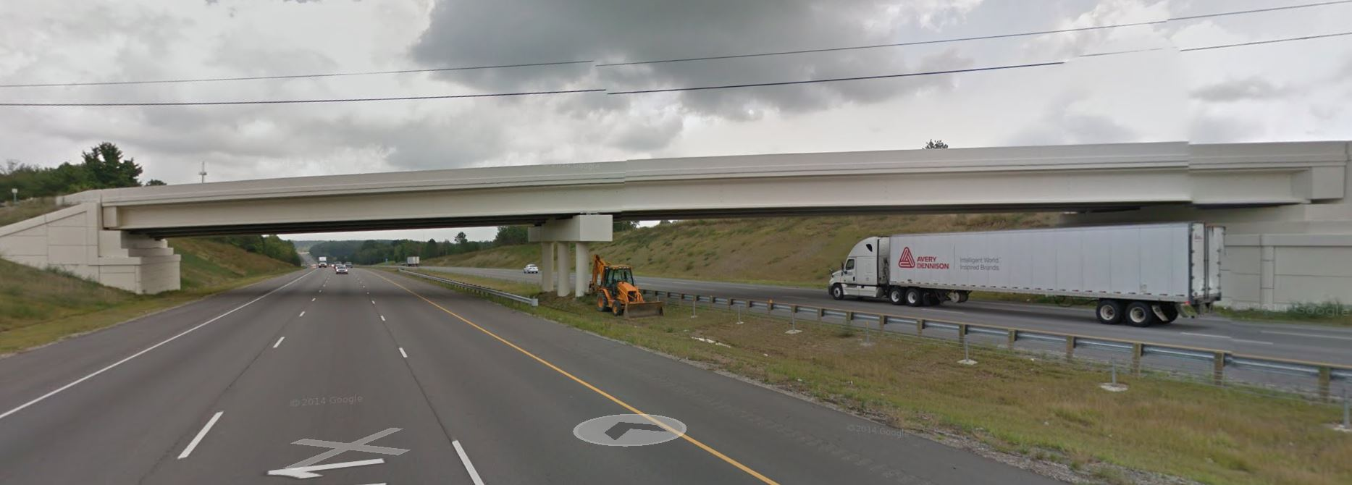
Case Study 2
2-Span Deck Replacement
FIX
EXP
EXP

Slide 36
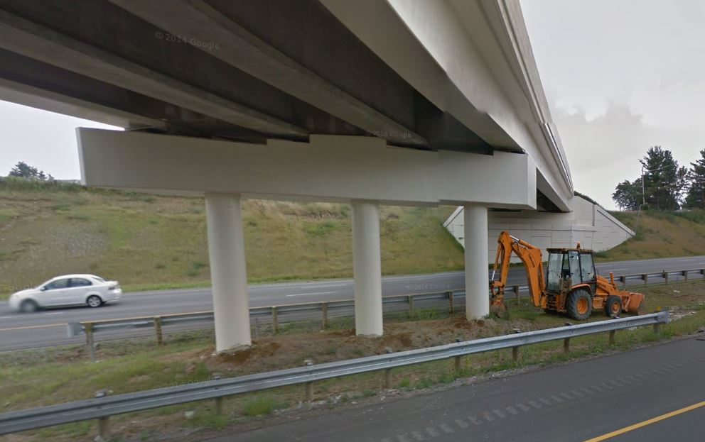
Case Study 2
2-Span Deck Replacement
Do columns meet BDM 301.4.4.1 & 301.4.4.2.b?
If not, fiber wrap fixed pier to improve ductility
Existing Seismic Pedestals

Slide 37
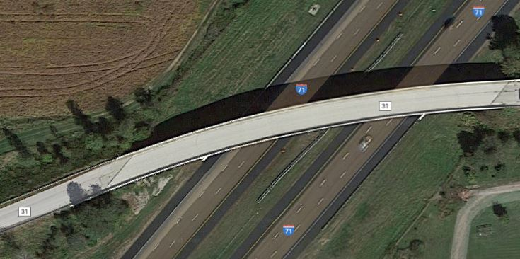
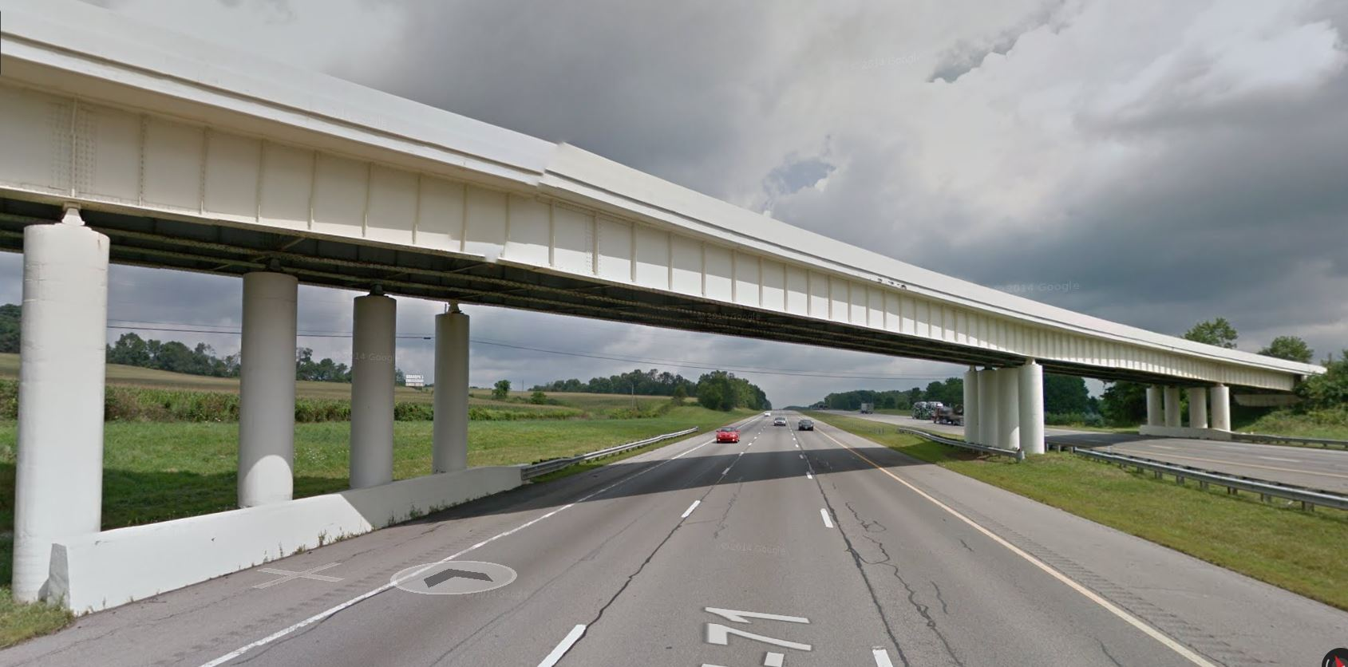
Case Study 3
Individual Column Substructure

Slide 38
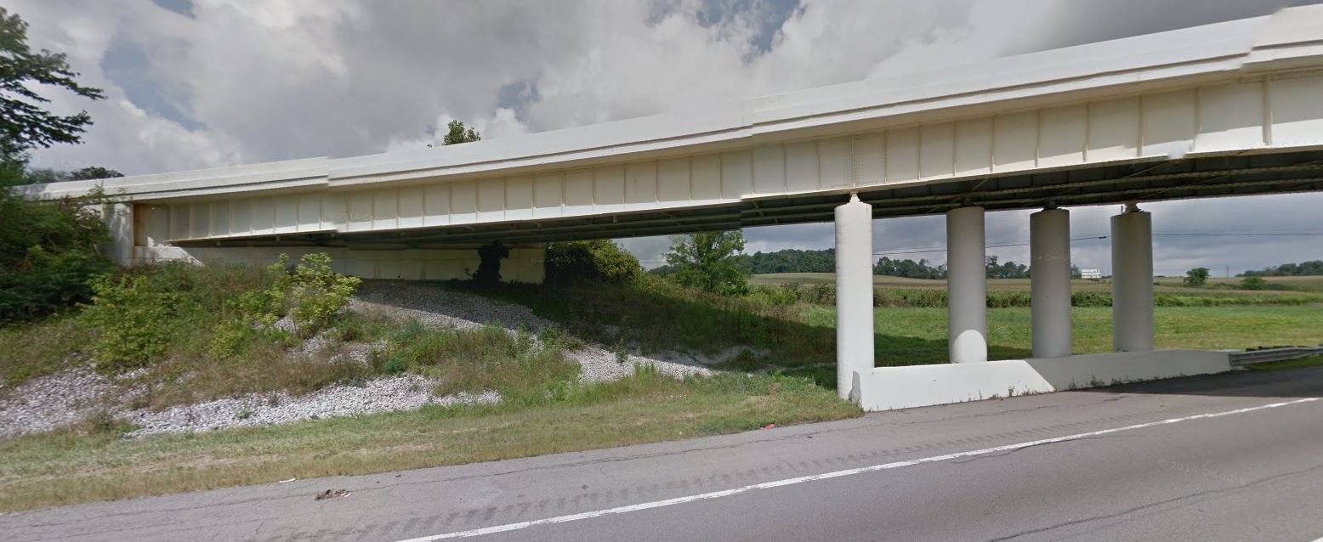
Case Study 3
Individual Column Substructure
Install seismic pedestals at abutments to provide horizontal restraint
Verify fixed bearing capacity for longitudinal and transverse loads – retrofit/repair if needed
Fiber wrap pier columns where restraint is provided
Verify/ place crossframes at horizontal restraint locations
Retrofit piers with cap beams?
(Only with superstructure replacement)

Slide 39
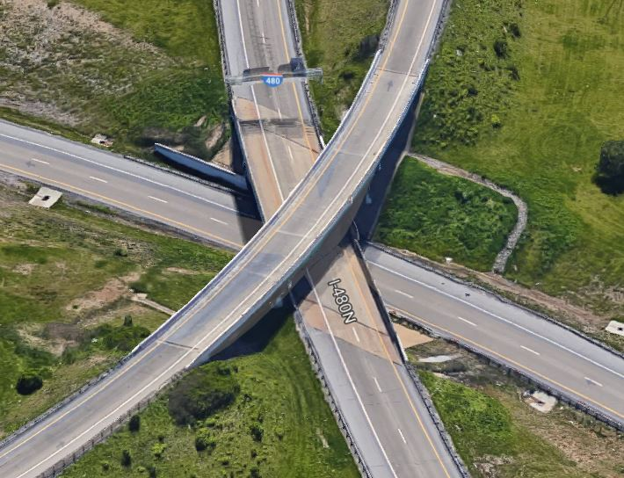
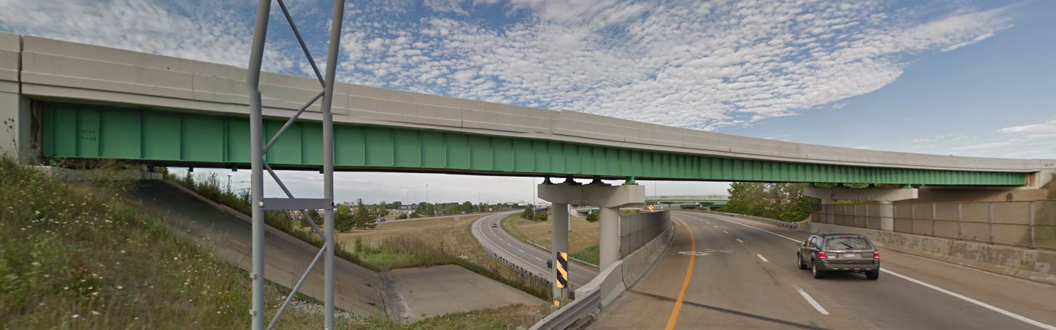
Case Study 4
Curved Girder Deck Replacement
EXP
FIX
FIX
EXP

Slide 40
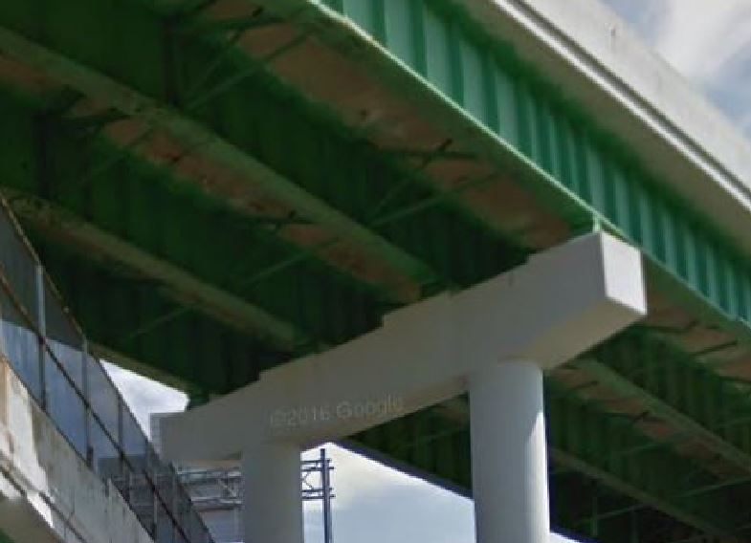
Case Study 4
Curved Girder Deck Replacement
Install seismic pedestals at abutments
Evaluate fixed bolsters for longitudinal and transverse horizontal connection force.
  If no good, replace bearings
FIX

Slide 41
Case Study 4
Curved Girder Deck Replacement
Install crossframes at piers (horizontal restraint)

Slide 42
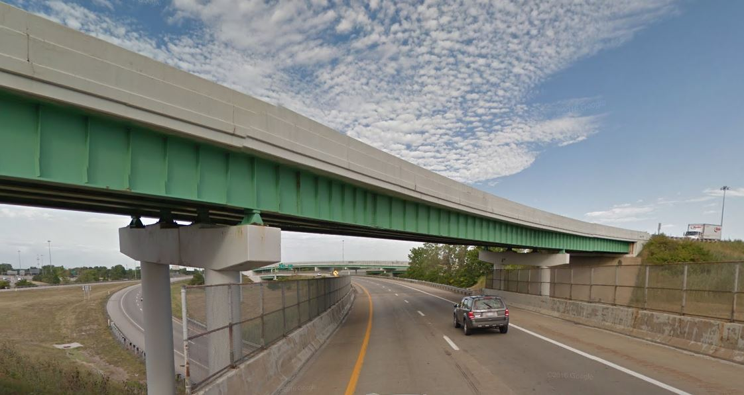
Case Study 4
Curved Girder Deck Replacement
Review plans to confirm spiral ductility provisions of AASHTO Std. Spec. 8.8.2 are met.
If deficient, fiber wrap fixed pier columns

Slide 43
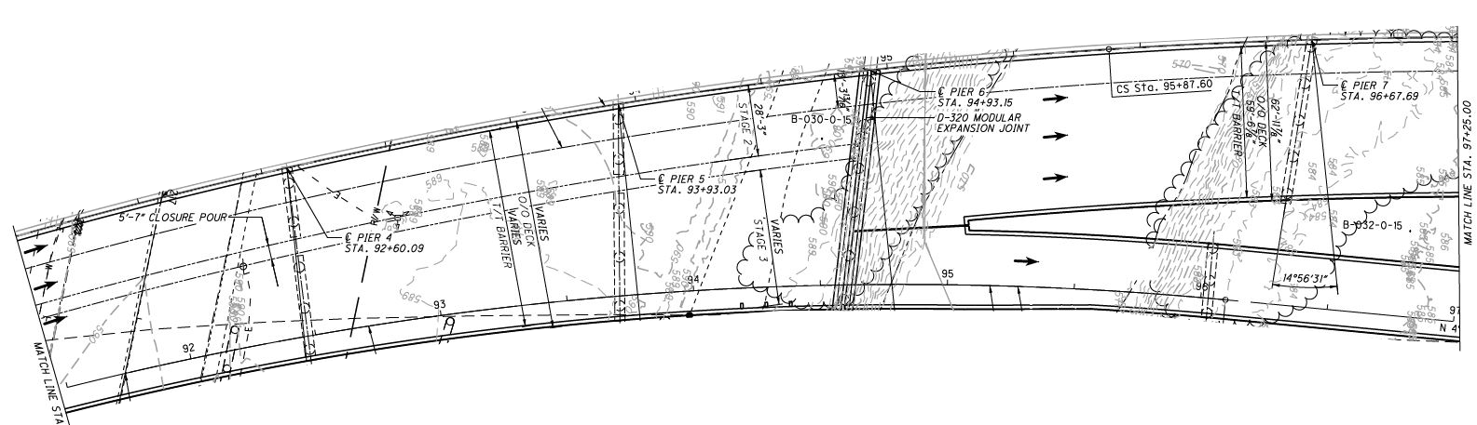
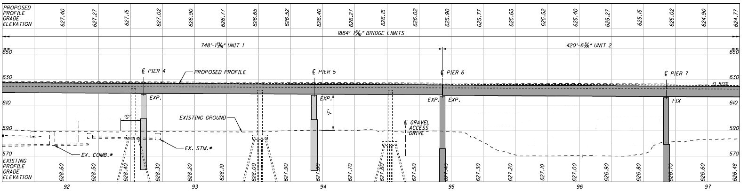
Case Study 5
Complex Geometry
Check Support Length, N2
Check Support Length, N1
Check Support Length, N3

Slide 44
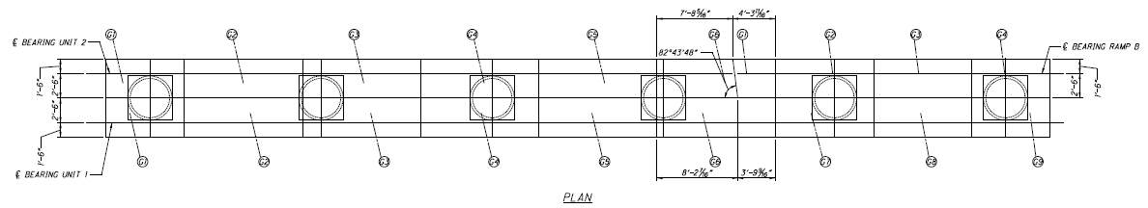
Case Study 5
Complex Geometry
N2
N3
N1
Verify pier cap width can satisfy N1, N2 & N3

Slide 45
Philosophy Revisited
Final Considerations
Incorporate seismic policy guidelines in retrofit, considering:
  Bridge’s remaining design life
  Scope of rehabilitation
  Is final condition better than pre-retrofit condition?

Slide 46
QUESTIONS?

