Slide 1
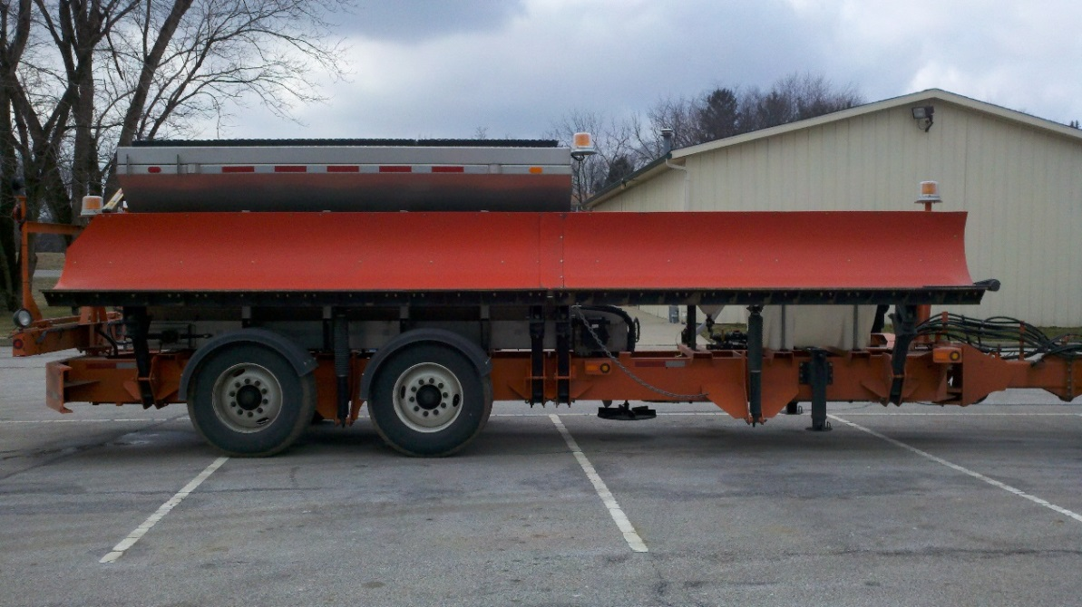
Evaluation of Viking-Cives® TowPlow for Winter Maintenance
William H. Schneider, IV
Christopher M. Miller
Mallory Crow
William A. Holik
State Job Number: 134704

Slide 2
Acknowledgements
The University of Akron would like to thank the Division of Planning, Statewide Planning & Research Team:
Ms. Jill Martindale,
Ms. Kelly Nye,
Ms. Cynthia Gerst,
Ms. Vicky Fout, and
Mr. Scott Phinney.
And the Technical Liaisons:
Mr. Paul Ensinger,
Mr. Brian Olson, and
Mr. Mark Griffiths.

Slide 3
Introduction
Snow and ice management is the single largest expenditure in the maintenance budget for the Ohio Department of Transportation (ODOT).
Goal to minimize costs while maximizing efficiency.
TowPlow is one piece of equipment being considered,
  Trailer with 27-foot blade and hopper / brine tank, and
  Rotates out to plow and treat a second traveling lane.
ODOT – Ashtabula County conducted pilot evaluation.
ODOT gain knowledge on new technologies.

Slide 4
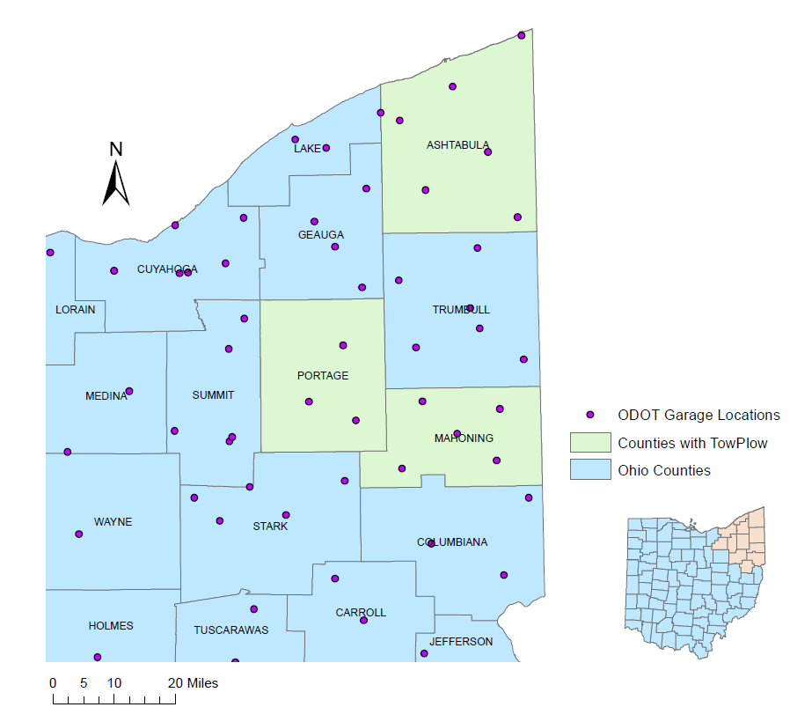
Project Setting

Slide 5
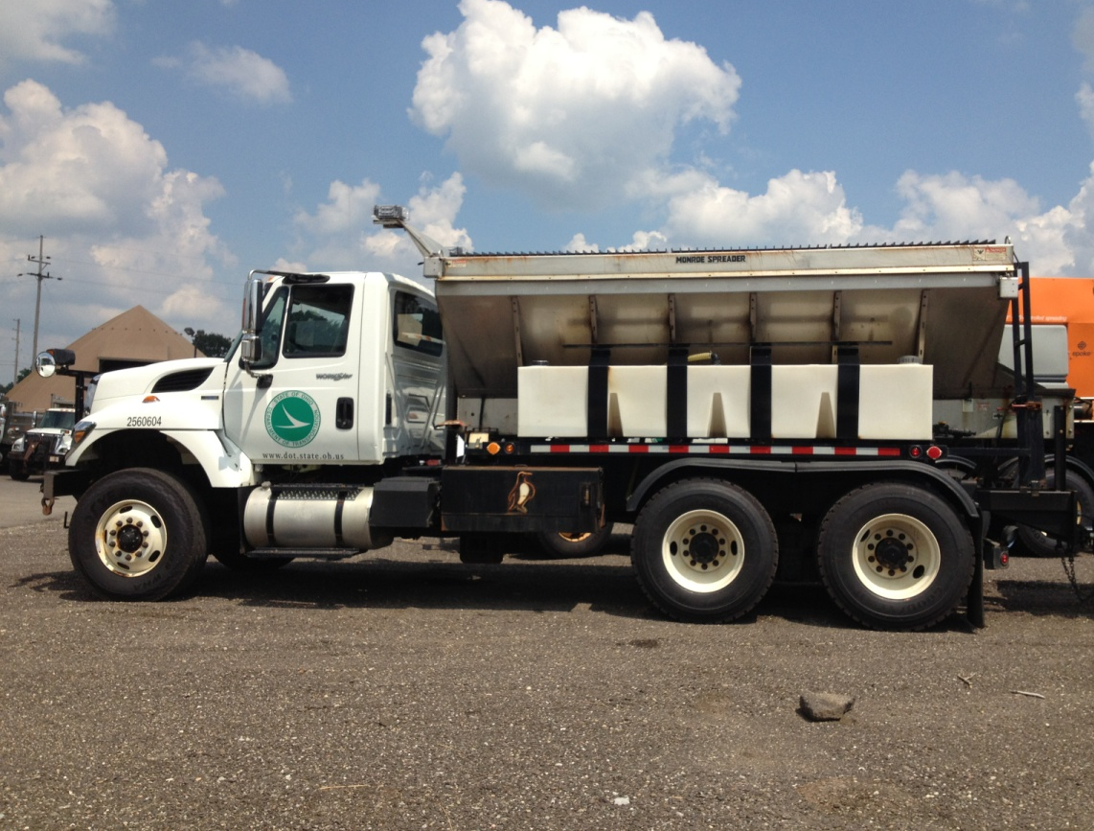
Standard Truck
Single axle or tandem axle,
11 or 12 foot front plow usually sometimes 14 foot, and
Some may have additional wing plow – adding extra 5.5 feet of plowing.

Slide 6
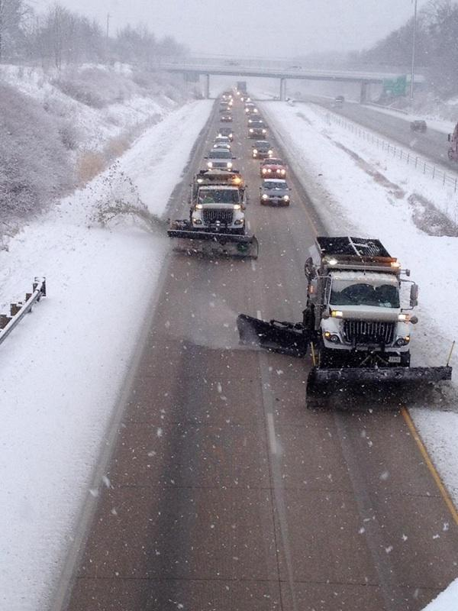
Standard Truck Comparison in Portage Co.
Truck opposite of TowPlow in Portage is tandem axle, 14 foot plow, with wing plow.
Treated opposite side of IR-76 while TowPlow treated other side.

Slide 7
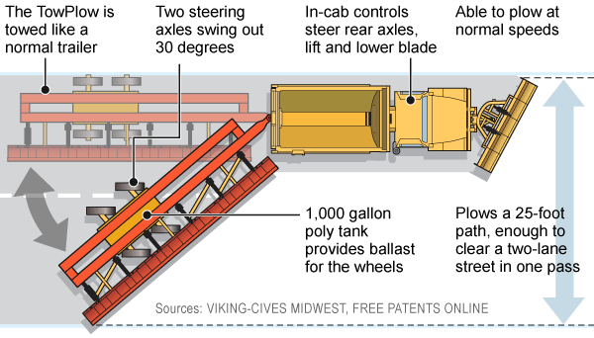
TowPlow System
Tandem axle truck with at least 350-horsepower engine.
TowPlow units equipped with hopper and brine tank.
Combined with front plow may clear 25 foot path.
Operate safely at 30 to 40 mph.
Image from Viking-Cives, www.vikingcives.com

Slide 8
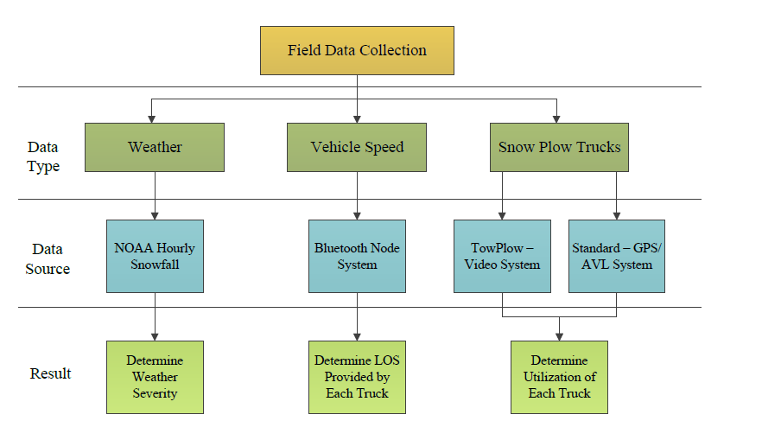
Data Collection

Slide 9
Weather – NOAA Data
National Oceanic and Atmospheric Administration
Hourly snowfall data from NOAA’s National Operational Hydrologic Remote Sensing Centers
  One near each garage with a TowPlow.
Review total accumulating snowfall and peak hourly snowfall during an event to categorize:
  No Snowfall
  Trace Snowfall
  Light Snowfall
  Moderate Snowfall
  Heavy Snowfall

Slide 10
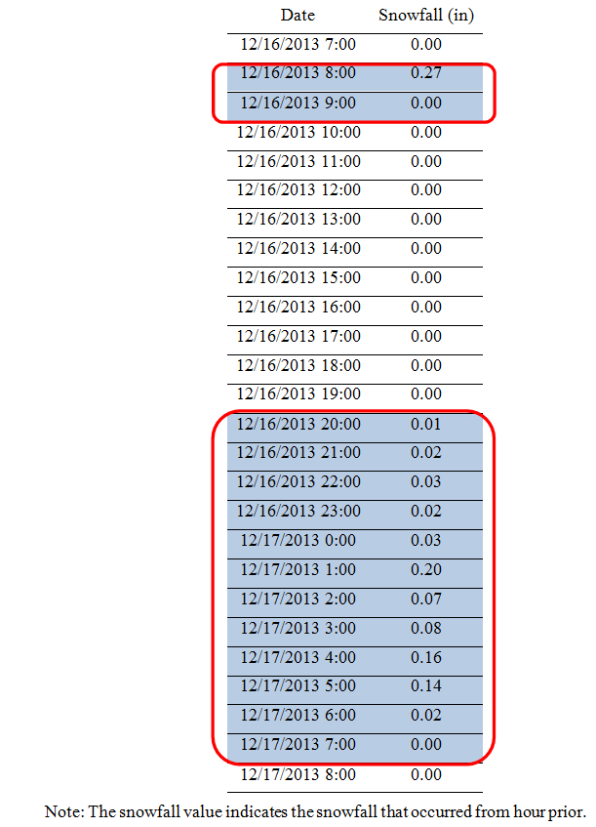
Weather Data
Number of Events: 60
All Three Counties Events:
Event Type | Number of Events
No Snow | 5
Trace | 8
Light | 27
Moderate | 15
Heavy | 5

Slide 11
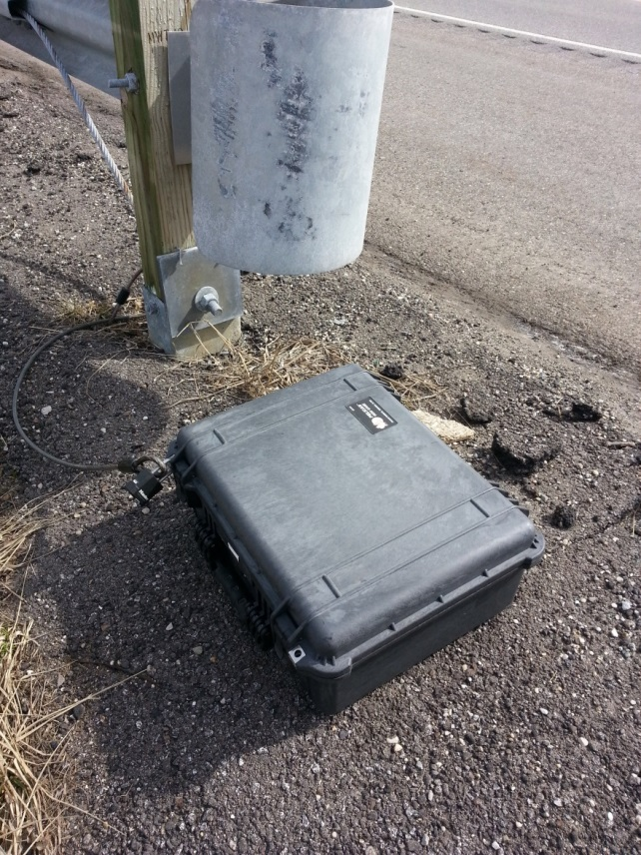
Vehicle Delay
Delay created by TowPlow in various configurations is compared to delay created by Standard truck.
Bluetooth Technology is used to capture vehicle speeds.
Bluetooth Nodes placed along IR-76 in Portage County
Bluetooth nodes consist of:
  Bluetooth radio
  Computer board with USB interfaces
  Bluetooth Antennae
  3G wireless card
  Power regulator
  Batteries
Maintained weekly

Slide 12
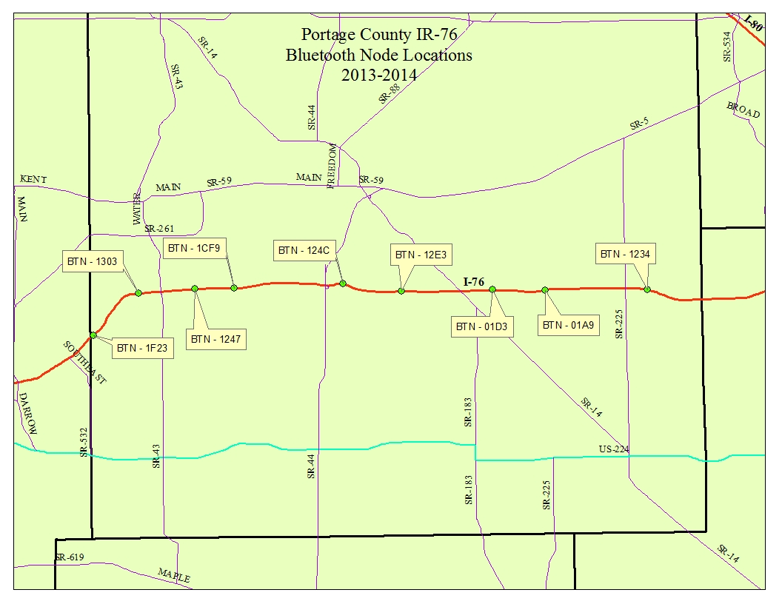
Western Route
Eastern Route

Slide 13
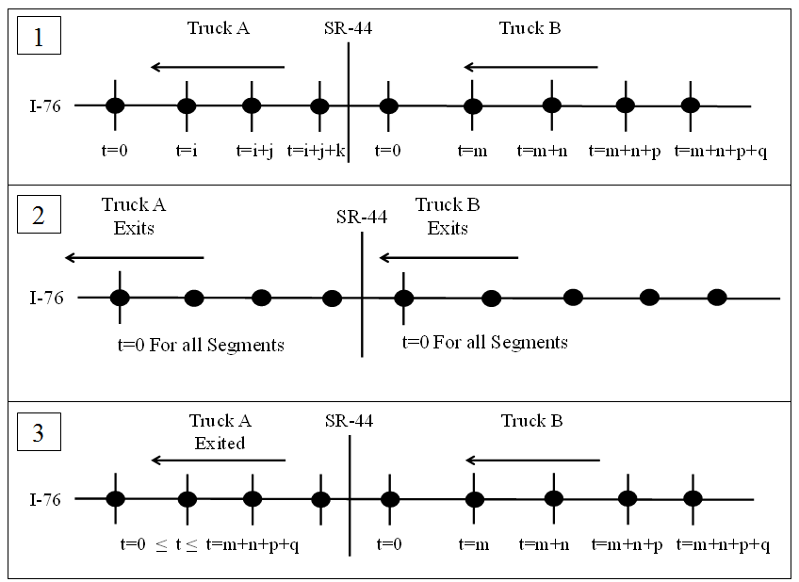
Delay Analysis
Comparing expected travel time to actual travel time.
Delay based on three different storm categories determined using previous 4-hour snowfall
  Light: snowfall < 0.5 in
  Moderate: 0.5 in ≤ snowfall < 1 in
  Heavy: Snowfall ≥ 1 in
Analyzed three scenarios
Expected travel time based on baseline data
  Western Side – 65 mph
  Eastern Side – 66 mph

Slide 14
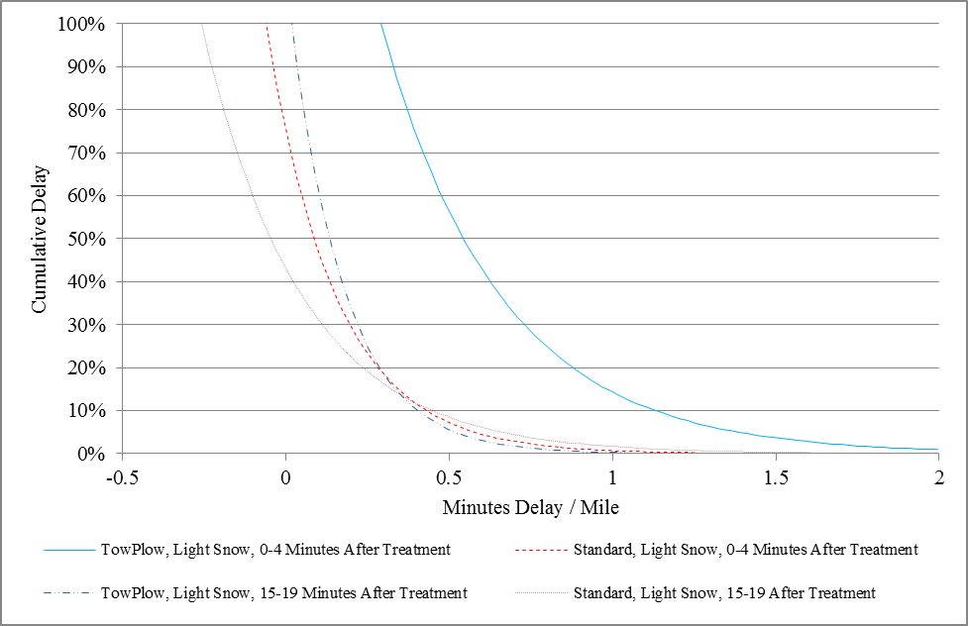

Delay – TowPlow Treating Two Lanes and Standard Treating One Lane in Light Snow

Slide 15
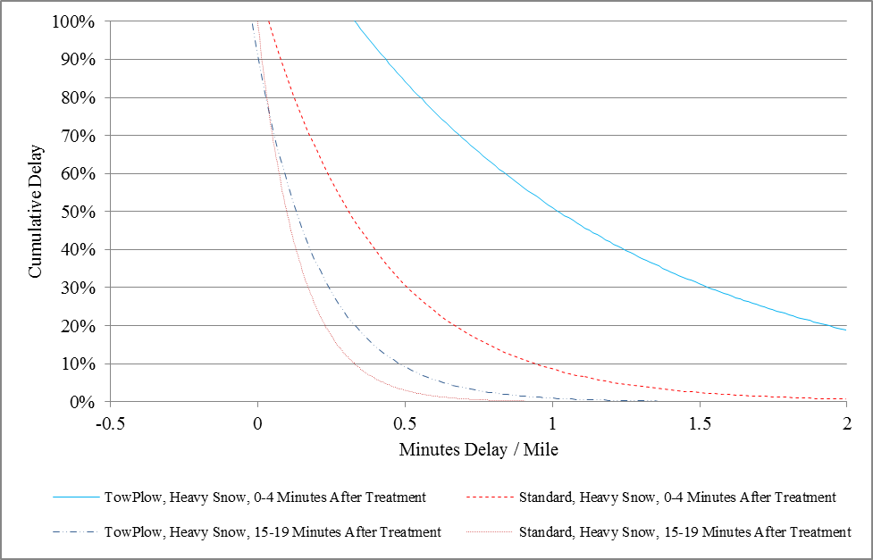

Delay – TowPlow Treating Two Lanes and Standard Treating One Lane in Heavy Snow

Slide 16
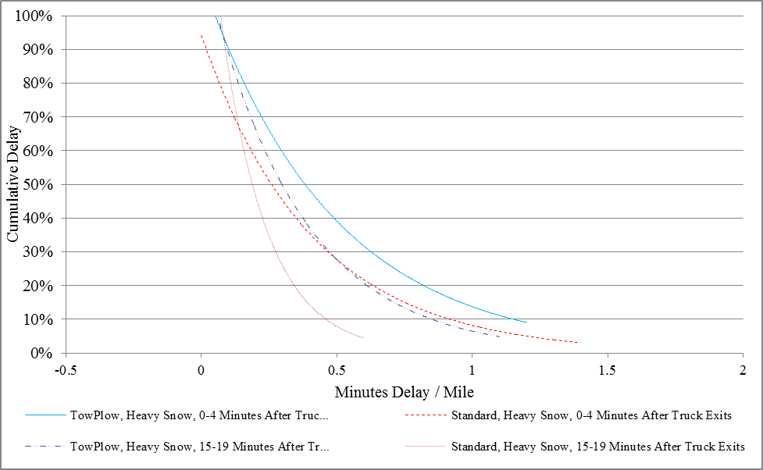

Delay – Trucks Exit Highway in Heavy Snow

Slide 17
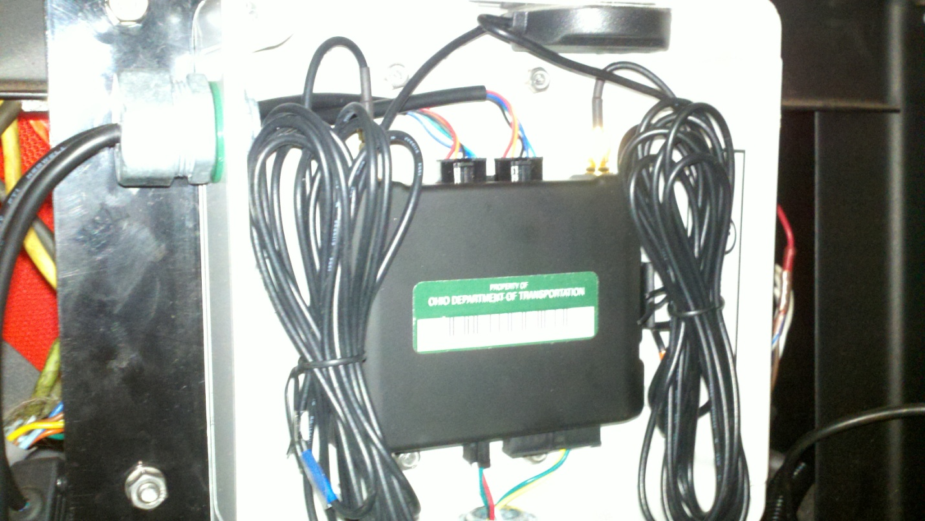
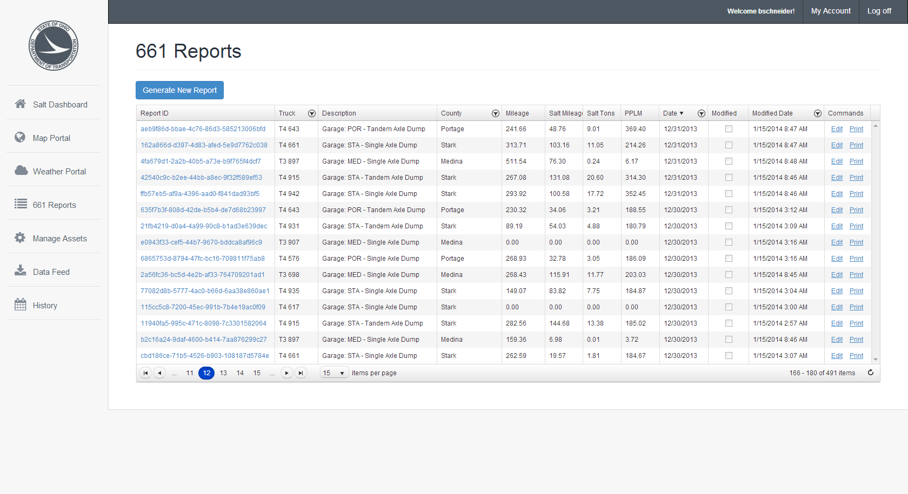
Standard Truck Data

Slide 18
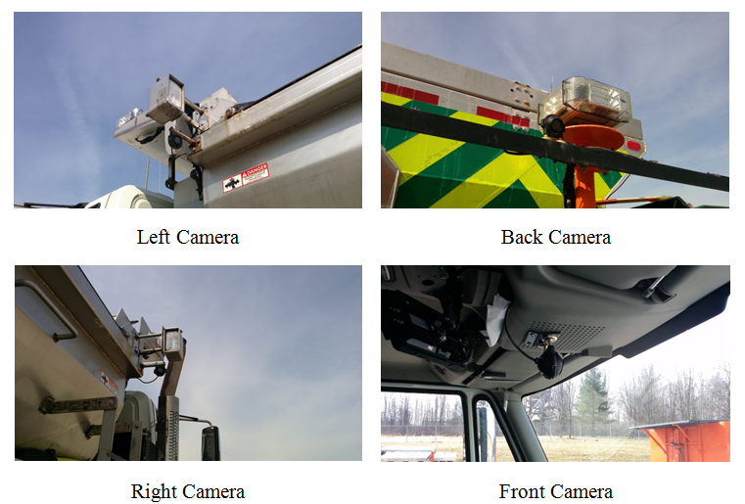
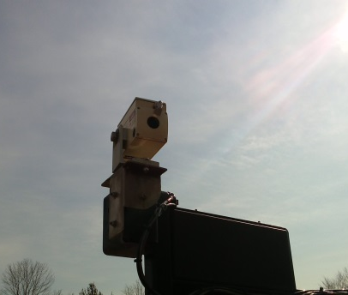
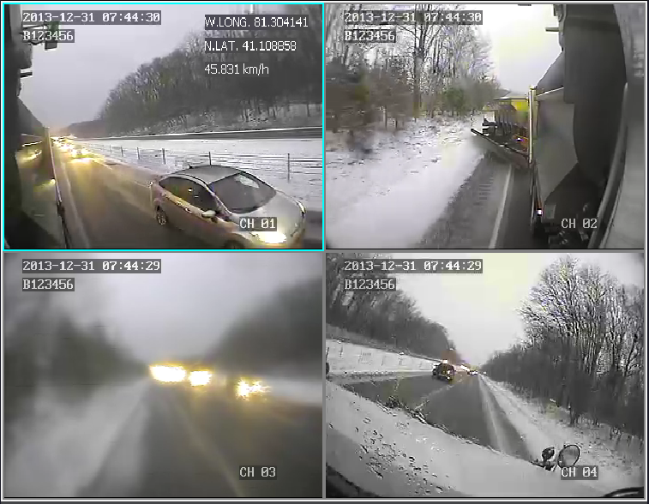
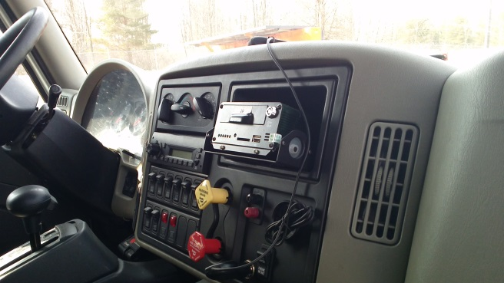
TowPlow Data
Driver Camera
Rear Camera
Passenger Side Camera
Front Camera
Guidance Laser
DVR

Slide 19
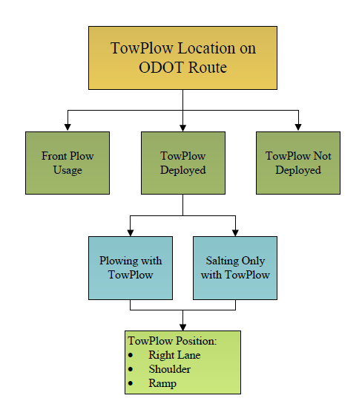
Video Documentation

Slide 20
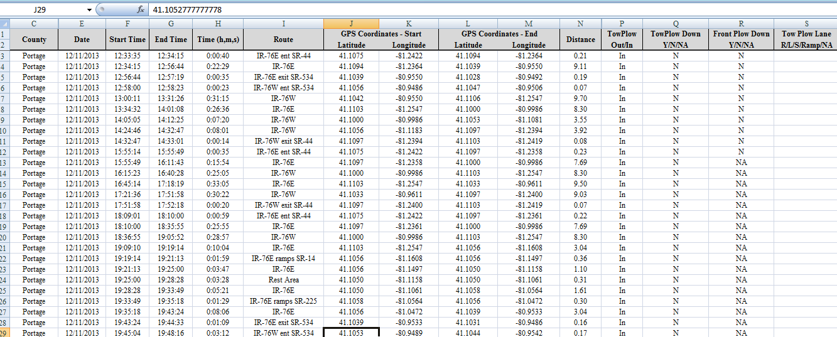
Video Documentation
2000 Hours of Video Used to Document:
  TowPlow Deployment
  TowPlow Treatment Change
  Front Plow Deployment
  New Route
  Lane Position Change

Slide 21
TowPlow Deployment Definitions

Slide 22
TowPlow Position Definitions

Slide 23
Overall TowPlow Deployment
Percentage Over Evaluation
Deployment Status
Number of Events: 60
Overall TowPlow Status:
Event Type | Average (%)
Deployed Mileage | 53
Deployed Time | 56
Not Deployed Mileage | 47
Not Deployed Time | 44

Slide 24
Overall Treatment Type
Percentage Over Evaluation
Treatment Type
Number of Events: 60
Overall TowPlow Treatment
Event Type | Average (%)
Plowing Mileage | 91
Plowing Time | 91
Salting Mileage | 9
Salting Time | 9

Slide 25
Overall TowPlow Position
Percentage Over Evaluation
Lane Position
Number of Events: 60
Overall Average TowPlow Lane Configuration:
Event Type | Shoulder (%) | Right Lane (%) | Ramp (%)
Plowing Mileage | 23 | 69 | 8
Plowing Time | 23 | 66 | 12
Salting Mileage | 52 | 36 | 12
Salting Time | 53 | 33 | 14

Slide 26
Cost
Annualized cost of TowPlow versus standard truck
Monte Carlo simulation
  Matlab
  Random number generator
Utilization rate for each truck by storm classification
TowPlow to standard truck equivalency
Comparison

Slide 27
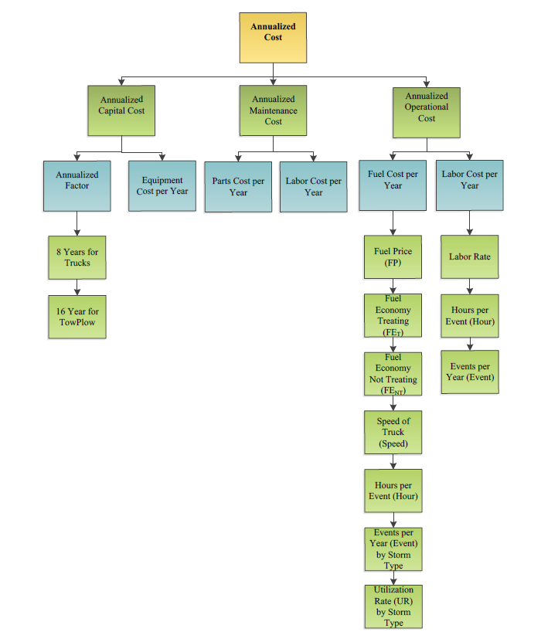
Variables

Slide 28
Cost Variables
Sources:
ODOT – Specific operational and financial data.
M&R 661 – Forms filled out by operators with treatment, time, and location data.
NOAA – Weather data from stations near garages with TowPlows.
GPS/AVL & Video – Data collected from trucks.

Slide 29
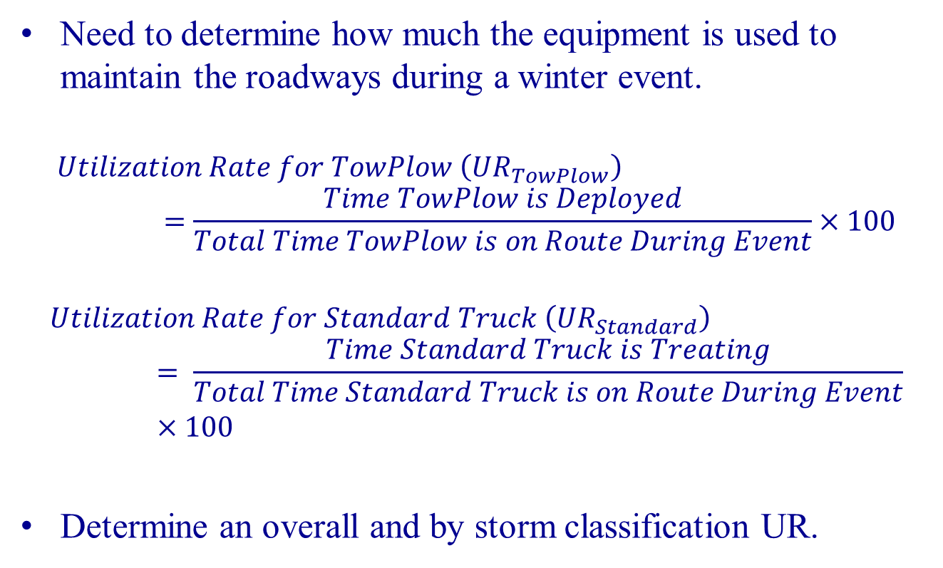
Utilization Rate (UR)
Need to determine how much the equipment is used to maintain the roadways during a winter event.
$$Utilization Rate for TowPlow \left({UR}_{TowPlow}\right)=\frac{Time TowPlow is Deployed}{Total Time TowPlow is on Route During Event}×100$$
$$Utilization Rate for Standard Truck \left({UR}_{Standard}\right)= \frac{Time Standard Truck is Treating}{Total Time Standard Truck is on Route During Event}×100$$
Determine an overall and by storm classification UR.

Slide 30
Utilization Rate - Results
 | TowPlow | Standard
Overall | 54% | 65%
Trace | 17% | 18%
Light | 45% | 67%
Moderate | 72% | 96%
Heavy | 91% | 100%
TowPlow UR determined from video data collected.
Standard UR determined from GPS/AVL data and verification from M&R 661.
UR calculated for hours during event – not clean up time after

Slide 31
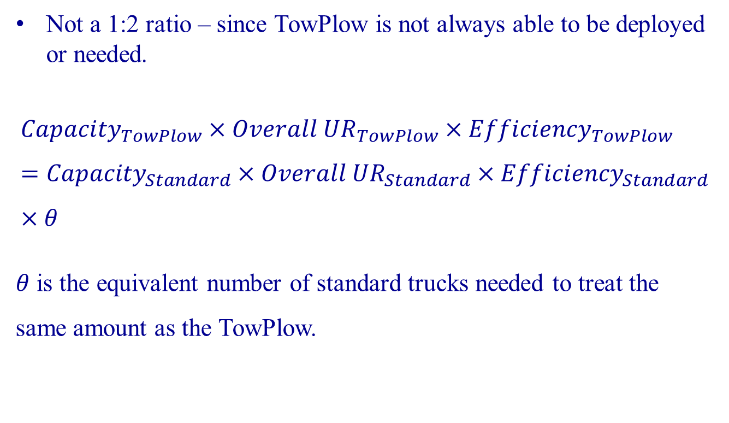
Truck Equivalency
Not a 1:2 ratio – since TowPlow is not always able to be deployed or needed.
$${Capacity}_{TowPlow}×{Overall UR}_{TowPlow}×{Efficiency}_{TowPlow}={Capacity}_{Standard}×{Overall UR}_{Standard}×{Efficiency}_{Standard}×θ$$
$θ$ is the equivalent number of standard trucks needed to treat the same amount as the TowPlow.

Slide 32
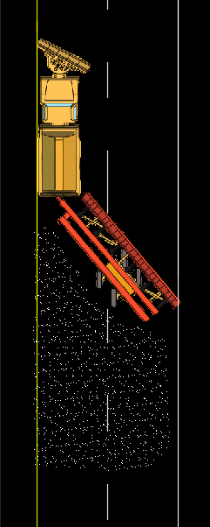
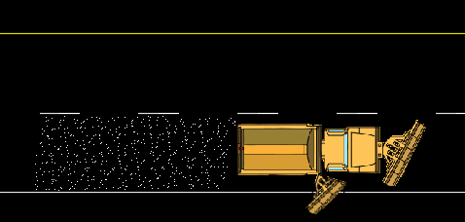

Truck Equivalency
$${Capacity}_{TowPlow}×{Overall UR}_{TowPlow}×{Efficiency}_{TowPlow}={Capacity}_{Standard}×{Overall UR}_{Standard}×{Efficiency}_{Standard}×θ$$
Assume efficiencies are equal between both trucks.
Capacity of each truck is lane(s) treated in one pass:
  TowPlow Capacity is 2 lanes
  Standard Capacity is 1 lanes

Slide 33
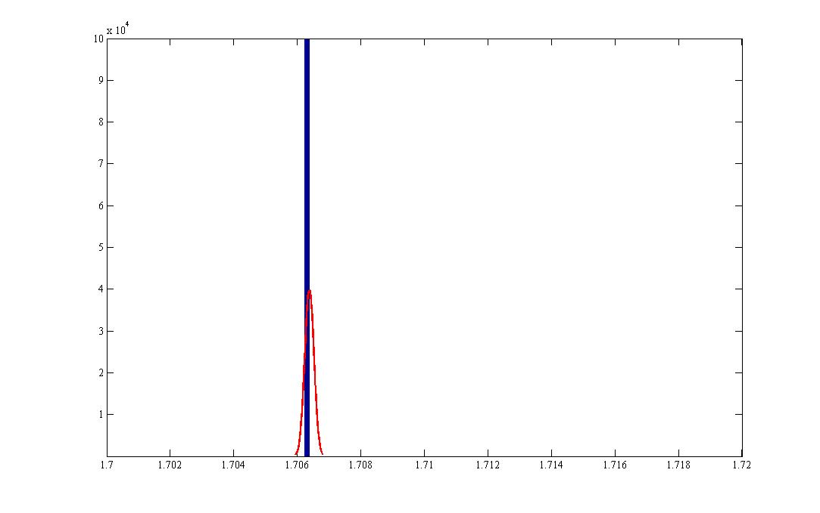
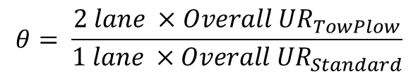
Truck Equivalency – Solving for Theta
$$θ= \frac{2 lane ×Overall {UR}_{TowPlow}}{1 lane ×Overall {UR}_{Standard}}$$
Frequency – Number of Time Theta is Calculated in Simulation
Value of Theta (unit less)
Monte Carlo simulation – 1,000,000 times randomly select from range of UR to determine a distribution.
θ is determined to have an average of 1.706

Slide 34
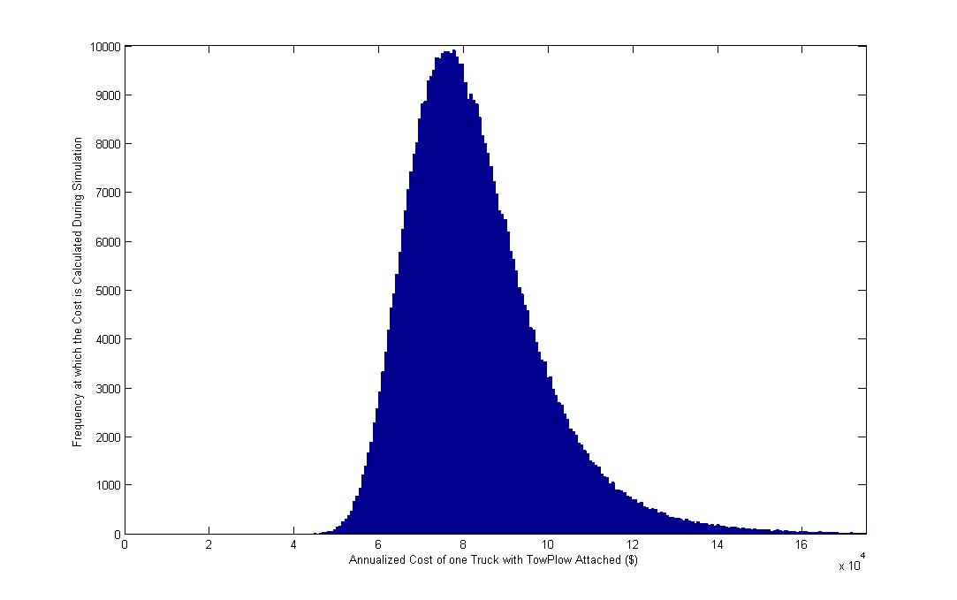

Annualized Cost
$$Yearly Cost = Annualized Capital Cost + Annualized Maintenance Cost + Annualized Operational Cost$$
Monte Carlo simulation – 500,000 times
Average cost - $83,629 per year

Slide 35
Cost Results
TowPlow has an annual savings averaging $22,551 per year.
1.4 standard trucks is break even point – no savings
More data presented in Chapter 6 of the Final Report

Slide 36
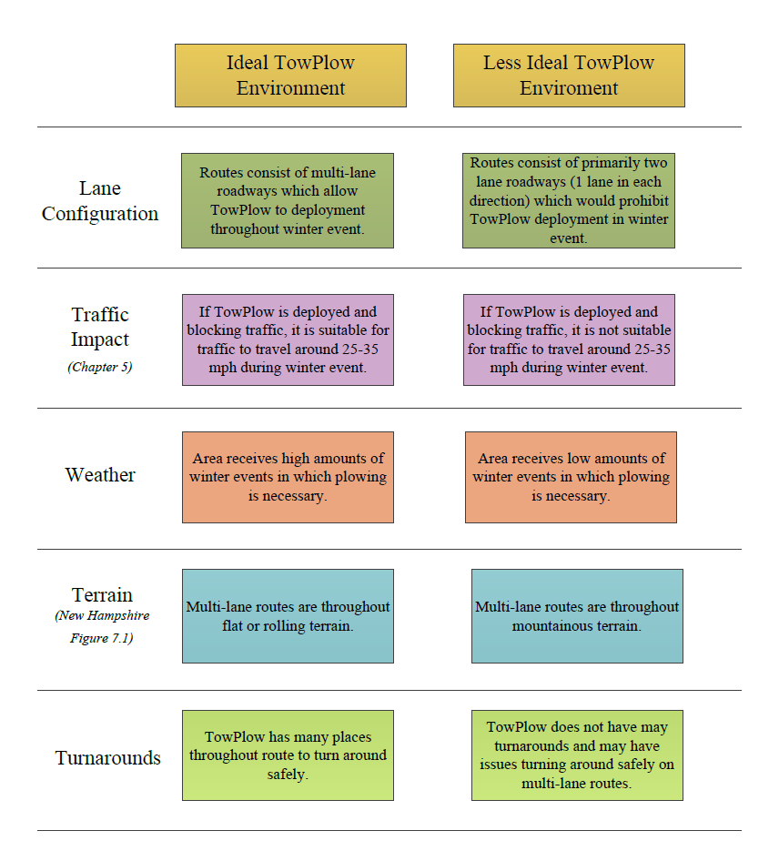
Implementation

Slide 37
Implementation – Potential Savings
 | 0 to 25 Events per Season | 26 to 50 Events per Season | 51 to 75 Events per Season | 76 to 100 Events per Season
Primarily Trace and Light Events (Some Moderate, No Heavy) | $4,100 to $12,000 | $13,100 to $17,400 | $17,900 to $20,800 | $20,800 to $24,100
Primarily Light and Moderate (Some Trace, Some Heavy) | $4,100 to $12,800 | $13,800 to $17,500 | $18,500 to $21,400 | $21,200 to $25,800
Primarily Moderate and Heavy (Some Light, Some Trace) | $4,100 to $12,900 | $14,300 to $17,500 | $20,000 to $29,000 | $22,500 to $29,200
Note: The primary assumption of this table is that routes currently require two or more Standard trucks to maintain the expected LOS on the routes. One TowPlow compared to Equivalent (1.71) Standard ODOT Trucks. Used same simulation as Chapter 6, only modifying number of events in each weather classification. Weather classification is listed in Section 3.1 of this report. Standard deviation of events is set as 1, unless 0 events, then set to 0. Rounded to nearest hundreds place. Simulation repeated 100,000 times, five random weather distributions for each category presented above.
TowPlow Quantity | Standard Truck Quantity | TowPlow Cost | Standard Cost | Cost Difference
1 | 1.71 | $38,700 | $42,800 | $4,100
2 | 3 | $77,200 | $75,000 | ($2,200)
7 | 12 | $269,600 | $300,200 | $30,600
Note: The primary assumption of this table is that routes currently require two or more Standard trucks to maintain the expected LOS on the routes. No maintenance cost is included, and all events are set to zero, therefore the capital cost is the only factor. The discount rate is varied as in Chapter 6. Life of the truck pulling the TowPlow and Standard is eight years, while the TowPlow itself is expected to be 16 years. RED indicates higher annual cost for the TowPlow than the Standard truck. GREEN indicates lower annual cost for TowPlow than Standard truck.

Slide 38
Thank You!

