Slide 1

Ohio’s Research Initiative for Locals
Greg Butcher
Violet Township Engineer
Vicky Fout
ODOT’s Office of Statewide
Planning & Research

Slide 2
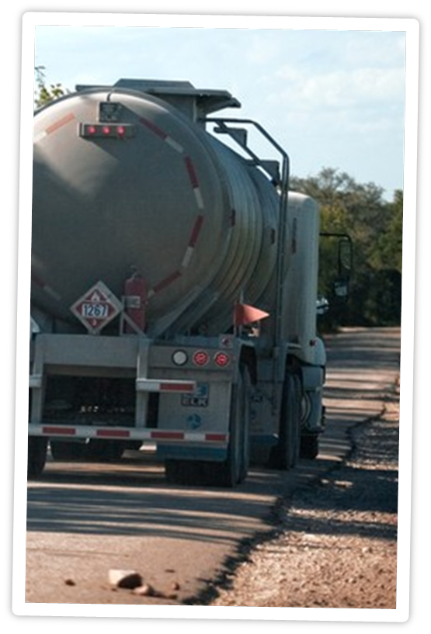
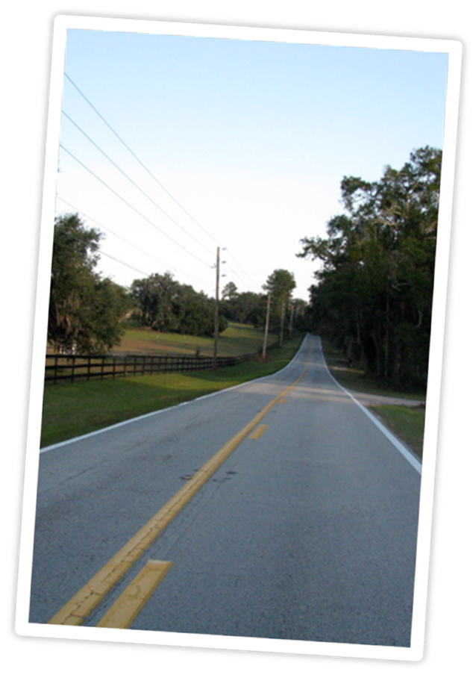

ORIL Projects
Assessment of IRP Truck Licensing
for Ohio Counties
  Study Completed: September 2015
11th International Conference on Low
Volume Roads and Peer Exchange
  Conference Held: July 2015
Notes:
IRP: investigated the phenomenon of trucking companies located and operating in OH but licensing their vehicles in other states – counties missing out on revenue from these out-of-state registrations, but wear and tear on county roads is occurring –study identified a projected impact of $13.7 million amongst OH counties if fleets changed their registration to Ohio
<click>
Low Volume Roads: Conference occurs every 4 years – two OH representatives attended the most recently conference in July – learned the latest information about low-volume road management, design, construction, safety, maintenance, and many other related topics

Slide 3
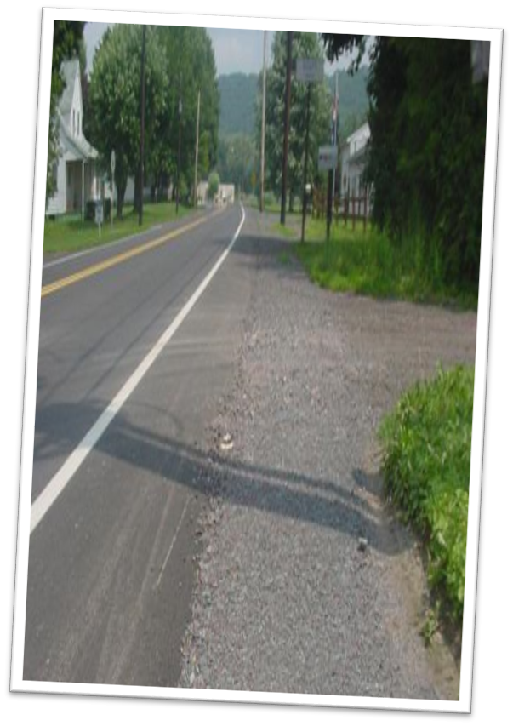
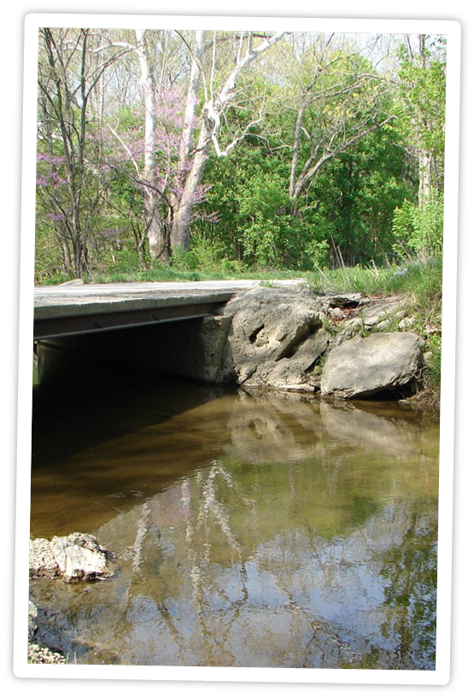
ORIL Projects
Investigation of In-Situ Strength of Various Construction/Widening Methods Utilized
on Local Roads
  End Date: February 2016
Practical Design Guidelines for
Replacement of Deficient Bridges
with Low-Water Stream
Crossing in the Rural Mid-West
  End Date: August 2016
Notes:
Construction/Widening: common to reuse materials from projects to widen existing roads or backfill other locations - easy to compare costs, but lack information to compare overall effectiveness in terms of projected strength or relative load capacity - could be using too much materials, not enough materials, or use a different material that would be more appropriate - establish a range of structural coefficients (or moduli) for various materials used to widen/construction local roads in OH - develop a repeatable, nondestructive methodology to characterize strength/load capacity when established values are not available
<click>
Low-Water: county and rural are bridges are deficient and in need of replacement- very expensive and only handful of people use the it – not a lot of scientific-based guidance on options – this pooled fund study with Kansas is attempting to develop that guidance

Slide 4
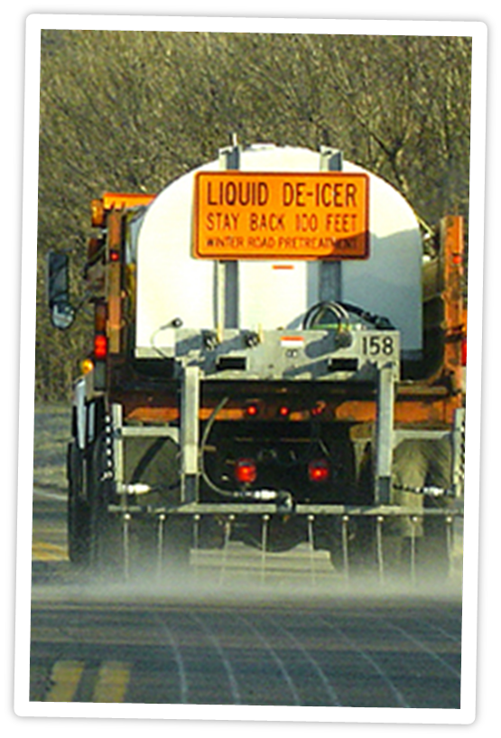
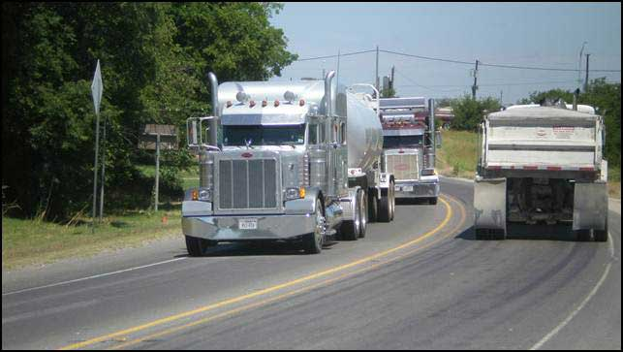
ORIL Projects
Evaluation of Liquid Deicers for Winter
Maintenance
  End Date: October 2016
Best Practices of Road User Maintenance
Agreement Amongst Local
Government Agencies in Ohio
  End Date: January 2017
Notes:
Deicers: evaluating variety of liquid deicers – field testing includes township road with township equipment and forces
<click>
RUMA: best practices – how are these being done – what’s working and what’s not working – also providing recommendations for RUMAS to assist locals – alleviate confusion and save time – not recreate the wheel every time

Slide 5
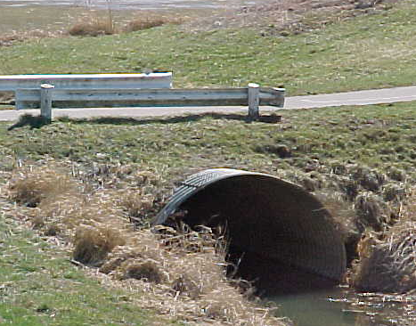
ORIL Projects
Structural Benefits of Concrete
Paving of Steel Culvert Inverts
  End Date: March 2017
Development of Recommendations
to Address IRP Truck Licensing
Impacts for Ohio Counties
  End Date: TBD
Notes:
Steel Culvert: verify and validate the viability of the practice of poring concrete on to invert of steel culverts that has experienced material loss – provide scientific-based guidance on its proper application
<click>
IRP: expanded upon a previously conducted study - provide recommendations for short- and long-term solutions to address the registering and/or fee allocation process for IRP registration within OH

Slide 6
ORIL Program
How do the projects work?
ORIL
Proposal
ORIL RFP Posted!
Notes:
This is how the projects come to be
<click 2xs – each bullet is a separate click>
Idea submitted by locals
ORIL board selects ideas for project development
Request for Proposals are developed and solicitation issued to research community
Transportation researchers develop and submit proposals
Proposals are reviewed by TACs and the Board selects researchers to conduct the projects
Contract is negotiated then work begins

Slide 7
ORIL Program
ORIL Board
Oversees Program
ODOT Research Section
Manages Administrative Tasks
TACs
Oversees Technical Direction
Researchers
Executes Scope of Work
Notes:
Program is a collaborative effort

Slide 8
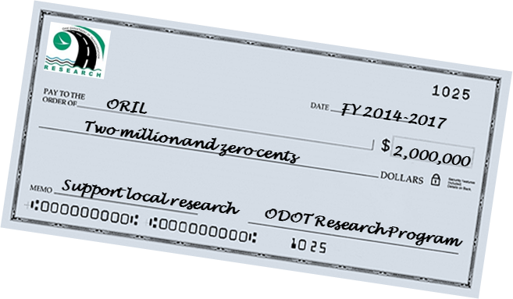
ORIL Program
How does the money work?
Not a grant
No funds are transferred to locals
No standard maintenance or capital improvements
Contracted projects
Funds & contracts managed by ODOT
Research expenses
Notes:
How does the money work and where does it come from?
<click>
ODOT check
<click>
Click for each line of CAN and CANNOT

Slide 9

ORIL Program
How can I get involved?
Submit an Idea
  http://oril.transportation.ohio.gov
Deadline: November 6, 2015 @ 3PM
Projects begin July 2016
Notes:
<5 clicks for page>

Slide 10

ORIL Research Idea Form
What is your problem/idea?
  Magnitude = How could it be addressed?
What is the benefit?
  Potential gain
  Potential impact
Notes:
Click #2 – what is the benefit

Slide 11
ORIL Research Idea Form
TAC recommendations
  Demonstrates support and need
Estimated duration and funding
  Not set in stone
  Shows how extensive/involved
Notes:
Click #2 – duration and funding

Slide 12
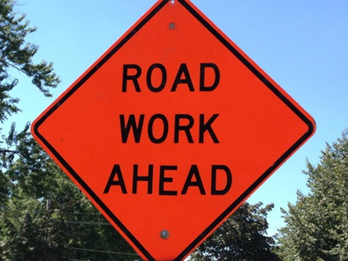
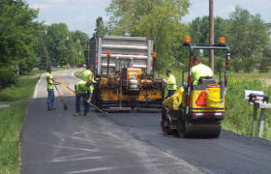
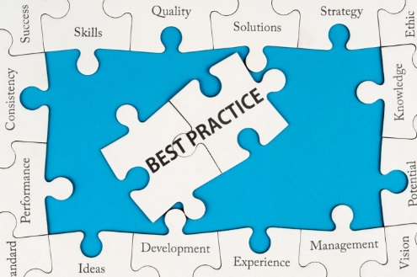
ORIL Research Focus Areas
Safety
Renewal/Infrastructure
Operations & Business Practices
Notes:
Click per focus area

Slide 13

ORIL Program
Visit the Website
  http://oril.transportation.ohio.gov
Email Us:
  ORIL@dot.ohio.gov
Open Discussion for Ideas & Questions
Thank You!
Notes:
Click for discussion
Click for thank you

